Slide 1
BSK1133 PHYSICAL CHEMISTRY CHAPTER 7 SURFACE CHEMISTRY
For updated version, please click on
http://ocw.ump.edu.my
PREPARED BY:
DR. YUEN MEI LIAN AND DR. SITI NOOR HIDAYAH MUSTAPHA Faculty of Industrial Sciences & Technology yuenm@ump.edu.my and snhidayah@ump.edu.my

Slide 2
Description
Aims
To study the colloidal systems.
To study the mechanisms for adhesion between surfaces and materials.
To describe the adsorption isotherms.
To learn the different types of catalysts.

Slide 3
Description
Expected Outcomes
Able to describe the principles of surface– and colloid
chemistry.
Able to understand all the forces involve between adsorbent
and adsorbate.
Able to describe the adsorption isotherms, measure isotherms and make calculations in connection with these.
Able to identify different types of catalysts.
References
Atkins, P & Julio, D. P. (2006).Physical Chemistry (8th ed.). New York: Oxford.
Chang, R. (2005).Chemistry (8th ed.). New York: McGraw Hill.
Atkins, P & Julio, D. P. (2012). Elements of Physical Chemistry
(sixth ed.). Freeman, Oxford.
Silbey, R. J., Alberty, A. A., & Bawendi, M. G. (2005). Physical Chemistry. New York: John Wiley & Sons.
Mortimer R. G. (2008) Physical Chemistry, Third Edition , Elsevier Academic press, USA.

Slide 4
Contents
7.1 Colloid and Crystalloid
7.2 Origin of Charge, Gels and Emulsions
7.3 Surface Growth, Composition and Structure
7.4 Adsorption
7.5 Catalysis
Conclusion

Slide 5
7.1 Colloid and Crystalloid

Slide 6
I. Colloid
A dispersion of the dispersed phase throughout dispersing medium.
Colloidal particles are 1 x 10³ pm to 1 x 10⁶ pm.
Tyndall effect is applied to distinguish a solution from a colloid.
Colloidal aerosols, colloidal emulsions, colloidal foams, colloidal dispersions or hydrosols are homogenous mixtures which a dispersed phase has a certain size range.
Colloidal suspension is referred to a solid as a dispersed phase and liquid as a dispersion medium.

Slide 7
Meanwhile, colloidal emulsion is a mixture of both dispersion medium and dispersed phase are liquid states.
The dispersed-phase particles or droplets are affected largely by the surface chemistry present in the colloid.
Some colloids are opaque, some are translucent and some have color.
Dispersed Phase | Dispersing Medium | Name | Example
Solid | Gas | Aerosol | Smoke
Gas | Liquid | Foam | cream
Solid | Liquid | Sol | Milk (magnesia)
Liquid | Liquid | Emulsion | Mayonnaise
Liquid | Solid | Gel | butter
Gas | Solid | Foam | Foams (plastic)
Solid | Solid | Solid sol | steel
Liquid | Gas | Aerosol | mist

Slide 8
Types of Colloid:
i. Hydrophilic Colloid
large molecules (proteins)
In aqueous phase, hydrophilic parts of the molecule can interact with H₂O molecules, lead to formation of hydrogen-bond (are on the outside surface)
ii. Hydrophobic colloid
not be stable in H₂O
Can be stabilized where attachment of ions on the surface due to the interaction with water
iii. Association colloids
Low concentration: normal strong electrolytes
High concentration: colloid cause aggregated particles or micelles are formed.
Details:
Surfactants or surface active agents (soaps and synthetic detergents) form micelles when present in solution at a concentration greater than critical micellar concentration (CMC).

Slide 9
Purification Methods of Colloidal Solution:
Dialysis
The removal of ions or molecules through diffusion across the membrane.
Electro dialysis
Similar as dialysis method. But, it is accelerated by application of electrical potential.
Ultra-filtration
Normally, sol particles can pass through a filter paper if the pore size of filter paper is bigger than sol particles. However, if the pore size of filter paper is smaller, then the filter paper is assume soaking in a gelatin of colloid ion solution and lastly soaking in formaldehyde. This treated filter paper may retain colloidal particles. This process is called ultra – filtration.

Slide 10
II. Crystalloid Fluids
Consists of a balanced of electrolyte composition
expands total extracellular volume
exerts a significant hydrostatic effect on capillaries that may lead to extracellular fluid accumulation, increased gastrointestinal wall edema (slow post-operative gastrointestinal recovery) and pulmonary edema.

Slide 11
7.2 Origin of Charge, Gels and Emulsions

Slide 12
I. Origin of the Charge on Colloidal Particles
Ways of sol particles gain electrical charge:
The dissociation or ionisation of the surface molecules in colloidal particles will be balanced by the oppositely charged ions in the sol.
Frictional electrification where rubbing of the dispersed phase particles with dispersion medium.
Dispersed phase will selectively adsorb ions that compatible with their lattice ions.

Slide 13
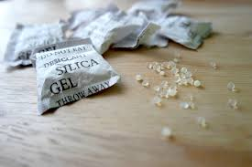
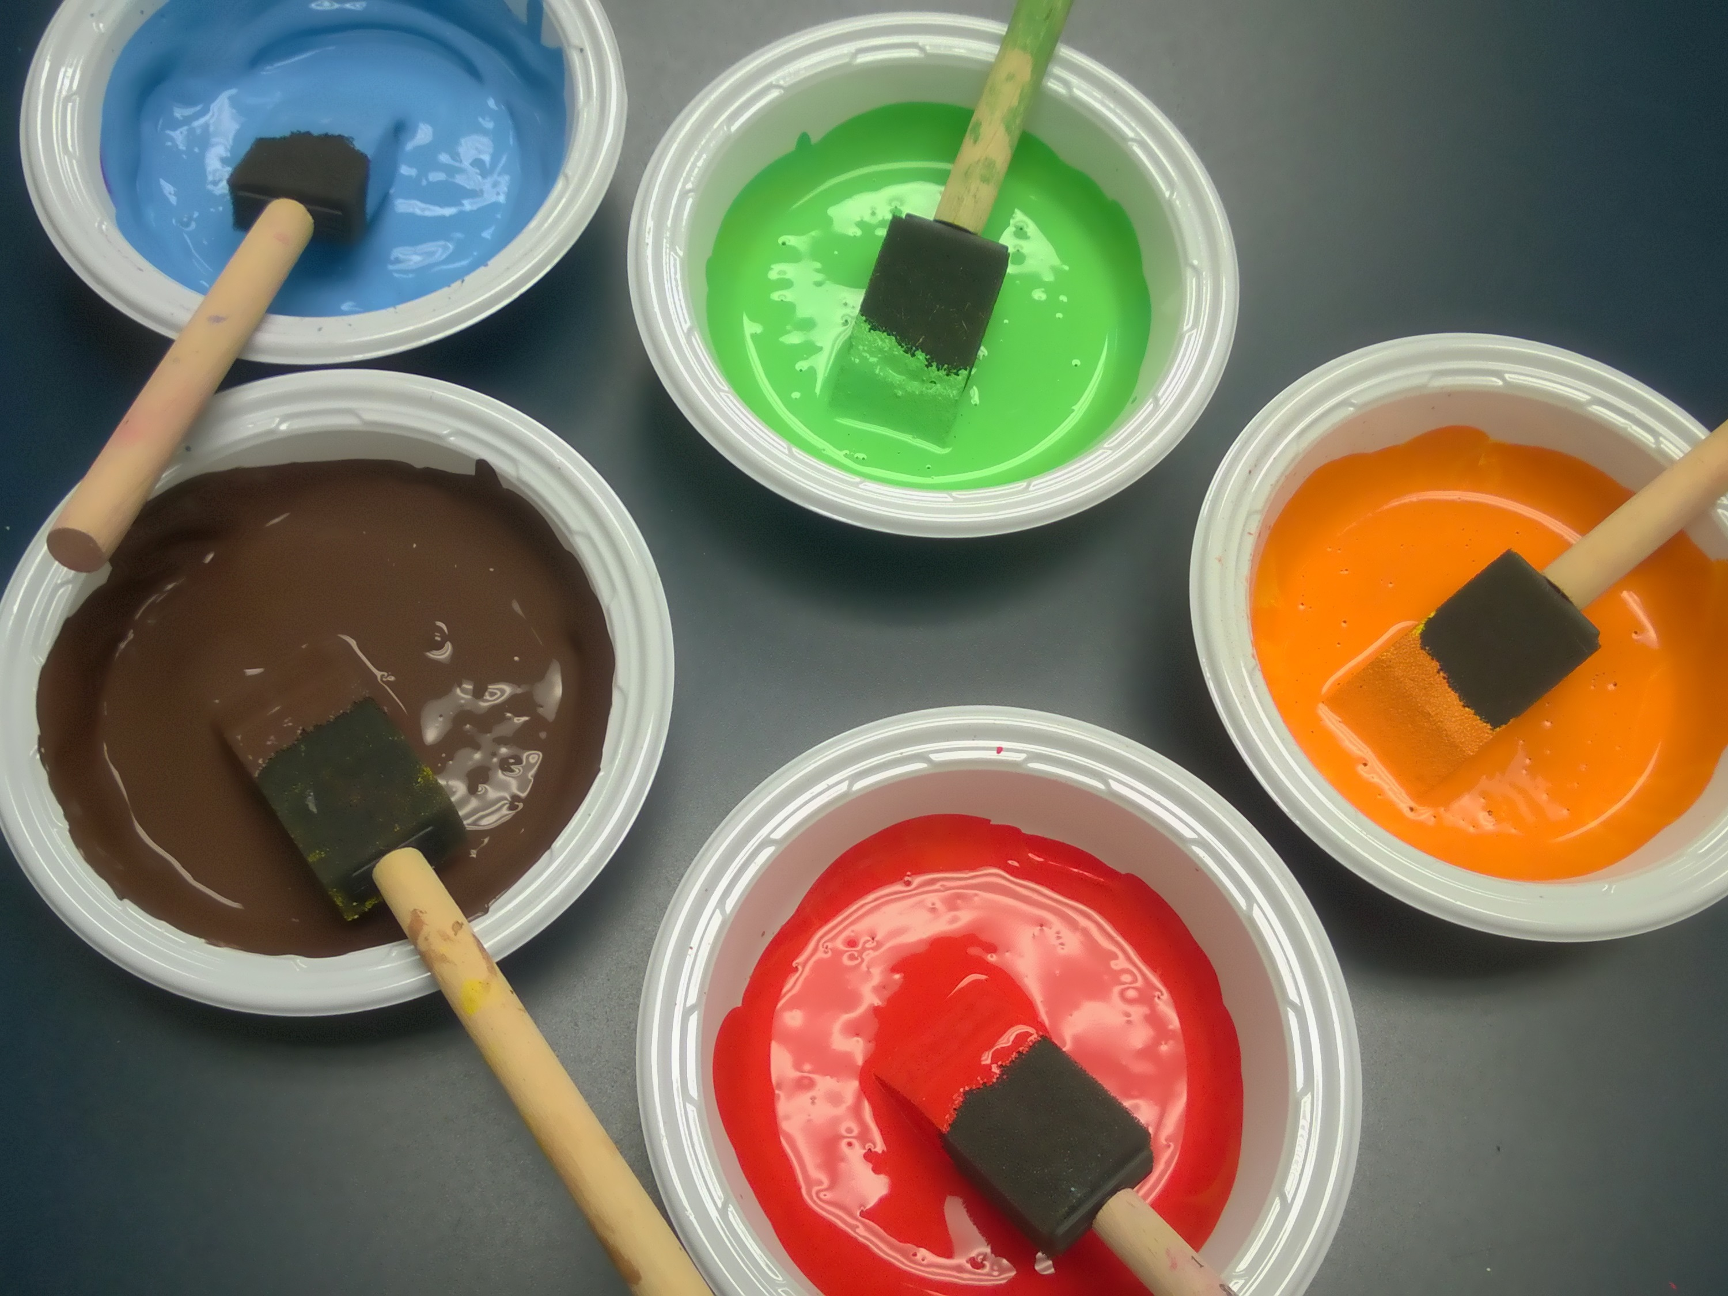
II. Gels
dispersed phase is liquid and dispersing medium is solid
Gelation is the process where coagulation of lyophilic sols and produce a semisolid jelly with encloses liquid.
Examples:
Elastic Gels (gelatin): show property of elasticity.
Non-elastic gels (silica gel): rigid and fix shape.
III. Emulsions
fine droplets of one liquid that dispersed in another liquid with mutually immiscible
Example: milk where fat globules are dispersed in water.

Slide 14
7.3 Surface Growth, Composition and Structure

Slide 15
I. Surface Growth
Terraces is a surface defect where a step between two otherwise flat layers of atoms.
When an atom settles on a terrace, it bounces across it and might come to a step. Instead of it, the molecule may interact with several step and the interaction become strong to trap it.
For the case that when ions deposit from solution, a strong Coulombic interaction between the arriving ions and several ions at the surface defect can offset the loss of the solvation interaction is offset by.
However, not all defect causes in sustained surface growth.

Slide 16
II. Surface Composition and Structure
When an exposed surface is constantly bombarded with molecules gas under normal conditions, a freshly prepared surface is covered very quickly.
The kinetic model of gases can be estimated and the expression for the collision flux:
OR
where
and M: molar mass of the gas
For air (M ≈ 29 g mol⁻¹) at 1 atm and 25°C, the collision flux is 3 × 10²⁷ m⁻²s⁻¹.
Explanation: For 1 m² of metal surface, has 10¹⁹ atoms. One atom can struck about 10⁸ times/second. When a few collisions leave a molecule adsorbed to the surface, the time is very short for which a freshly prepared surface remains clean.

Slide 17
7.4 Adsorption

Slide 18
Adsorption
adsorb
Adsorbent + Adsorbate Adsorption Process
desorb
Occur: different forces between adsorbent and adsorbate lead to attract and retain the molecules of a gas or a dissolved substance on to their surfaces with which they come in contact.
a. Basic Terms
Interface: Any surface is a plane which separates any two phases in contact with each other.
Occlusion: When adsorption of gases occur on the surface of metals.

Slide 19
b. Surface Forces
These atoms posses unbalanced forces (Van der Waal’s forces or chemical bond forces), which cause adsorption process occurs.
Example: when a solid substance is broken into two pieces, two new surfaces are formed. Hence, the number of unbalanced forces becomes more. As a result, the tendency for adsorption become large.
Reversible adsorption
Adsorbate can be removed from adsorbent by physical methods.
ii. Irreversible adsorption
Adsorbate can not be removed from adsorbent.
Example: Adsorption of O₂ on tungsten adsorbent.

Slide 20
c. Adsorption Isotherms
At certain temperature, the relationship of pressure of the adsorbate (gas phase) and the extent of adsorption can be expressed as the following.
Extent of adsorption = $\frac{x}{m}$
where
x gram of the adsorbate is adsorbed on m gram of the adsorbent.

Slide 21
1. Freundlich Adsorption Isotherm (Gas phase)
Freundlich adsorption isotherm: a monomolecular layer of adsorbate is forms on the surface of the adsorbent.
$\frac{x}{m}$ = ${kp}^{\frac{1}{n}}$ or log $\frac{x}{m}$ = log k + $\frac{1}{n}$ log p (n > 1)
k and n are constant at a certain temperature, adsorbent and adsorbate (gas).
n > 1, indicating the amount of the adsorbate does not increase as great as the pressure.

Slide 22
A decrease in adsorption when the temperature is increase.
These curves approach to saturate at high pressure.
Freundlich isotherm is not obeyed at high pressure.

Slide 23
2. Freundlich Adsorption Isotherm (not applicable for high pressure)
At low pressure which $\frac{1}{n}$ = 1, hence $\frac{x}{m}$ = kp. Therefore, $\frac{x}{m}$ α $p$.
It is varies linearly with pressure.
At high pressure which $\frac{1}{n}$ = 0, hence $\frac{x}{m}$ = constant. Therefore, the extent of adsorption is independent to pressure.
$\frac{x}{m}$ depends on pressure, which is raised to powers $\frac{x}{m}$ α $p^{\frac{1}{n}}$
at moderate pressure,

Slide 24
3. Langmuir Adsorption Isotherm
Irving Langmuir (1916) related the adsorption isotherm to kinetic theory of gases.
Only an unimolecular layer of the adsorbate.
Adsorption consists of:
The rate of condensation (refer to uncovered surface ): At the beginning, the rate is very high.
After certain time, the rate is decreased cause many covered surfaces are present.
The rate of evaporation (refer to covered surface): increase rapidly as more covered surfaces are present.
Finally, an equilibrium is achieved.

Slide 25
Formula
The Langmuir isotherm
relation between the fractional coverage and partial pressure of the adsorbate:
θ = $\frac{KP}{1+KP}$
θ = the number of covered surface by adsorbate
P = pressure
K = equilibrium constant
What will happen to the equilibrium constant at low and high pressure?
At lower pressure, θ = KP.
At high pressure, θ = $\frac{KP}{KP}$ = 1

Slide 26
l. Application of Adsorption
High vacuum region can be produced
Gas masks
Desiccation or dehumidification
Removal of pollutants from solution
Catalysis
Separation (inert gases)
Chromatographic analysis

Slide 27
7.5 Catalysis

Slide 28
Catalysis
Catalyst - a substance which can alter the rate of a chemical reaction only.
Types:
Homogeneous catalysis: reactants and the catalyst are in the same physical state.
Hydrolysis of ester:
CH₃COOCH₂CH₃(l) + H₂O(l) $⇌$ CH₃COOH(l) + CH₃CH₂OH(l)
ii. Heterogeneous catalysis: reactants and catalyst are in different physical state.
Haber’s Process:
N₂ (g) + 3H₃ (g) $⇌$ 2NH₃ (g)
HCl (l)
Fe(s)

Slide 29
Positive catalysis: enhance the reaction rate
2KClO₃ (s) 2KCl (s) + 3O₂ (g)
Negative catalysis: decrease the reaction rate
Na₂SO₃ (s) + O₂ (g) Na₂SO₄ (s)
Auto-catalysis: form as one of the products in the reaction and will aid in the reaction rate.
2KMnO₄ + 5H₂C₂O₄ + 3H₂SO₄ K₂SO₄ + 2MnSO₄(autocatalyst) + 10CO₂ + 8H₂O
Induced catalysis: as one of the reactants, but unlikely happen under certain condition.
Na₃AsO₃ + Na₂SO₃(induced catalyst) Na₃AsO₄(sodium arsenate) + Na₂SO₄
MnO₂(s)
C₂H₅OH(l)

Slide 30
Conclusion
Tyndall effect is applied to distinguish a
solution from a colloid.
Different forces between adsorbate and adsorbent result in an adsorption process.
Catalyst is used to alter the reaction rate of a process.

Slide 31
AUTHOR INFORMATION
DR. YUEN MEI LIAN (SENIOR LECTURER)
INDUSTRIAL CHEMISTRY PROGRAMME FACULTY OF INDUSTRIAL SCIENCES & TECHNOLOGY UNIVERSITI MALAYSIA PAHANG yuenm@ump.edu.my
Tel. No. (Office): +609 549 2764
DR. SITI NOOR HIDAYAH MUSTAPHA (SENIOR LECTURER)
INDUSTRIAL CHEMISTRY PROGRAMME FACULTY OF INDUSTRIAL SCIENCES & TECHNOLOGY UNIVERSITI MALAYSIA PAHANG snhidayah@ump.edu.my
Tel. No. (Office): +609 549 2094

