Slide 1
Digital Electronics Introduction to Digital Electronics
Prepared by: Norazian Subari
Fakulti Kejuruteraan Elektrik & Elektronik aziansubari@ump.edu.my
Credited to: Faradila Naim, Nurul Wahidah Arshad

Slide 2
Chapter Description
Expected Outcomes
At the end of this topic, students should be able to:
Explain the meaning of digital electronics.
Explain the differences between analogue and Digital.
Explain the advantages and disadvantages of both system.

Slide 3
Topics
Digital Electronics System
Differences of analogue and Digital System
Advantages and Disadvantages of Both Systems

Slide 4
Digital Electronics System
2 ways of representing the numerical value of quantities:
analogue Representation
Quantity is represented by a variable indicators that is proportional to the value of that quantity.
Continuously Varying
Eg: Car Speed, temperature
Digital Representation
Quantity is represented by symbols called digits.
Discrete (Step by Step)
Eg: Digital watch

Slide 5
DIFFERENCES OF analogue AND DIGITAL system
Analogue systems:
A combination of devices designed to manipulate physical quantities
that are represented in analogue form.
Example: amplifier and light dimmer switch.
Digital systems:
A combination of devices designed to manipulate physical quantities that are represented in digital form.
Usually are electronic devices, but can be also mechanical, pneumatic or magnetic.
Computer and calculator are some of the examples.

Slide 6
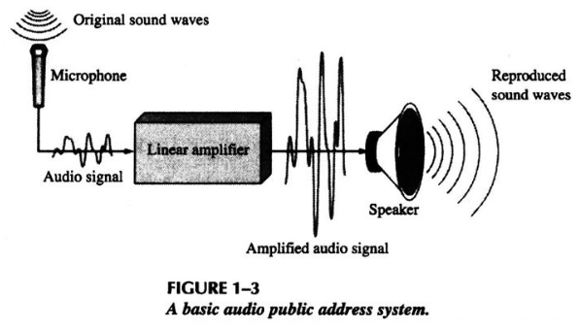
EXAMPLE OF AN ANALOQUE SYSTEM – PA System
Public Address System (PA) is a sound system. It need to amplify the sound (in analogue) in order to be heard by audience in large number.
Source: http://slideplayer.com/slide/2433690/

Slide 7
EXAMPLE OF AN digital SYSTEM – Computer system
Source: https://commons.wikimedia.org/

Slide 8
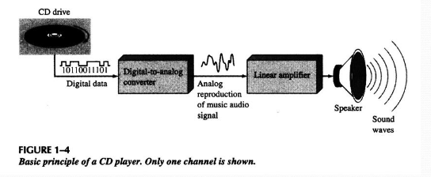
EXAMPLE OF analogue and digital system – cd player
The compact disk (CD) player is one of the example of a system which is consist both analogue and digital signal. The DAC is used to convert digital to analogue signal from CD.
Source: http://slideplayer.com/

Slide 9
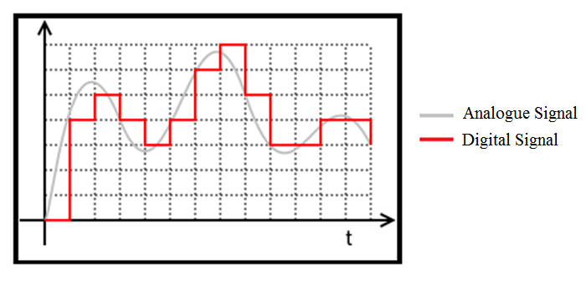
Analogue and digital signal quantities
Source: https://commons.wikimedia.org

Slide 10
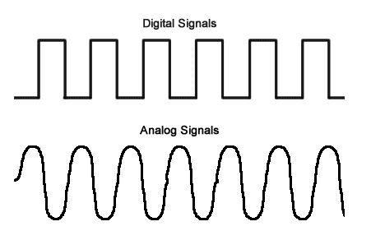
Analogue and digital signal quantities
Analogue quantities have continuous values.
Digital quantities have discrete sets of values.
Source: http://readanddigest.com

Slide 11
Advantages and disadvantages both system
ANALOGUE | DIGITAL
Noise and distortion problems | Can be very immune to noise
Precision is limited to three or four digits | Can handle as many digits of precision
Storage capability are limited | Mass storage techniques
Can be programmed but limited variety and complexity | Programmability
Usually simple | Can be complex

Slide 12
Conclusion of The Chapter
Analogue means continuous; digital means discrete
Physical quantities are mostly analogue in nature at one level but digital at another
Information can be represented in either digital or analogue form
Digital formats are more accurate and reliable
Accuracy (to discrete level), Reliable, Repeatable.

Slide 13
References
T. Floyd, “Digital Fundamental”, 10th Ed., USA : Prentice-Hall, 2008.
R.J. Tocci, “Digital Systems: Principles and Applications”, 10th Ed., USA : Prentice-Hall, 2006.

Slide 14
Norazian Subari Fakulti Kejuruteraan Elektrik & Elektronik Universiti Malaysia Pahang 26600 Pekan, Pahang, Malaysia http://fkee.ump.edu.my/index.php/en/staff-menu/articles-staff/1622-norazian-subari-main-profile

