Slide 1
Chapter 7 COMPARTMENT MODELS
by
Dr. Arshad Ali Khan Faculty of Engineering Technology arshad@ump.edu.my

Slide 2
Topic outcomes
Classify to open compartmental models
Discuss the non-compartmental models

Slide 3
One compartment

Slide 4
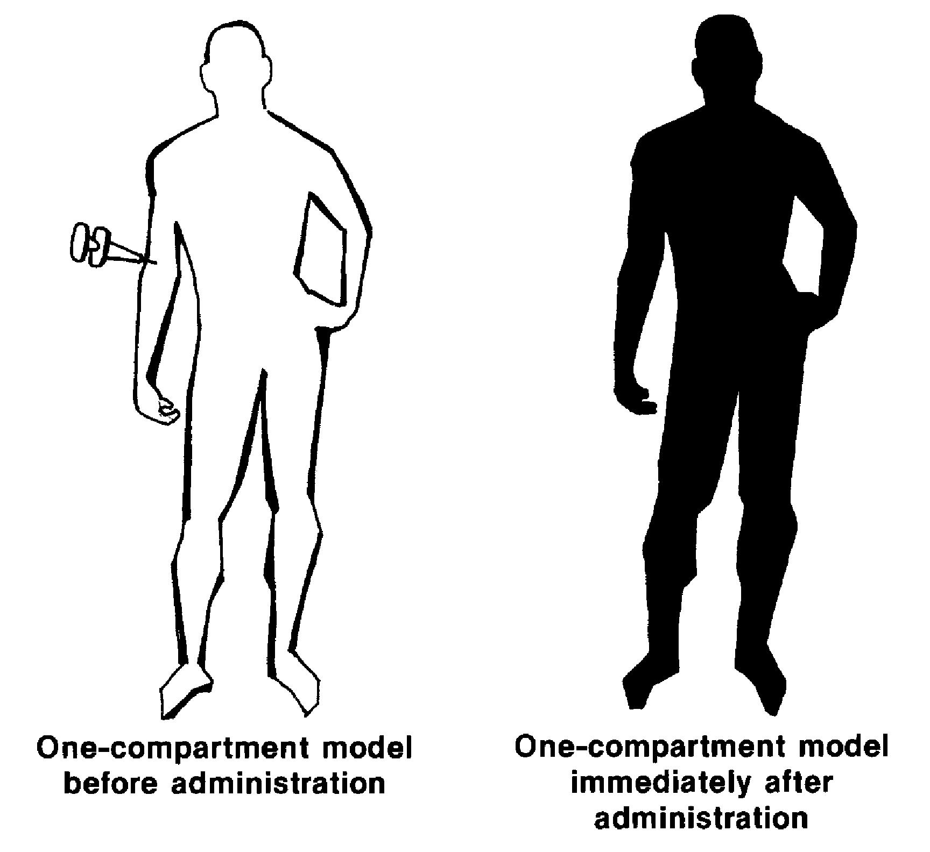
One compartment

Slide 5
More than one compartment

Slide 6
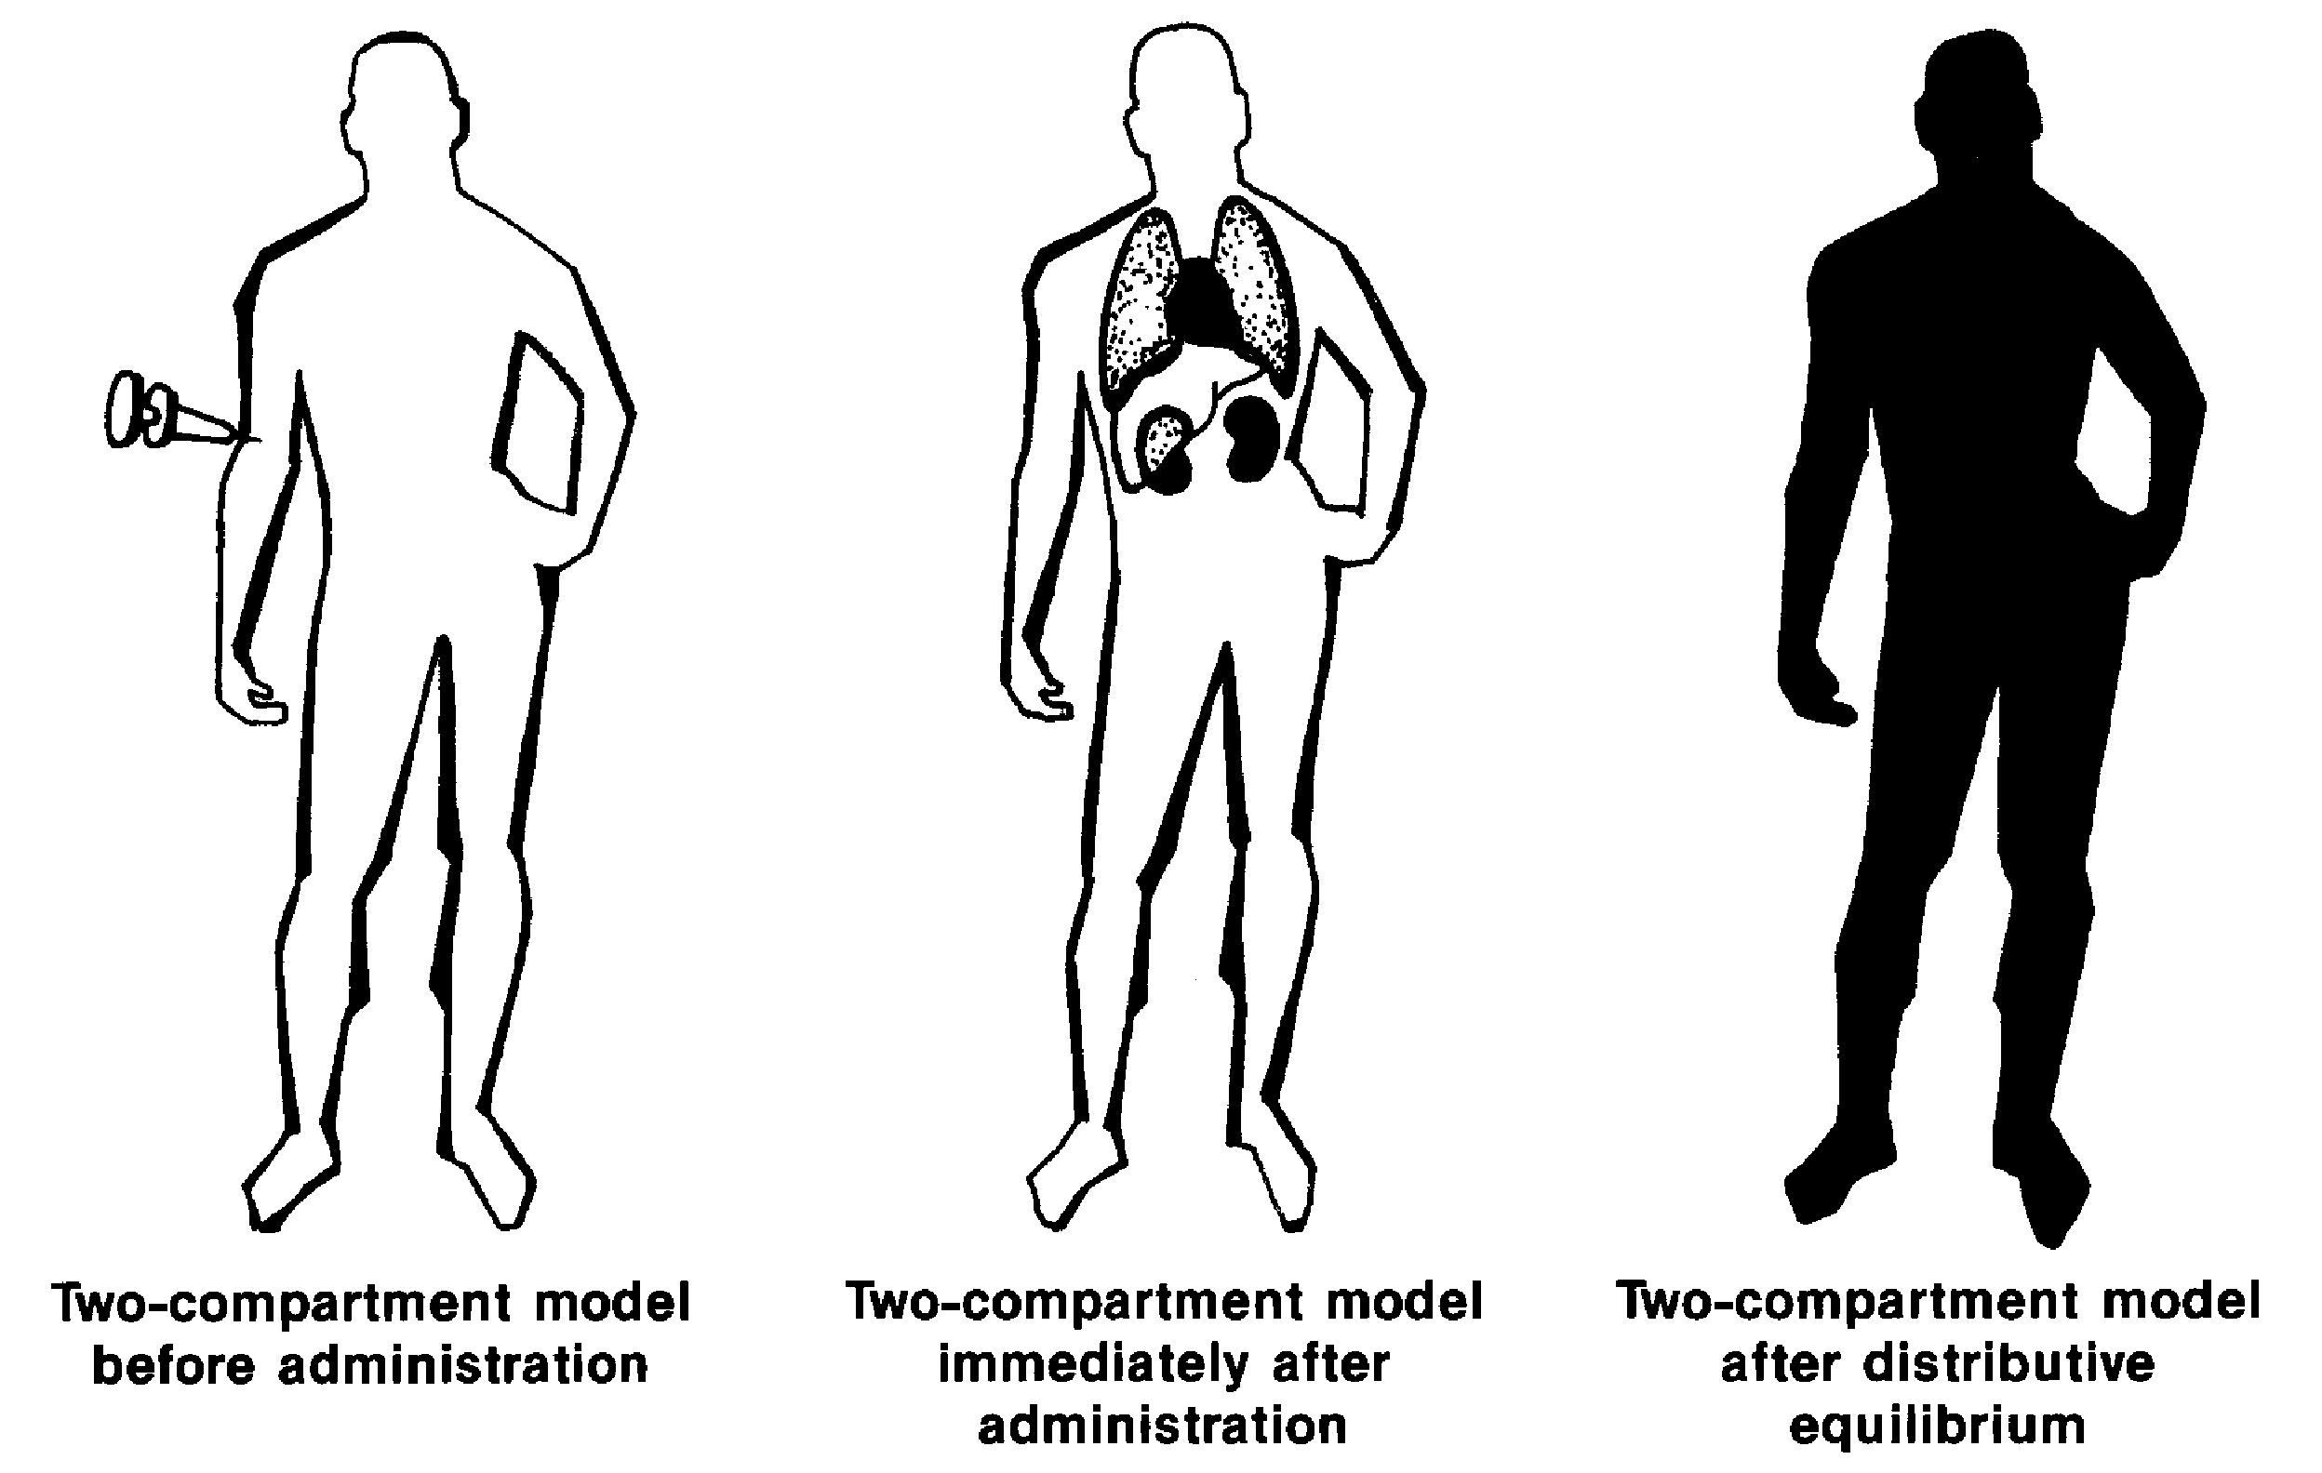
More than one compartment

Slide 7
One compartment open model
It is a simple way to explain the drug distribution and elimination in the body.
In this model, the body assumes as a single uniform compartment in which drug can enter and exit the body.
The intravenous injection (IV bolus) is a easiest route of administration for the modeling prospective.
The drug elimination starts from the body (compartment) suddenly after the injection.

Slide 8
One compartment:
Drug amount in the
Body (D_{B})
IV bolus administration (dose = X₀)
Elimination process
Elimination rate constant (K)
Based on the assumption of first order elimination process:

Slide 9
Elimination rate constant (K)
Elimination rate constant tells about the amount of drug eliminate per unit of time
K has a unit of reciprocal of time such as minute⁻¹.

Slide 10
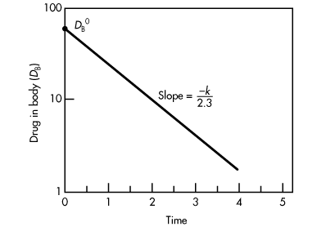
Elimination Rate Constant
D _{B} = drug inside the body after time t and D _{B} ⁰ = drug inside the body at t = 0.
When log D _{B} is plotted against t for this equation, a straight line is obtained
Rate expression:
Semilog graph showing the rate of drug elimination in one compartment model

Slide 11
Apparent Volume of Distribution (Vd)
In general, drug equilibrates rapidly in the body. When plasma or any other biologic compartment is sampled and analyzed for drug content, the results are usually reported in units of concentration instead of amount
Each individual tissue in the body may contain a different concentration of drug due to differences in drug affinity for that tissue. Therefore, the amount of drug in a given location can be related to its concentration by a proportionality constant that reflects the volume of fluid the drug is dissolved in
The volume of distribution represents a volume that must be considered in estimating the amount of drug in the body from the concentration of drug found in the sampling compartment

Slide 12
The real Volume of Distribution has physiological meaning and is related to body water
Total body water 42 L
Plasma
Plasma volume 4 L
Interstitial
fluid
Interstitial fluid volume 10 L
Intracellular
fluid
Intracellular fluid volume 28 L

Slide 13
Apparent Volume of Distribution: Mathematics
In order to determine the Vd of a drug, it is necessary to have plasma/serum concentration versus time data
where
C _{p} = concentration of drug in plasma t = t
C _{p} ⁰ = concentration of drug in plasma at t = 0

Slide 14
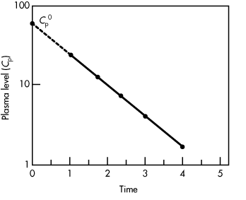
Calculation of Volume of Distribution
Semilog graph giving the value of C _{p}⁰ .

Slide 15
The
The apparent V _{D} can be estimated from the dose (D₀) at time t=0, elimination rate constant (k), and the area under the curve (AUC) from t = 0 to t = ∞.

Slide 16
Elimination half life (t_{1/2})
Elimination half life (t_{1/2}) is a time at which the amount of bioavailable drug become 50% (half) of the initial amount of the bioavailable drug.

Slide 17
Elimination half life (t_{1/2}) estimation
Two methods:
From the value of K:
Directly from Conc vs. time plot
Select a concentration on the best fit line (C1)
Look for the time that is needed to get to 50% of C1 ➔ half-life

Slide 18
Clearance (Cl)
Clearance is a the measurement of the depletion of drug from the body
The drug half life can be determined by drug Cl and Vd
For One compartment pharmacokinetics , clearance is calculated using:

Slide 19
Area Under the Conc. Time Curve (AUC) calculation
Two methods:
Model dependent: can be used only for one compartment IV bolus
Model independent: Can be used for any drug with any route of administration

Slide 20
AUC calculation: Model dependent
For intravenous drug administration following first order elimination in one compartment model, the AUC can be estimated using:

Slide 21
AUC calculation: Model independent

Slide 22
AUC calculation: Model independent
1- Divide the area into different parts based on the observed concentration points (parts 1-5)
1
2
3
4
5

Slide 23
AUC calculation: Model independent
2- Calculate the area for each part of the parts 1,2,3 and 4 (until the last observed concentration) using trapezoidal rule
1
2
3
4
5

Slide 24
Trapezoidal rule
C1
C2
where C = concentration
t = time
t1
t2

Slide 25
AUC calculation: Model independent
3- For part 5 (area between the last observed concentration and infinity) use the following equation:
C*

Slide 26
AUC calculation: Model independent
4- The total AUC (from zero to infinity) is the sum of the areas of parts: 1,2,3,4, and 5
1
2
3
4
5

Slide 27
Thank you

