Slide 1
Digital Electronics Flip-Flops
by
Norazian Subari
Fakulti Kejuruteraan Elektrik & Elektronik aziansubari@ump.edu.my

Slide 2
Chapter Description
Expected Outcomes
At the end of this topic, students should be able to:
Understand the operation of a latch flip-flops.
Understand the operation of a edge-triggered flip-flops.
Draw the output timing waveforms of several types of flip-flops in response to a set of input signals.

Slide 3
Topics
NAND Gate Latch
NOR Gate Latch Clock Signals and Clocked Flip-Flops
Clocked S-R, J-K and D Flip-Flop
D Latch

Slide 4
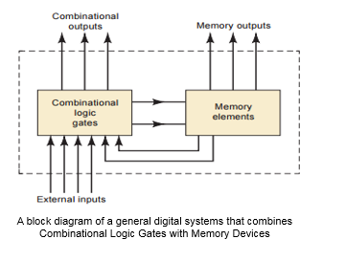
Sequential logic circuits
Flip=Flop
Latch

Slide 5
Latch
Set Reset (SR)
Set (S) input : HIGH or 1 state
Two Type
NAND Gate Latch
Reset (R) input : LOW or 0 state
NOR Gate Latch

Slide 6
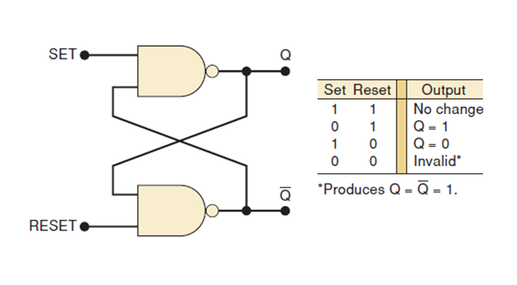
NAND GATE Latch

Slide 7
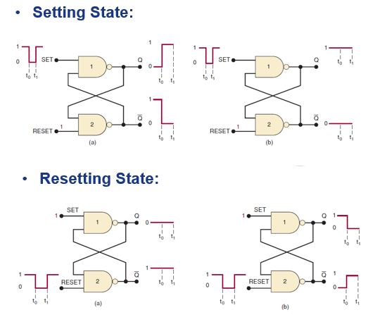
NAND GATE Latch

Slide 8
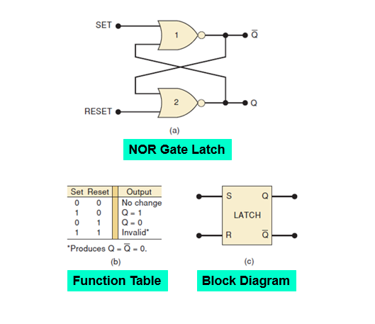
NOR GATE Latch

Slide 9
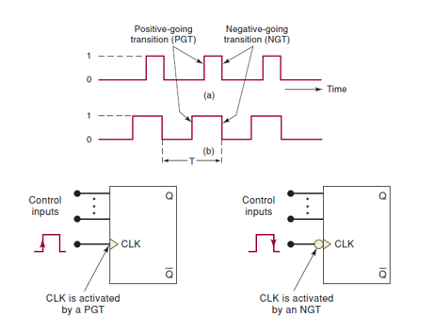
Clocked signal and clocked flip-flop

Slide 10
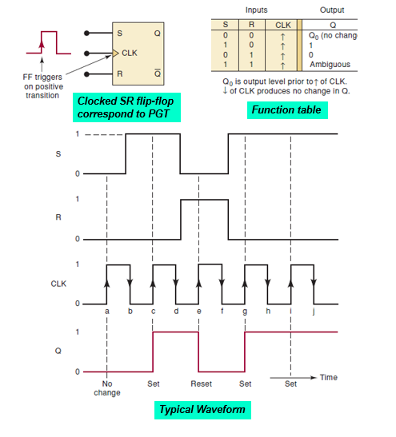
Clocked S-R flip-flop

Slide 11
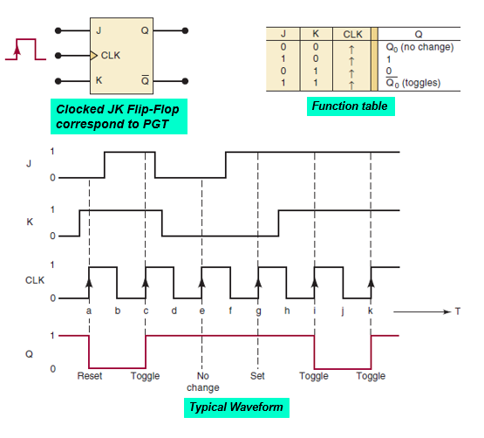
Clocked J-K flip-flop

Slide 12
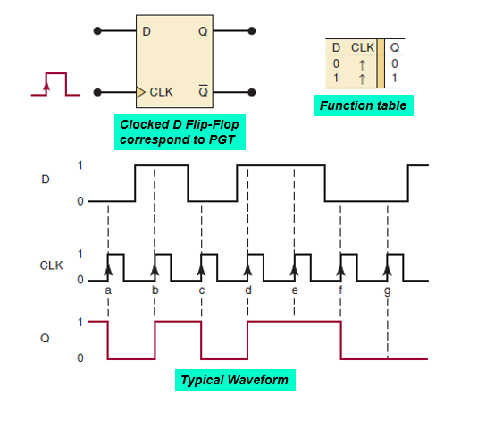
Clocked D flip-flop

Slide 13
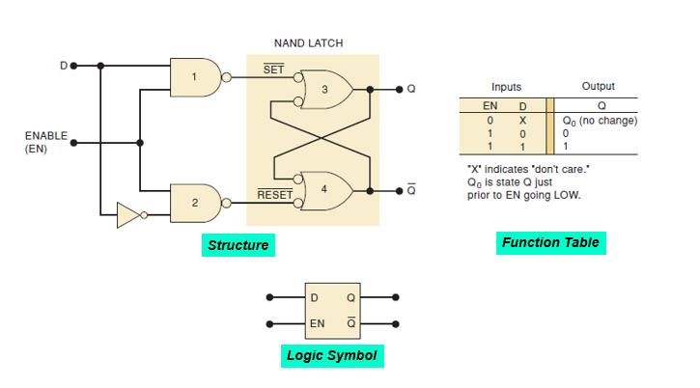
D latch (transparent latch)

Slide 14
References
T. Floyd, “Digital Fundamental”, 10th Ed., USA : Prentice-Hall, 2008.
R.J. Tocci, “Digital Systems: Principles and Applications”, 10th Ed., USA : Prentice-Hall, 2006.

Slide 15
Norazian Subari Fakulti Kejuruteraan Elektrik & Elektronik Universiti Malaysia Pahang 26600 Pekan, Pahang, Malaysia http://fkee.ump.edu.my/index.php/en/staff-menu/articles-staff/1622-norazian-subari-main-profile

