Slide 1
Electric and Electronic Technology Chapter 3 – Capacitance and Inductance
by
Akhtar Razali FKM akhtar@ump.edu.my

Slide 2
QUIZ 3 – Equivalent inductance
This quiz contributes 2% of the total marks.

Slide 3
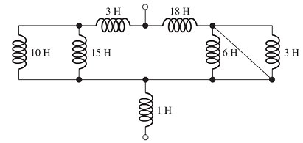
QUIZ 3b – Equivalent Inductance
QUESTION 1:
Find the equivalent inductance as in the figure (10 Marks)
Image source: Rizzoni

Slide 4
Akhtar Razali FKM, UMP.

