Slide 1
Chapter 8 BIOAVAILABILITY & BIOEQUIVALENCE
by
Dr. Arshad Ali Khan Faculty of Engineering Technology arshad@ump.edu.my

Slide 2
TOPIC OUTCOMES
Apply the pharmacodynamics and pharmacokinetics methods to measure bioavailability
Demonstrate the in vitro and in vivo correlation
Design novel dosage forms by improve bioavailability

Slide 3
BIOAVAILABILITY
The rate and extent of drug moiety reaches to the systemic circulation or target organ in an unchanged form to produce the therapeutic response is known as the bioavailability.
• absolute bioavailability
• relative bioavailability

Slide 4
Consideration in in-vivo bioavailability study design
Absolute bioavailability (F) – when systemic availability of drug administered orally is determined in comparison to its intravenous administration.
Type of standard used:
- Intravenous dose is selected as a standard
- intramascular dose for the poorly water-soluble drugs
- oral solution used in certain cases

Slide 5
Drawbacks of using oral solutions as a standard
Limits the pharmacokinetics treatment to one-compartment model only
Difficult to differentiate between the fraction of unabsorbed dose unabsorbed and metabolized drug
The true elimination rate constant cannot be determined (K_{E}), if the rate of oral absorption is not higher than the rate of elimination.

Slide 6
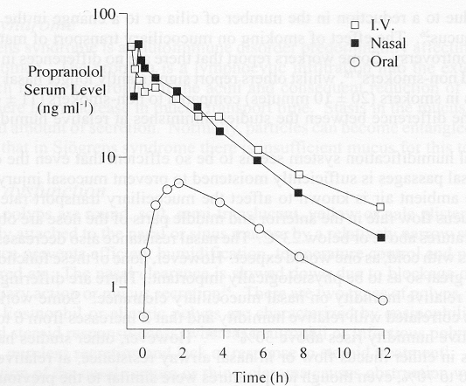
Bioavailable fraction (F ), is the fraction of administered dose which enters the systemic circulation.

Slide 7
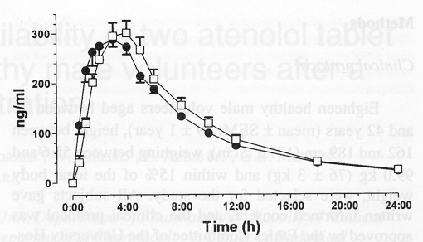
Relative bioavailability (F_{R}) – When systemic availability of a drug after oral administration is compared with that of standard oral administration of the same drug
When same dosage given for A and B
When different dosage given for A and B

Slide 8
Measurement of bioavailability
Pharmacokinetics ( Indirect method) – the assumption that the pharmacokinetics profile reflects the therapeutics effectiveness of a drug
plasma level-time studies
urinary excretion studies
Pharmacodynamics ( Direct method) – Measurement of drug effects on a physiological process as a function of time.
Acute pharmacological studies
Therapeutic response

Slide 9
Plasma level-time studies
tmax:
The time when drug concentration reaches to the maximum after drug administration. At this point, the rate of drug absorption is equal to the drug elimination
C_{max}:
The amount of drug when reaches to the maximum concentration in the plasma. It is also known as the maximum plasma concentration.
AUC (Area under the curve):
It is a measurement of extent of drug bioavailability. It shows the total amount of active drug that is bioavailable in the systemic circulation.

Slide 10
F = fraction of absorbed dose,
D ₀ = dose
k = elimination rate constant
V _{D} = volume of distribution.

Slide 11
Urinary drug excretion
D ∞ _{u} (cumulative amount of drug excreted in the urine) it is directly related to the total amount of absorbed drug
dD _{u}/dt. (rate of drug excretion)
Most of the drugs are excreted by a first-order and the rate of drug excretion is dependent on the first-order elimination rate constant (k) and the concentration of drug in the plasma (C _{p}).

Slide 12
Acute Pharmacological Effect
Acute effects used when bioavailability measurement by pharmacokinetic methods is difficult, inaccurate or non-reproducible.
Bioavailability determine by construction of pharmacological effect-time curve as well as dose response graph
Disadvantages :
more variables and no accurate correlations observed between measured response and drug availability
the observed response may be due to an active metabolite whose concentration is not proportional to the concentration of parent drug

Slide 13
In vitro- in vivo correlation (IVIVC)
Define as the predictive mathematical model Which explains the relationship between an in vitro property and in vivo response.
It is an alternative method for the bioavailability studies in human being through the dissolution test.

Slide 14
The applications of developing IVIVC
To ensure batch-batch consistency in the physiological performance of a drug product by use of in vitro values
To serve as tool in the development of a new dosage form

Slide 15
Correlations based on the plasma level data.
2. Correlations based on the urinary excretion data
3. Correlation based on the pharmacological response

Slide 16
In vitro –in vivo correlations levels
Level A – A point to point relationship between in vitro dissolution and the in vivo rate of absorption
Level B – utilizes the principle of statistical moment analysis.
The mean in vitro dissolution time compared to either mean of residence time or the mean in vivo dissolution time
The data is not point to point data, cannot use for quality control standards
Level C – single point correlation. Relates one dissolution time point to one pharmacokinetics parameter such as AUC, tmax,or Cmax.
- one suitable to guide in formulation development or QC standards
Multiple level C – correlation involving one or several pharmacokinetic parameters to the amount of drug dissolved at various time point

Slide 17
Biopharmaceutics classification system (BSC)-Based biowaiver to in vivo bioavailability/bioequivalence studies
According to BSC , in vivo bioavailability and bioequivalence studies need not to be conducted for drug products under following circumstances
Rapid and similar dissolution
High solubility
High permeability
Wide therapeutics window
Excipient used in dosage form are same as those present in approved drug products

Slide 18
Bioequivalence studies
Objective of the studies
If new product intended to be substitute for an approved product as a pharmaceutical equivalent or alternative.
The equivalence of this product should be shown or justified
Definition:
Drug substances in two or more identical dosage forms, reaches the systemic circulation at the same relative rate and to the same relative extend.

Slide 19
Thank you

