Slide 1
BSK1133 PHYSICAL CHEMISTRY CHAPTER 2 COLLISIONS OF GASES MOLECULES
For updated version, please click on
http://ocw.ump.edu.my
PREPARED BY:
DR. YUEN MEI LIAN AND DR. SITI NOOR HIDAYAH MUSTAPHA Faculty of Industrial Sciences & Technology yuenm@ump.edu.my and snhidayah@ump.edu.my

Slide 2
Description
Aims
To understand the collision molecules theory of gases.
To understand the different types of molecules speed.
To understand the different between ideal gas and real gas.

Slide 3
Description
Expected Outcomes
Able to understand the collision of gas molecule theory
Able to understand the diffusion and effusion of gases
Able to understand mean free path
Able to understand the different between ideal gas and real gas
References
Atkins, P & Julio, D. P. (2006).Physical Chemistry (8th ed.). New York: Oxford.
Chang, R. (2005).Chemistry (8th ed.). New York: McGraw Hill.
Atkins, P & Julio, D. P. (2012). Elements of Physical Chemistry
(sixth ed.). Freeman, Oxford.
Silbey, R. J., Alberty, A. A., & Bawendi, M. G. (2005). Physical Chemistry. New York: John Wiley & Sons.
Hans Kuhn, Horst-Dieter, F. and David, H. W. (2009). Principles of Physical Chemistry (Second Edition), Wiley
Mortimer R. G. (2008) Physical Chemistry, Third Edition , Elsevier Academic press, USA.

Slide 4
Contents
2.1 Average Speed of Molecules in A Gas
2.2 Diffusion and Effusion
2.3 Graham’s Law
2.4 Mean Free Path
2.5 Fick’s Law
2.6 Real Gas
Conclusion

Slide 5
2.1 Average Speed of Molecules in A Gas

Slide 6
As discussed previously in Chapter 1:

Slide 7
2.2 Diffusion and Effusion

Slide 8
Type of gas movement:
Diffusion :
A process which spreading of molecules from higher concentration to low concentration.
Effusion :
A process of molecules escape from a compartment to a vacuum compartment through a small hole.

Slide 9
According to the equation of molecular speed, number of molecule hitting the wall of container is proportional to their speed.
Thus, the rate of effusion also considered as proportional to its molecular speed (Vrms).

Slide 10
2.3 Graham’s Law

Slide 11
Stated that the speed (on average) is inversely proportional to the square root of the molecular mass.
At the same temperature, the ratio of the gas movement rates is:
$$\frac{{Rate}_{gas A}}{{Rate}_{gas B}}=\sqrt{\frac{{Molar Mass}_{gas B}}{{Molar Mass}_{gas A}}}$$

Slide 12
Expansion of gases
The pressure difference between the two sides of orifice (small hole) and the orifice diameter determine whether the gas expands supersonically or effusively:
Effusion :
the diameter of orifice is smaller than the average distance a molecule travels between its collision with another molecule (mean free path).
No collisions occur between the gas molecules as they move through the orifice and the flow is ‘molecular’

Slide 13
Supersonic :
Diameter of hole is larger than the average distance between collisions.
Many collisions between the gas molecule can occur during the expansion through the hole.
The collision act to transfer energy from the random atomic and molecular motions of the gas into the directed flow of the gas molecules along the expansion direction.
The gas moves as a whole; most of the molecules have the same speed in direction of the flow
The speed of the gas molecules relative to each other becomes very small, and the temperature also becomes very low.

Slide 14
2.4 Mean Free Path

Slide 15
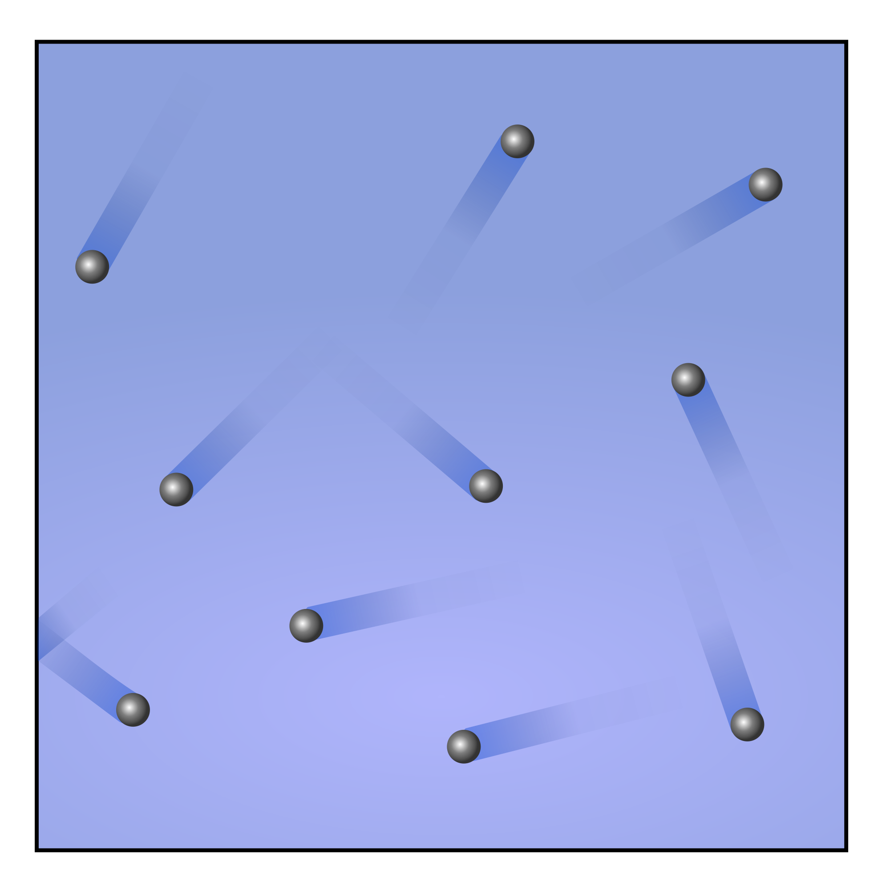
A gas molecule travels in a straight line and collide with other molecule or wall of the container.
Mean free path is the average distance a molecule travels between collisions.
The mean free path of molecule will depend on its speed and the density of molecules surrounding it.
As the pressure increases, the mean free path decreases.
Sources:
Wikimedia commons

Slide 16
How to calculate mean free path?
1. Imagine that the molecules of gases are evenly distributed in a cube of length L.
$L^{3}=N a^{3}$
where N is total number of molecules in a cube and a is the average distance of two nearest neighbors.
$$a=\sqrt[3]{\frac{L^{3}}{N}}= \sqrt[3]{\frac{V}{N}}= \sqrt[3]{\frac{kT}{P}}$$

Slide 17
Using the ideal gas law equality at P=1 bar and T=273.16 K, the average distance is a=3.3 nm.
The free path (λ) (the distance a molecule traverses between collisions) is much longer than the average distance a because the molecule passes between many neighboring molecules.
Assumptions to determine the mean free path (a or ):
1. approximate the molecules as hard sphere
Assumptions to determine the free path (λ) :
1. Consider a particle of type 1 moving among many particles of type 2 that are so massive that they can be considered nearly stationary.
2. A collision occurs each time a type 1 particle with radius (r1) touches a type 2 particle with radius (r2).
3. As type 1 molecule moves through space it sweeps out a cylindrical volume
(Vcyl).

Slide 18
Since collision only occurs at correct orientation, thus the diameter of the collided molecules is 2(r1 + r2).
$V_{cyl}=π{(r_{1}+r_{2}) }^{2}$ λ
If there are N type of particle in the total volume V of the gas, then the average volume element for a type 2 particle is V/N and the average cylinder volume ($\overline{V_{cyl}}) is$
$$\overline{V_{cyl}}=\frac{V}{N}=π{(r_{1}+r_{2}) }^{2}\overline{\text{λ}}$$
$$\overline{\text{λ}}=\frac{V}{Nπ{(r_{1}+r_{2}) }^{2}}$$
This equation can be simplify to:
$$\overline{\text{λ}}=\frac{V}{σN} ; σ is collision cross section$$
this equation is significant for one light particle among N heavy particles

Slide 19
2.5 Ficks’s First Law

Slide 20
Although it is interesting to calculate the average behavior of a molecule, experimentally we most often deal with collections of molecules.
Normally being asked like:
“What amount of bromine vapor emerges through the opening of the cylinder in time, t, if a cylinder has a cross-sectional area A and height H?”
Thus, the Fick’s first law equation:
$$\frac{∆n}{∆t}=−A D \frac{C_{H}}{H}$$
dn/dt is considered for sufficiently small time changes, dc/dh concentration gradient in general cases
Where :
$∆n$ is the concentration of collections molecules vapor, A is the cross-sectional area, D is diffusion coeffision, $C_{H}$ is concentration of liquid, H is the height of cylinder/distance

Slide 21
2.6 Real Gas

Slide 22
A gas is considered as non-ideal when it is not fulfil an ideal gas behavior.
Ideal gas assumptions:
absent of attractions between gas molecules
Gas molecules do not take up space as it elastically collide (based on the kinetic molecular theory).
At high pressure and low temperature, this assumptions are not valid for real gases
At high pressure, the molar volume of a real gas is larger than predicted by the ideal gas law

Slide 23
Behavior of Real Gases:
1. At low pressure and high temperature:
The volume of the gas particles is negligible compared to the total volume.
2. At higher pressure and low temperature:
The volume of the gas particles is more significant compared to the total volume.
Thus, the volume of a real gas is larger than the ideal gas.

Slide 24
Conclusion
There are some parameters such as mean path, need
need to be considered in molecular collisions of
gases.
In specifically, it will relates to some other laws explaining the theories.
The specific parameter will differentiate the gases properties either as an ideal or non-ideal gas.

Slide 25
AUTHOR INFORMATION
DR. YUEN MEI LIAN (SENIOR LECTURER)
INDUSTRIAL CHEMISTRY PROGRAMME FACULTY OF INDUSTRIAL SCIENCES & TECHNOLOGY UNIVERSITI MALAYSIA PAHANG yuenm@ump.edu.my
Tel. No. (Office): +609 549 2764
DR. SITI NOOR HIDAYAH MUSTAPHA (SENIOR LECTURER)
INDUSTRIAL CHEMISTRY PROGRAMME FACULTY OF INDUSTRIAL SCIENCES & TECHNOLOGY UNIVERSITI MALAYSIA PAHANG snhidayah@ump.edu.my
Tel. No. (Office): +609 549 2094

