Slide 1
BSB3503 - Biomanufacturing CHAPTER 2 Process Plant Design Part I
Author: Nurul Azyyati Sabri
Co-Author / Editor: Rama Yusvana Faculty Industrial Sciences & Technology yusvana@ump.edu.my

Slide 2
Chapter Description
Aims
Provide overview of process plant design in biomanufacturing industry
Expected Outcomes
Understand the basic process in production of biopharmaceuticals
Aware of the regulatory issues involved in production of biopharmaceuticals
References
.

Slide 3
Introduction
Source materials
Merchantable products

Slide 4
PLANT DESIGN OBJECTIVE
A Facility That Can be built within the project budget
Meets applicable standards & regulations
Meets production goals

Slide 5
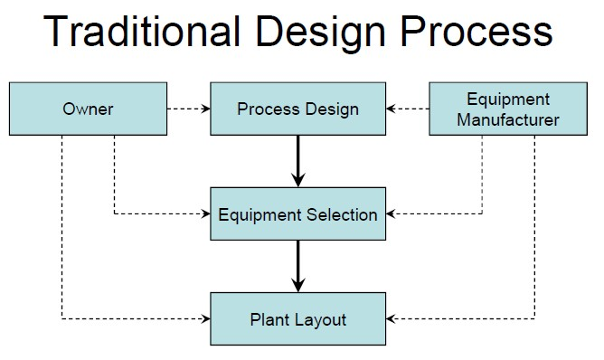

Slide 6
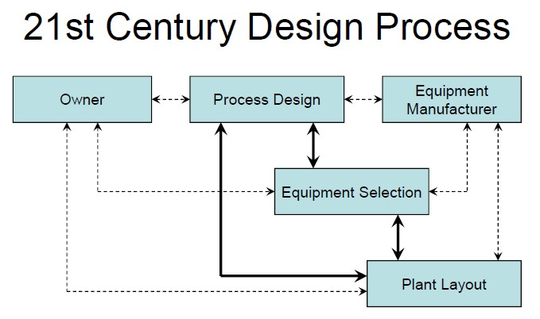

Slide 7
Introduction
Typical products of process plants:
Chemistry
Pharmaceuticals
Cosmetics
Building materials
Food industry
Coal

Slide 8
Introduction
Two parties
Plant operator: operate a process plant.
Plant constructor: agree with scope.

Slide 9
Introduction
Biotech industries & chemical engineering require the use of engineering principles combined with a practical application.
Development of a new plant or process is a complex problem – often through a series of stages

Slide 10
Typical stages
1. Inception
2. Preliminary evaluation of economics and market
3. Development of data necessary for final design
4. Final economic evaluation
5. Detailed engineering design
6. Procurement
7. Erection
8. Start up and trial runs
9. Production

Slide 11
Overview of activities
Project planning
phase
Cost forecasts & analyses – important
Execution
phase
After the starting signal for the construction given
Basic engineering – assess production cost for the manufacturing of a planned product as exactly as possible.
Detail engineering
Planning, procurement, assembly, commissioning of the plant
Determination, optimization, implementation at least rough component, installation plan (layout), tender and contract award.
Conclusion of
contract

Slide 12
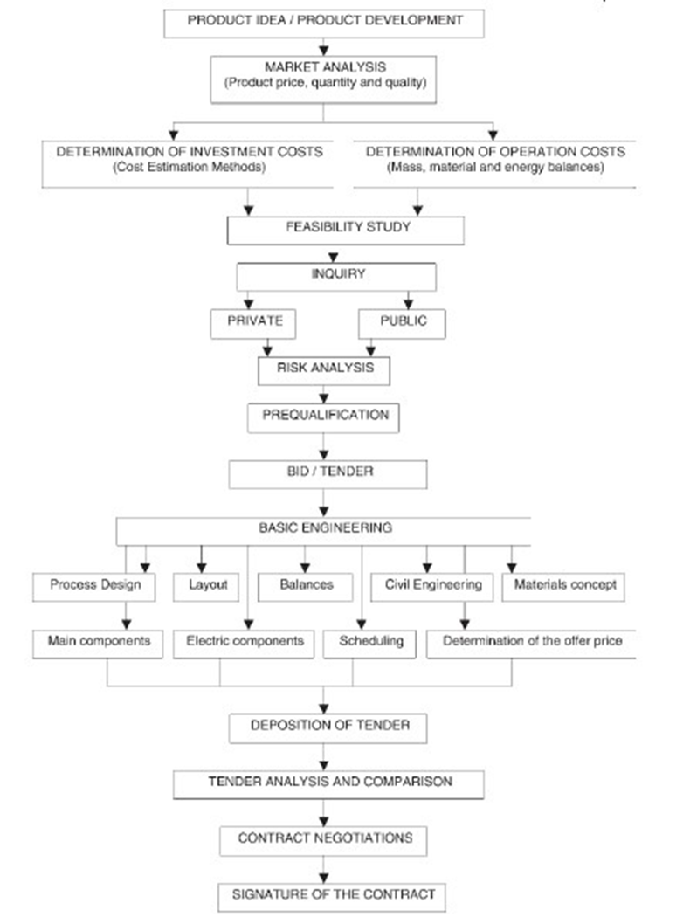
Project planning phase
1-3 years
Politic arguments, R&D

Slide 13
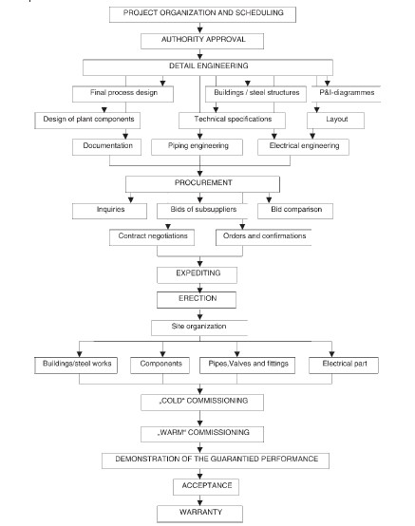
Execution phase
2-4 years

Slide 14
Project planning
Operator
Plant manufacturer
Risk analysis
Product development
Plant type
Plant location
Costs
Inquiry / invitation to tender
Basic engineering
Quotation

Slide 15
Operator
Goal: draw the utmost profit from products.
First step: development of marketable products followed by appropriate production plants.
Generate turn overs by selling the products.

Slide 16
Product development
Plant Type & location
Capacity
Availability
Lifespan
Degree of automation
Legal
Cost

Slide 17
PRODUCT DEVELOPMENT
Main targets
High sold price
Favorable
Produced in Large quantities.
Sustainable.

Slide 18
PRODUCT DEVELOPMENT
To achieve the targets:
Product : Technical aspect, product development by R&D, use of highly trained scientists
Not necessarily new product
Market analysis.

Slide 19
PLANT TYPES & LOCATION
Strong influence and may require many different factors to be considered.
Location should lead to minimum cost of production.

Slide 20
PLANT LOCATION
Should be established upon completion of the detailed-estimate design.
Based on a complete survey.

Slide 21
Factors should be considered in selecting a plant site:
Plot of land.
Availability of suitable land.
Raw material availability / operating resources.
Availability of labours
Political conditions.
Geographic conditions / Climate.
Transport facilities.
Availability of utilities (Water, Electricity).
Environmental impact and effluent disposal.
Local community considerations.
Taxations and legal restrictions

Slide 22
TYPE OF (BIO) MANUFACTURING PLANTS
Small
Large-scale
Medium-size

Slide 23
Small plant
Production volume up to USD 600,000.
Transportable.
Project duration : short.

Slide 24
Medium-sized plant
Sales volumes of single or double digit millions
Duration: 1-3 years
Include several smaller plants.
E.g. individual chemical plants

Slide 25
Large-scale plant
Order volume – billion
Project term exceeds 2 years.
Handled by several project managers.
General manager – overall responsibility
Managers – responsible on time scheduling with special tools.
Municipal waste incineration power plant in Europe. Total investment €500m

Slide 26
Capacity
Scheduled annual production output
Procurement cost of a plant depends on production output capacity
The production output depends on expected sales and market

Slide 27
Availability
Actual operating time of a plant
It stated as percentage

Slide 28
Lifespan
Decision are made separately for each plant
Period range: 5 - 30 years
If longer lifespan entails higher procurement cost and maintenance cost

Slide 29
Degree of automation
Mostly “automatic plant”.
Repair and maintenance units has to be staffed.
Fully-automatic plant entails corresponding expenses.

Slide 30
Degree of automation
Personnel costs arise during the whole operating time of the plant
In low-wage countries, it is different case.
Cheap personnel are often sufficiently available
Demand a certain degree of automation

Slide 31
Legal requirements
TWO (2) main legal requirements:
Environmental regulations
Safety regulation

Slide 32
Environmental regulations
Forced worldwide especially in the US, Japan and European Union
Plant operators are bound by legal regulations.
Regulations may result higher costs than actual production costs.

Slide 33
Environmental regulations
Take environmental aspects into consideration.
Worldwide standardized regulation of environmental requirements

Slide 34
Safety regulations:
Similar situation is applicable
Varying & country specific.

Slide 35
Safety regulations:
Requirements regarding the safety of people (“Safety Regulations, Accident Prevention Regulation”).
Eg: compulsory wear protective clothes in certain area
Accidents: poisonous, explosion, combustible substances

Slide 36
Conclusion of The Chapter
There are mainly TWO (2) types of process design
Biomanufacturing project development consists mainly plant operator and plant constructor

