Slide 1
BSB3503 - Biomanufacturing CHAPTER 2 Process Plant Design – Part III
Author: Nurul Azyyati Sabri
Co-Author / Editor: Rama Yusvana Faculty Industrial Sciences & Technology yusvana@ump.edu.my

Slide 2
Basic flow diagram

Slide 3
Production of Ethane from Ethanol
Ethanol is feed to continuous reactor with presence of Acid Sulphuric catalyser to produce ethylene. Distillation process then will be applied to separate ethylene-H2O mixture. Ethylene as a top product is then condensate with condenser to perform liquid ethylene. Hydrogenation of ethylene applies in another reactor with presence of Nickel catalyzer to produce ethane as a final product.

Slide 4
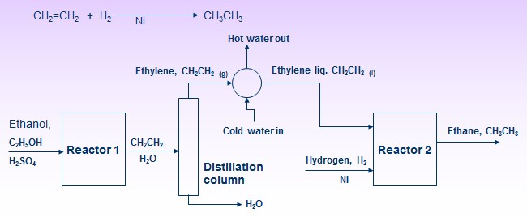
Production of Ethane from Ethanol

Slide 5
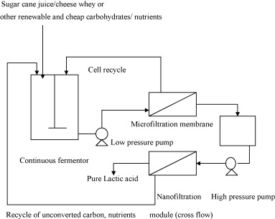

Slide 6
Process flow diagram (PFD)
Showing the connectivity of all the streams of materials and the equipment
PFD will contains the following information:-
All equipments : such as pumps and valves, compressors, columns.
All utility streams such as steam lines, compressed air lines, electricity, etc.
All process flow streams: identified by a number, process condition, chemical composition.
Basic control loops: showing the control strategy used

Slide 7
Using software – AUTOCAD and VISIO
Developed special for process engineering
Typical component data in the software:
Instrument ID
Drawing number
Dimensions

Slide 8
The Process Flow Diagram (PFD)
Process Unit Symbology
Symbol
Description
Heat exchanger
H₂O
Water cooler
S
Steam heater
Cooling coil

Slide 9
The “Process Flow Diagram” (PFD)
Process Unit Symbology
Symbol
Description
Heater coil
Centrifugal pump
Turbine type compressor
Pressure gauge

Slide 10
The “Process Flow Diagram” (PFD)
Process Unit Symbology
Symbol
Name
Description
Stripper
Convert liquid mixture into gas phase
Absorber
Convert mixture gas into liquid phase

Slide 11
The “Process Flow Diagram” (PFD)
Process Unit Symbology
Symbol
Name
Description
Distillation
column
Separate liquid into miscellaneous component fractions.
Liquid mixer
Mix liquid components.
or

Slide 12
The ”Process Flow Diagram” (PFD)
Process Unit Symbology
Symbol
Name
Description
Reaction
chamber
Location of chemical process or reaction occurs
Horizontal tank
or cylinder
Store liquid or gas.

Slide 13
The “Process Flow Diagram” (PFD)
Process Unit Symbology
Symbol
Name
Description
Boiler
Heating purposes.
Centrifuge
Physically separated liquid mixture (exp: oil-liquid)

Slide 14
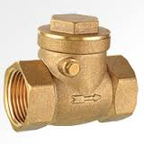
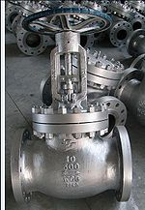
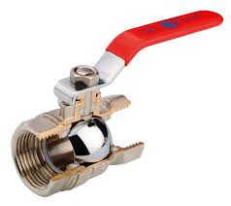
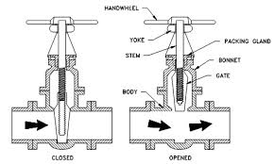
The “Process Flow Diagram” (PFD)
Valve Symbology
Symbol
Name
Gate Valve
Globe Valve
Ball Valve
Check Valve
Butterfly Valve

Slide 15
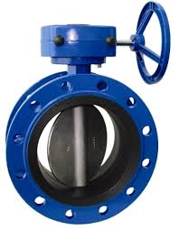
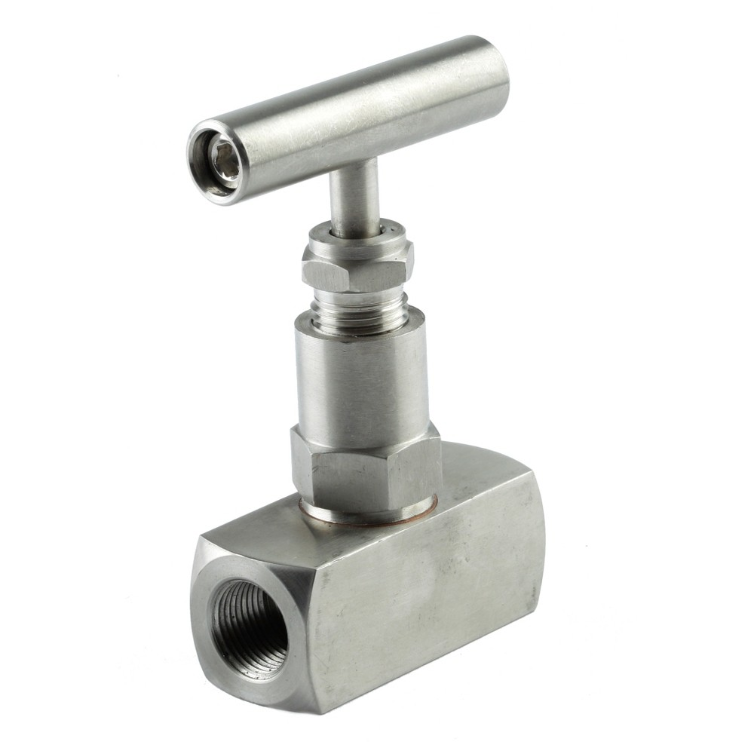
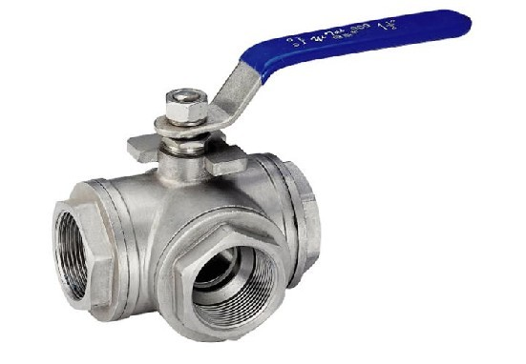
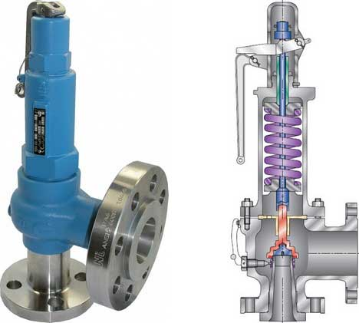
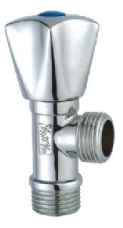
The “Process Flow Diagram” (PFD)
Valve Symbology
(a)
Symbol
Name
Relief Valve (d)
(b)
Needle Valve (a)
3-Way Valve (c)
(c)
(d)
Angle Valve (e)
(e)
Butterfly Valve (b)

Slide 16
The “Process Flow Diagram” (PFD)
PFD will contains the following information:-
All process flow streams: identification by a number, process condition, chemical composition.
Line Numbering and Method for Drawing
- Generally numbers made from left to right.
- Horizontal lines cuts or break vertical line.
Yes
No
No

Slide 17
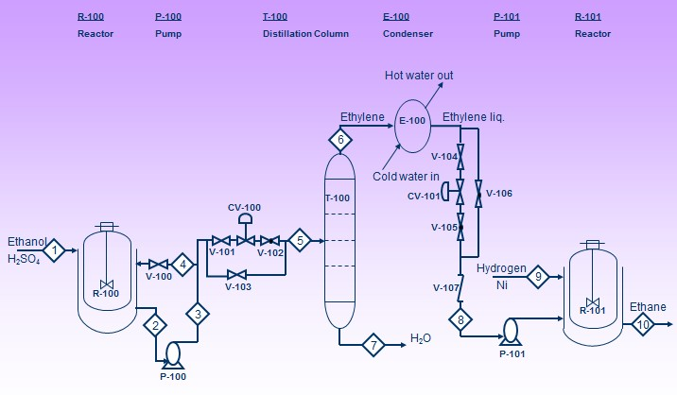
Example

Slide 18
The Process Flow Diagram (PFD)
Stream Description
- Mainly reactors and towers, etc.
Use Flags when necessary
Can include full stream data

Slide 19
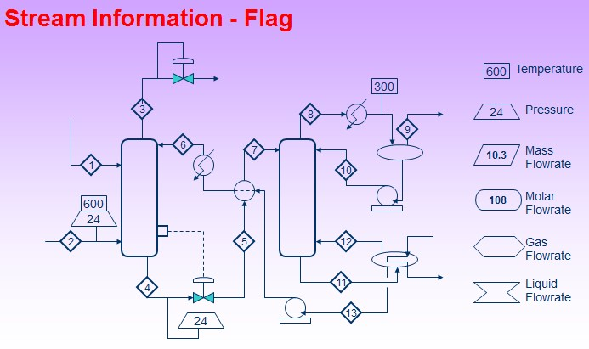
The Process Flow Diagram (PFD)

Slide 20
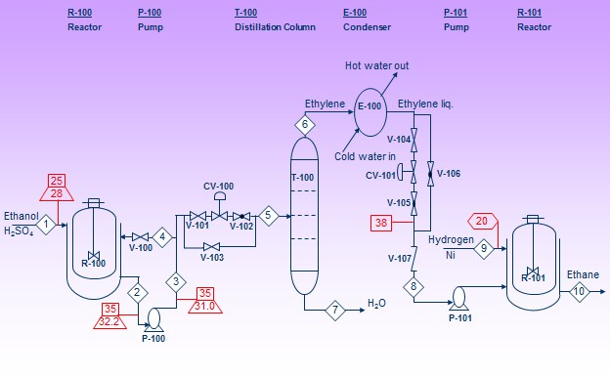
Example

Slide 21
Stream Information - Full stream data
Stream Number | 1 | 2 | 3 | 4 | 5 | 6 | 7 | 8 | 9 | 10
Temperature (oC) | 25.0 | 35.0 | 35.0 | 35.0 | 35.0 | 60.3 | 41 | 38 | 54.0 | 45.1
Pressure (psi) | 28 | 32.2 | 31.0 | 31.0 | 30.2 | 45.1 | 31.3 | 24.0 | 39.0 | 2.6
Vapor fraction

Slide 22
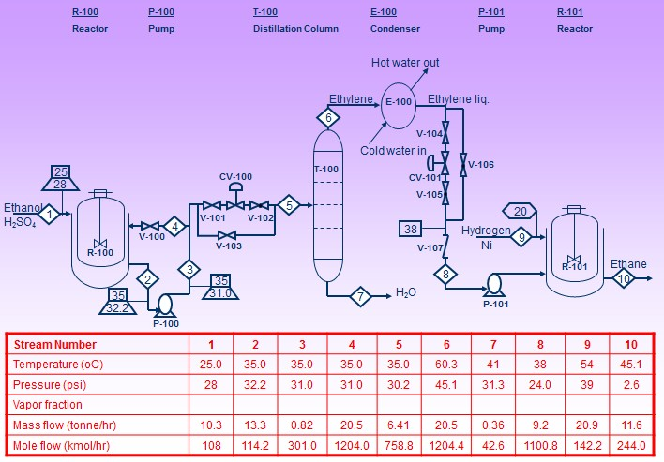
Example

Slide 23
The Process Flow Diagram (PFD)
PFD usually also contains the following information:-
Basic control loops: showing the control system in place.

Slide 24
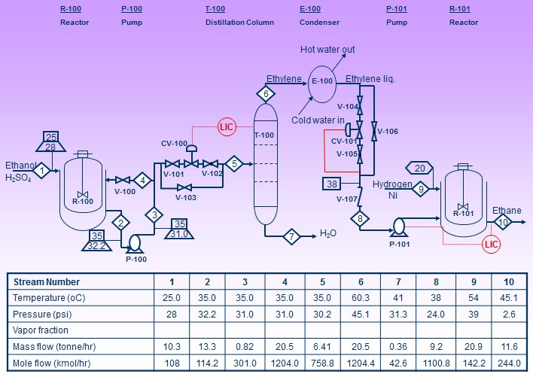

Slide 25
Piping and instrumentation diagrams
The drawing is started after the order placement and approximately at the same time to the procurement of the components.
The information given is subdivided into basic information.

Slide 26
Information includes:
Appliances and machinery
Pipes or means of transport (e.g. moving belts)
Valves and fittings
Information on dimension, nominal pressures and material classification
Any insulation, electric pipe heater, gradients & materials

Slide 27
Example:
Simple pump group
Atmosphere Vessel
Pump unit with automatic flushing device
Tubular heat exchanger
Hydrochloric acid metering system

Slide 28
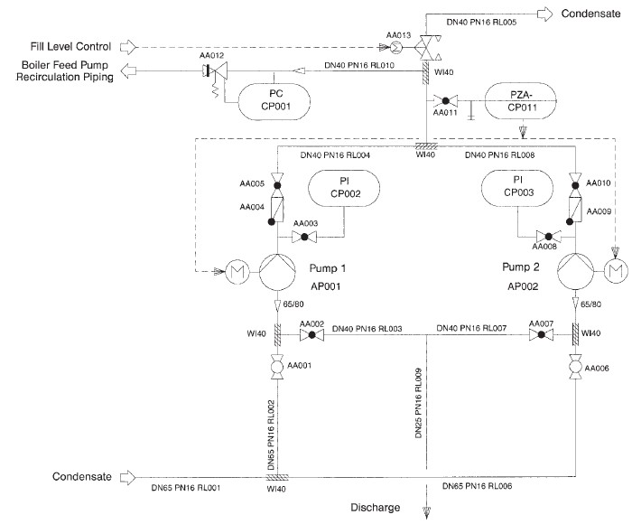
Example: Simple pump group

Slide 29
Main apparatus
Steps in procurement of the main apparatus:
1) process-related design
Applied knowledge of thermal, chemical, mechanical, biological process engineering.
Hydrodynamic: The reactor diameter and its height, Heat exchangers, Design of compressors: thermodynamic aspect
All results recorded in technical data sheet

Slide 30
2) strength related design
Calculation on wall thickness
3) production-related design
Carried out within detail engineering
Assigned to subcontractors

Slide 31
Layout
Generally very complex
Occur only after submission of P&I drawing – within the detail engineering

Slide 32
Quotation
A request for quotation (RFQ) is a standard business activity inviting suppliers to bid specific products or services.
Include payment terms, quality level per item or contract length etc.
To receive accurate quotation, therefore it also includes the full specifications of the items/services.

Slide 33
Quotation
The more detailed the specifications should minimize potential problems regarding products or services specification.
Acting as legal binding documentation for the suppliers.
Best suited for products and services that are as standardised to make each supplier's quote comparable.

