Slide 1
Computer Programming Chapter 5: Switch statement
by
Mohd Jamil Mohamed Mokhtarudin Faculty of Mechanical Engineering mohdjamil@ump.edu.my

Slide 2
Chapter Description
Aims
To construct C programming involving switch statement
Expected Outcomes
Know to construct conditional statement using C programming

Slide 3
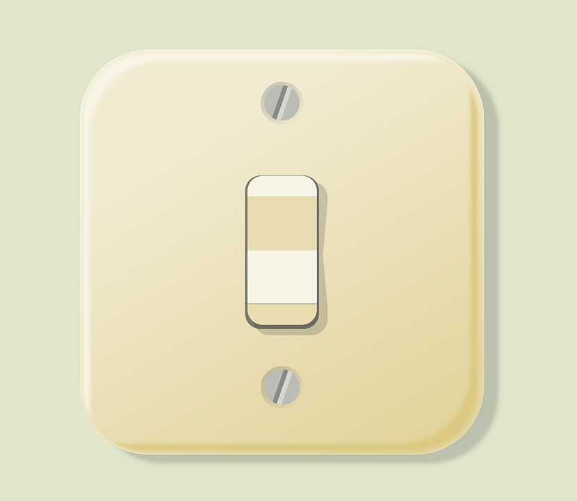
Switch statement
Still remember??
Not this switch. Switch statement has similar operation as electrical switch, which allows user ‘to choose’ either on or off.

Slide 4
Switch statement
Still remember??
CAT
PET
ANIMAL
CHICKEN
FOOD
LION
DANGER

Slide 5
Example switch statement

Slide 6
Switch statement
Basic structure: switch, case, break
switch() {} – put your variable in the ()
case – switch will find the case that has similar value as the variable in ()
REMINDER: must put : after case!
If the variable is equal with the case value, any statement following the case will be executed
Break – allow the switch statement to exit

Slide 7
Switch statement
default – executed when none of the case matches the variable
Switch and if-else are almost similar – switch allows for more possibility of execution paths.

Slide 8
Conclusion of The Chapter
Know how to use switch!
Switch and if-else are almost the same…

