Slide 1
Electric and Electronic Technology Chapter 2C – Resistance in Series and Parallel
by
Akhtar Razali FKM akhtar@ump.edu.my

Slide 2
Chapter Description
Aims
To understand what is voltage divider, analysis and its application
To understand what is current divider, analysis and its application
Expected Outcomes
Student should be able to identify voltage and current divider circuit.
Able to solve problem related to voltage and current divider
Other related Information
One of mid semester exam is from this topic
No other relevant information be disclosed
References
Rizzoni G., 2004, Principles and Applications of Electrical Engineering, Revised Fourth Edition, Fourth Edition, McGraw Hill
Hambley A.R., 2005, Electrical Engineering Principles and Applications, Third Edition, Pearson Prentice Hall

Slide 3
Contents
Voltage divider circuit
Current divider circuit

Slide 4
Voltage Divider
When a voltage is applied to a series combination of resistances, a fraction of voltage appears across each of the resistance.
A series circuit acts as a voltage divider. The voltage divider is an important application of series circuits.
A circuit consisting of a series string of resistors connected to a voltage source act as voltage divider.

Slide 5
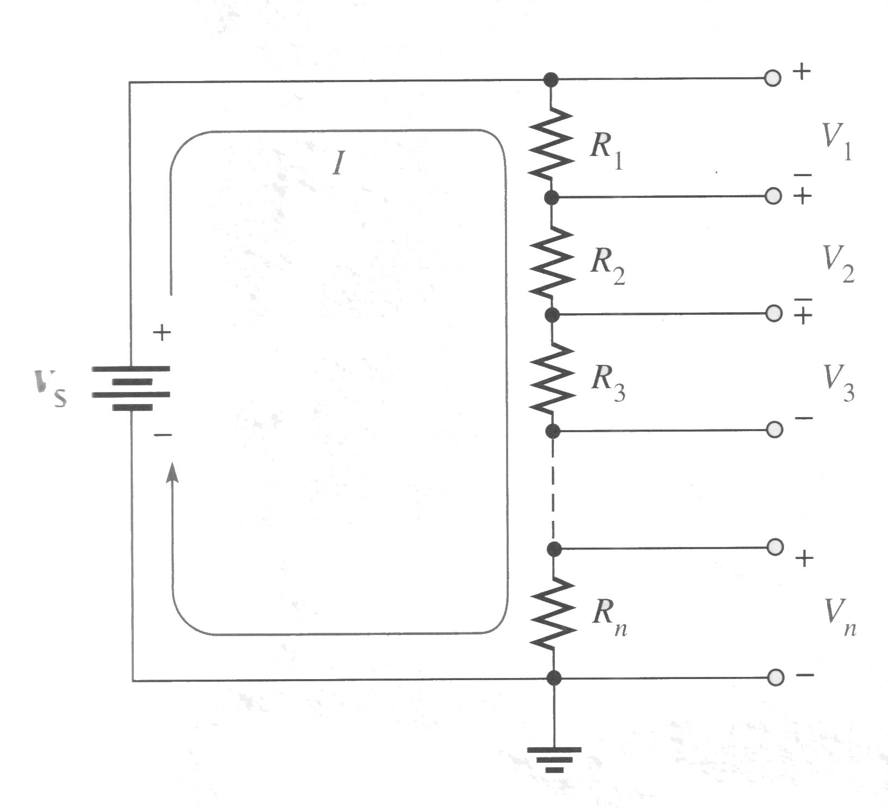
Voltage Divider Formula
Assume a circuit with n resistors in series as shown in Figure where n can be any number.
Source: Rizzoni

Slide 6
Voltage Divider Formula
Let V_{x} represent the voltage drop across anyone of the resistors and R_{x} represent the number of a particular resistor or combination of resistors.
By Ohm's law, you can express voltage drop across R_{x} as follows:
V_{x} = IR_{x}

Slide 7
Voltage Divider Formula
The current through the circuit is equal to the source voltage divided by the total resistance (I= V_{s}/R_{T}). In the circuit of Figure, the total resistance is R₁+R₂+R₃ + ... + R_{n}.
By substitution of V_{s}/R_{T} for I in the expression for V_{x},
V_{x}=(V_{s}/R_{T})R_{x}

Slide 8
Voltage Divider Formula
Rearranging the terms, you wil get,
V_{x}=(R_{x}/R_{T})V_{s}

Slide 9
Voltage Divider by Definition
Therefore,
“The voltage drop across any resistor or combination of resistors in a series circuit is equal to the ratio of that resistance value to the total resistance, multiplied by the source voltage.”

Slide 10
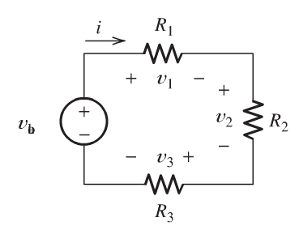
Example – Voltage Divider Problem
Source: Rizzoni

Slide 11
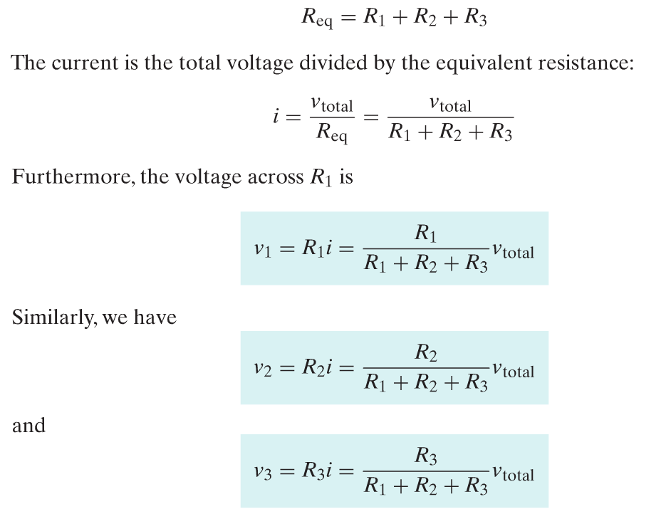
Example – Voltage Divider Problem (Solution)
Source: Rizzoni

Slide 12
Example 2
Source: Rizzoni

Slide 13
Solution for Example 2
Source: Rizzoni

Slide 14
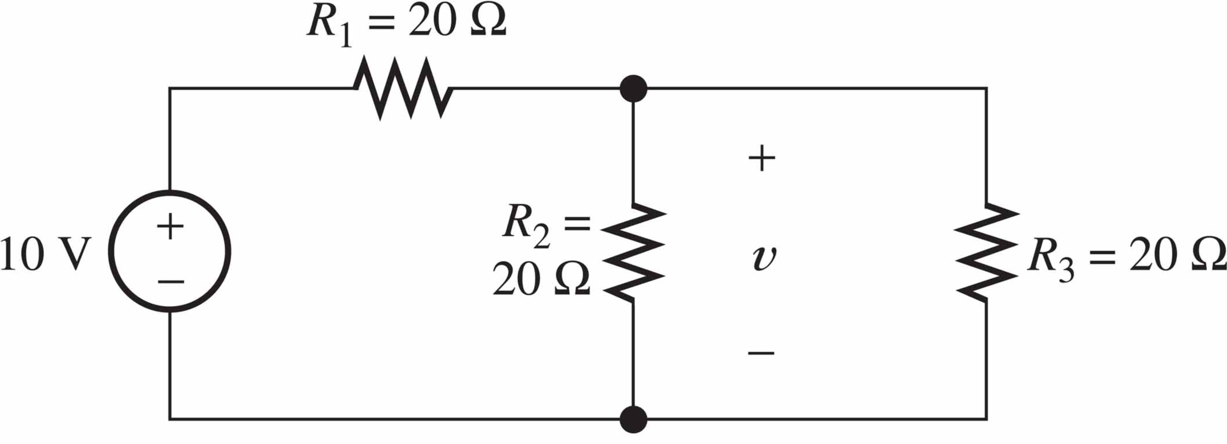
Exercise 1
use the voltage-division principle to calculate v
Source: Rizzoni

Slide 15
Exercise 2
A source supplies 120V to the series combination of a 10 Ohm Resistance, a 8 Ohm Resistance, and an unknown resistance Rx. The voltage across the 8 Ohm Resistance is 20 V. Determine the value of the unknown resistance.

Slide 16
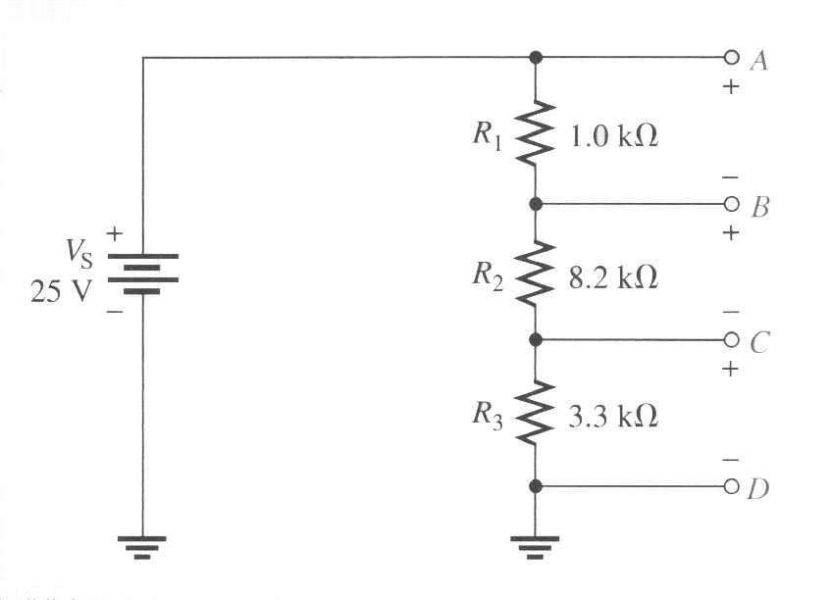
Exercise 3
Determine the voltage between the following points in the voltage divider of below circuit.
a) A to B
b) A to C
c) B to C
d) B to D
e) C to D
Source: Rizzoni

Slide 17
Current Divider
In a parallel circuit, the total current into the junction of the parallel branches divides among the branches. Thus, a parallel circuit acts as a current divider. This current-divide principle is illustrated in next Figure for a two-branch parallel circuit in which part of the total current I_{T} goes through R₁ and part through R₂.

Slide 18
Example
Source: Rizzoni

Slide 19
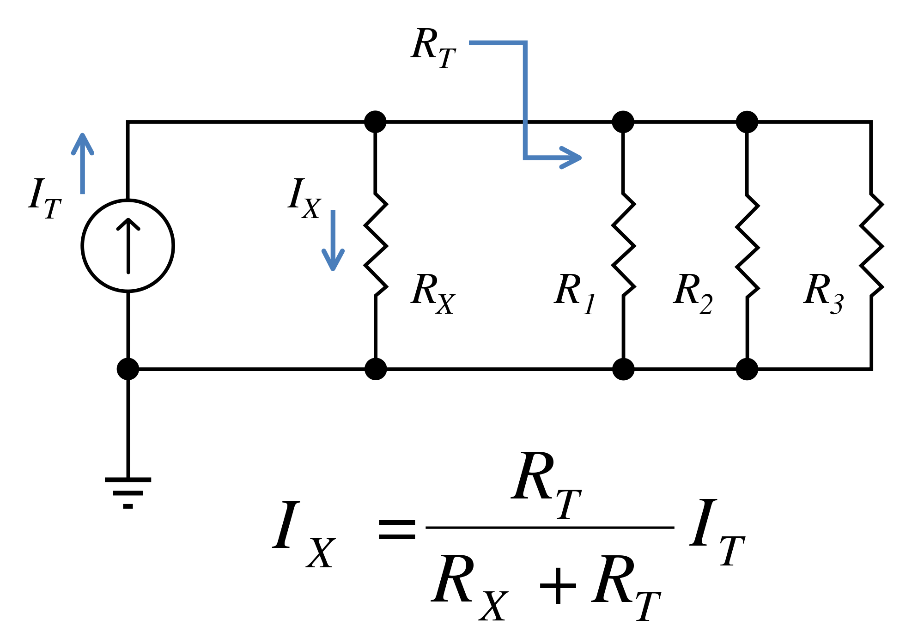
Current Divider Formula
Source: https://commons.wikimedia.org/wiki/File:Current_division_example.svg

Slide 20
Current Divider Formula
The current through any one of the parallel resistors is I_{x}, where x represents the number of a particular resistor (l, 2, 3, and so on).
By Ohm's law, you can express the current through any one resistors in previous Figure as follows:
I_{x}=(V_{s}/R_{x})

Slide 21
Current Divider Formula
The source voltage, Vs, appears across each of the parallel resistors, and R_{x} represents any one of the parallel resistors. The total source voltage, Vs, is equal to the total current times the total parallel resistance.
V_{s}=I_{T}.R_{T}

Slide 22
Current Divider Formula
Substituting I_{T}R_{T} for V_{s} in the expression for I_{x} results in
I_{x}=(I_{T}R_{T})/R_{x}
Rearranging the formula,
I_{x}=(R_{T}/R_{x}).I_{T}
where x = 1,2,3, etc.

Slide 23
Current Divider Definition
Therefore,
“The current (I_{x}) through any branch equals the total parallel resistance (R_{T}) divided by the resistance (R_{x}) of that branch, and then multiplied by the total current (I_{T}) into the junction of parallel branches. “

Slide 24
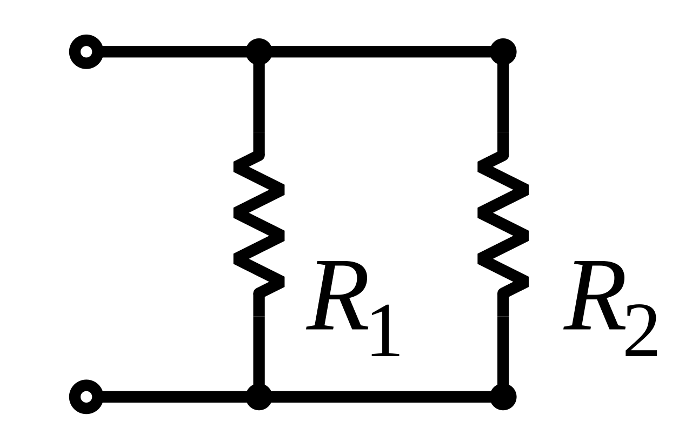
Example
Source: https://commons.wikimedia.org/wiki/File:Two_Resistors_in_Parallel.svg

Slide 25
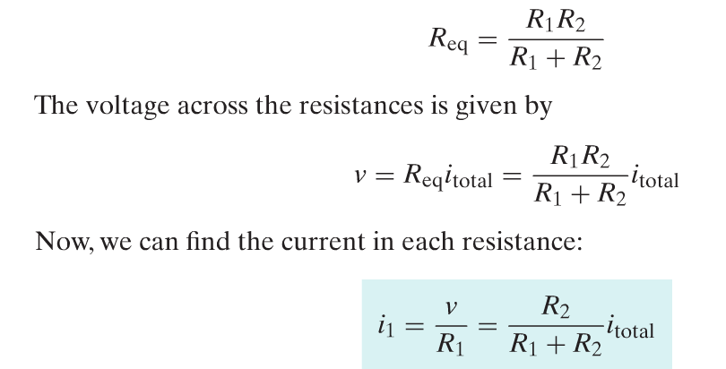
Solution
Source: Rizzoni

Slide 26
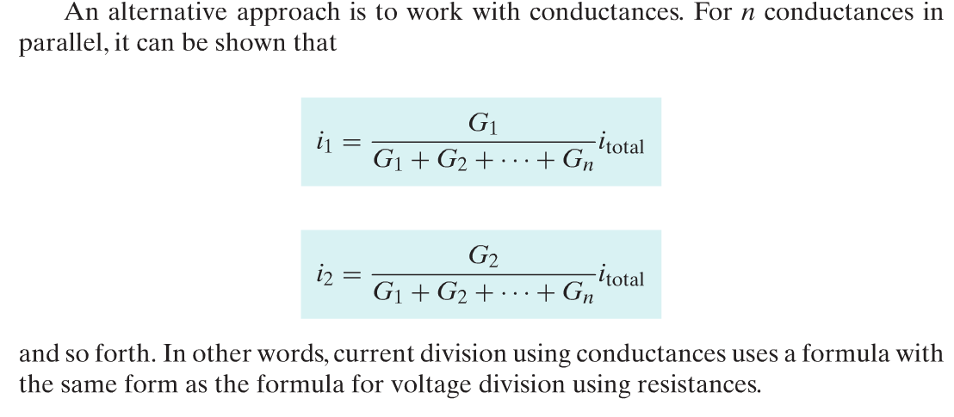
Conductance in Parallel
Source: Rizzoni

Slide 27
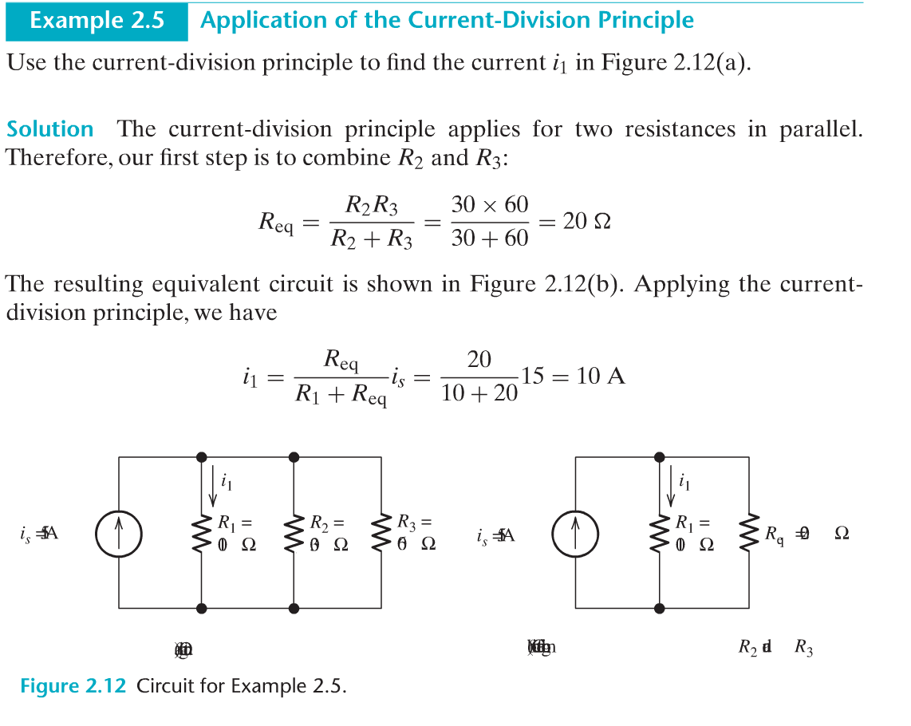
Example
Source: Rizzoni

Slide 28
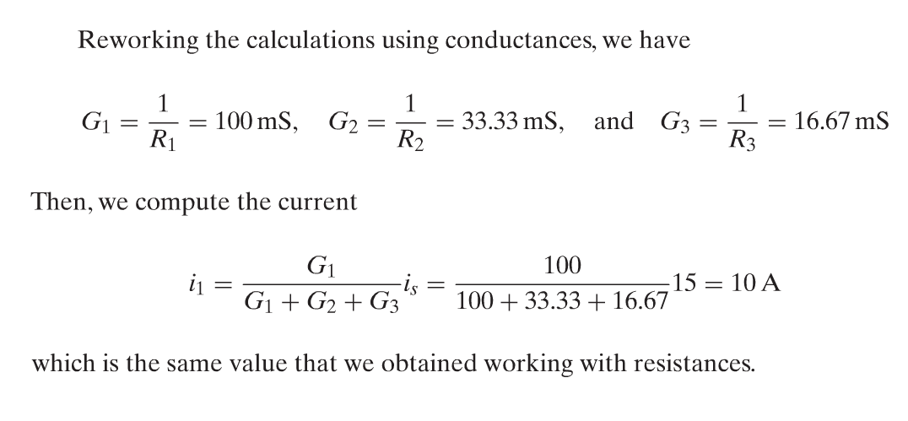
Solution
Source: Rizzoni

Slide 29
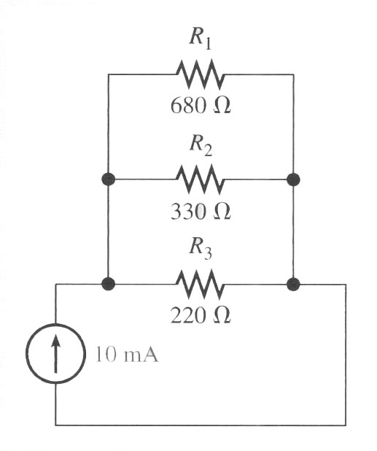
Determine the current through each resistor in the circuit of below Figure.
Source: Rizzoni

Slide 30
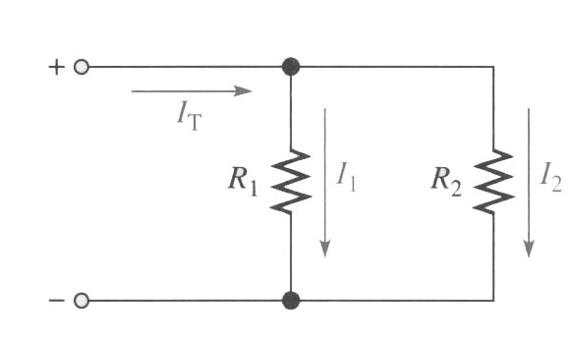
R_{T}=(R₁R₂)/(R₁+R₂)
Source: Rizzoni

Slide 31
Current Divider Other Formula – for 2 resistors only
Using the general current divider formula, the formula for I₁ and I₂ can be written as;
I₁= (R_{T}/R₁)I_{T}
and
I₂= (R_{T}/R₂)I_{T}

Slide 32
Current Divider Other Formula – for 2 resistors only
substitute R_{T} in above formulas, we will obtain current-divider formulas for the special case of two branches, which are;
I₁= (( R₂/(R₁+R₂)) I_{T}
and
I₂= (( R₁/(R₁+R₂)) I_{T}

Slide 33
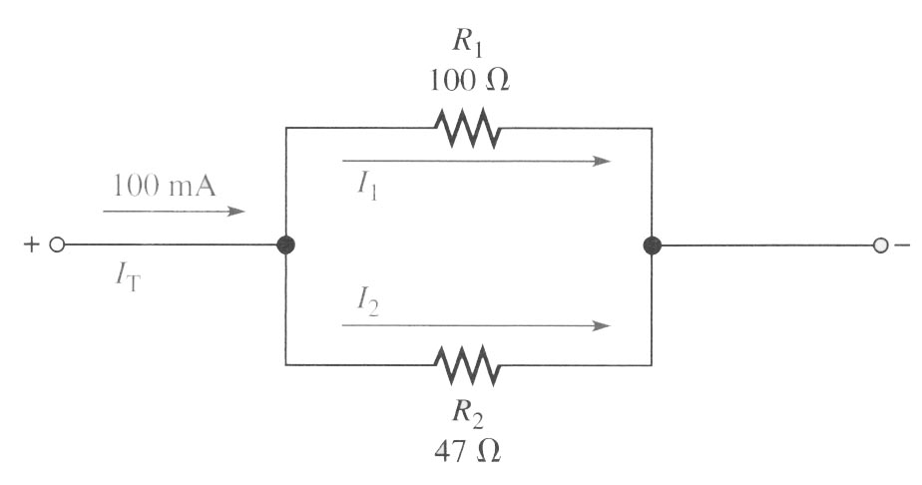
Exercise
Find I₁ and I₂,
Source: Rizzoni

Slide 34
Conclusion of The Chapter
Conclusion #1
Voltage divider is represented by a series circuit.
Current divider is represented by a parallel circuit.

Slide 35
Akhtar Razali FKM, UMP.

