Slide 1
Computer Programming Chapter 2: Print & Read data
by
Mohd Jamil Mohamed Mokhtarudin Faculty of Mechanical Engineering mohdjamil@ump.edu.my

Slide 2
Chapter Description
Aims
To display data in C
To read data from input
Expected Outcomes
Gain understanding of the print and read in C

Slide 3
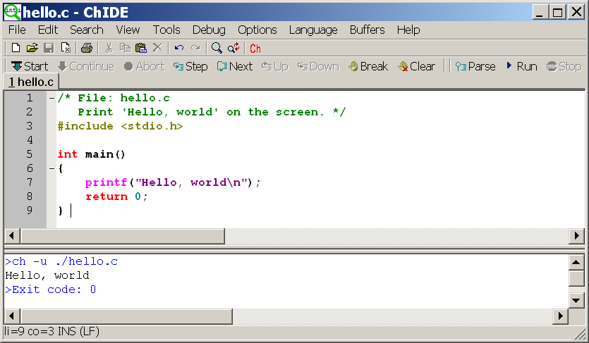
Still remember?
Still remember??

Slide 4
Print and Read
It is a common task in programming to print and read
Purposes:
Print → to display something from the program (eg: results, calculations, “error” and “non-error” states)
Read → to allow user to key-in something from input (eg: keyboard, mouse)

Slide 5
Print and Read
In C, printf() and scanf() functions are used to print and read
Can you find out what are the functions to print and read in C++ and FORTRAN?

Slide 6
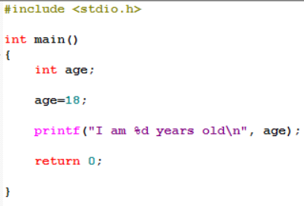
Example 1: printf()

Slide 7
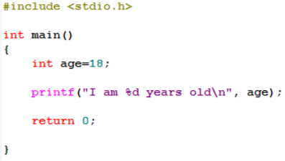
We can rewrite it!

Slide 8
Example 2: Different data types

Slide 9
Example 3: Arithmetic operations

Slide 10
Example 4: Division and Modulo
Note:
Divison – because of “int”, only whole number is produced
Modulo – will give the remainder of the division
8 divided by 2 equals 3 with remainder 2

Slide 11
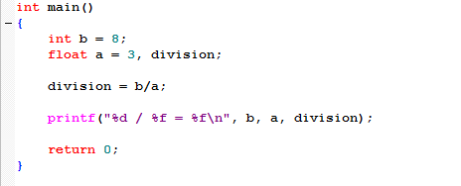
Example 5: Data Type Float

Slide 12
Example 6: Decimal Places
Note:
Number of decimal places depends on the number (i.e. 3 and 5) put in front of ‘f’.

Slide 13
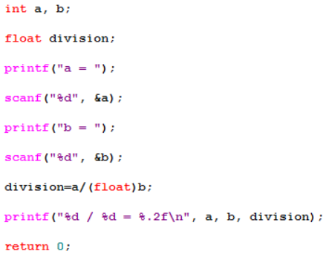
scanf()
Allow user to key-in something into the program
a = (7+ENTER)
a = 7
b = (5+ENTER)
IMPORTANT!! Must put & symbol for scanf()
a = 7
b = 5
7 / 5 = 1.40

Slide 14
Conclusion of The Chapter
Hope you know now how to print and read data using C.

