Slide 1
IMAGE PROCESSING INTRODUCTION TO DIGITAL IMAGE PROCESSING
By
DR. FERDA ERNAWAN
Faculty of Computer Systems & Software Engineering ferda@ump.edu.my

Slide 2
Today’s Lecture
This lecture will cover:
Digital Image
Image Types
Image Processing Applications
Image Processing Procedures
Learning Outcomes:
To introduce digital image processing.
Expose with image processing application.
Familiar with image processing methodology

Slide 3
Image Processing
A digital image consists of pixel values that represents the brightness. In order to convert an analog image into a digital image, sampling and quantization process are required in digitalization which illustrate as follows:
Images taken from Gonzalez and Woods, 2016
Analog Image
Sampling
Quantization
Digital Image
Digital image from analog image

Slide 4
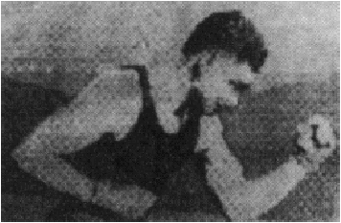
Origin of image Processing
Media industry (1921):
Digital images were transmitted through undersea cables, and then printed by telegram printers.
Images taken from Gonzalez and Woods, 2016

Slide 5
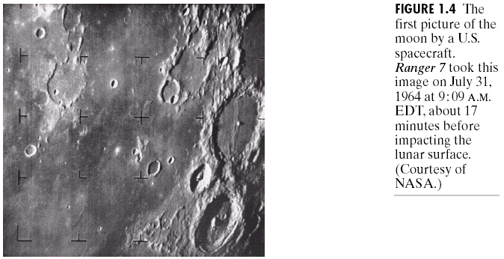
Soar Into Outer Space
Taken by space probe in 1964 Picture made with a1964. Picture made with a television camera (vidicon), transmitted to the earth by analog modulation, and digitized on the ground.
Images taken from Gonzalez and Woods, 2016
Moon picture by US spacecraft

Slide 6
Image Types
Digital images are categories as follows (Jayaraman, Veerakumar, Esakkirajan, 2017):
Binary image
Grayscale image
Color image
False-color image or Pseudo-color image
Multi-spectral image
Thematic image
Video Image

Slide 7
Image Types
Binary image
An image has only two possible pixel values, 0 or 1.
Grayscale image
Grayscale image is typically stored with 8-bits per pixel, which allows 256 intensities.
Thematic image
Image products of classification processing of multispectral image of any terrain.
Video image
a three-dimensional generalization of still images, where third dimension is time.

Slide 8
Image Types
Color image
A digital image that includes color informations for each pixel.
False-color image
An image derived from mapping each pixel value to a color image based on a table or function.
Multi-spectral image
An image of the same object (earth or planetary surface), taken in different bands of visible of electromagnetic spectrum

Slide 9
Image Processing Applications

Slide 10
Medical Images
Images taken from Gonzalez and Woods, 2016
Heart Image
Edge Detection

Slide 11
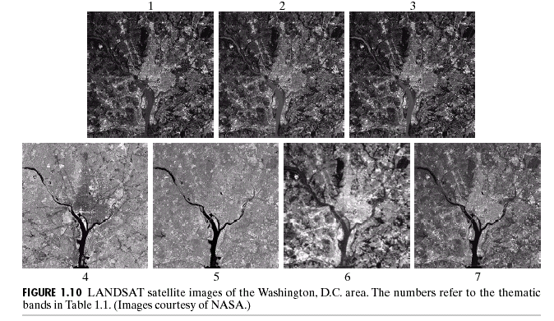
Multispectral Satellite
Images taken from Gonzalez and Woods, 2016
LANDSAT satellite images of the Washington DC area
(Image courtesy of NASA)

Slide 12
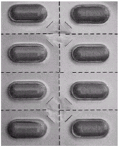
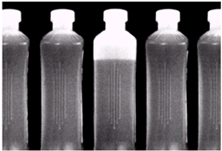
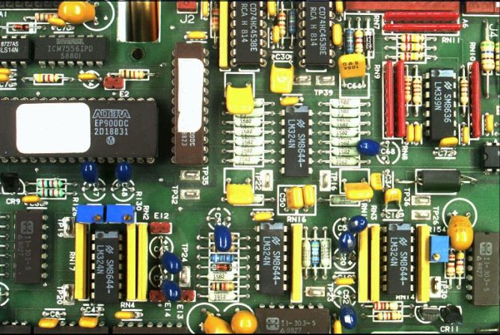
Image Processing in Manufacturing
Images taken from Gonzalez and Woods, 2016
a
b
c
Some examples of image processing in manufacturing (a) Packaged pills (b) Bottles (c) A circuit board

Slide 13
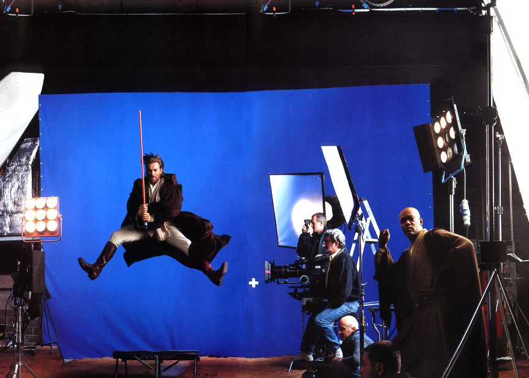
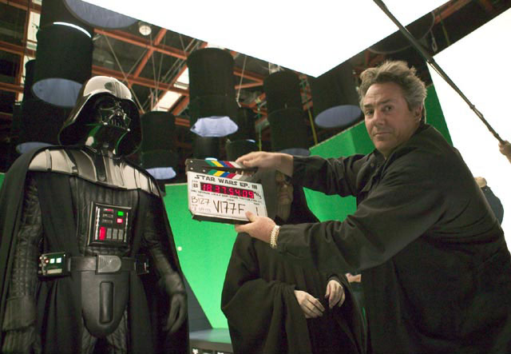
Motion Pictures

Slide 14
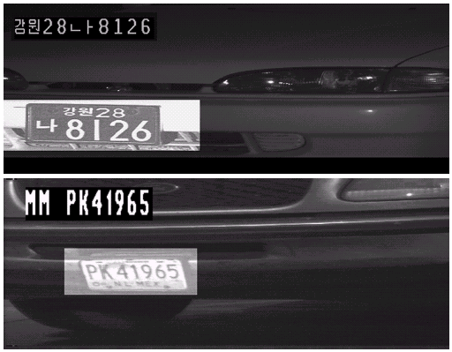
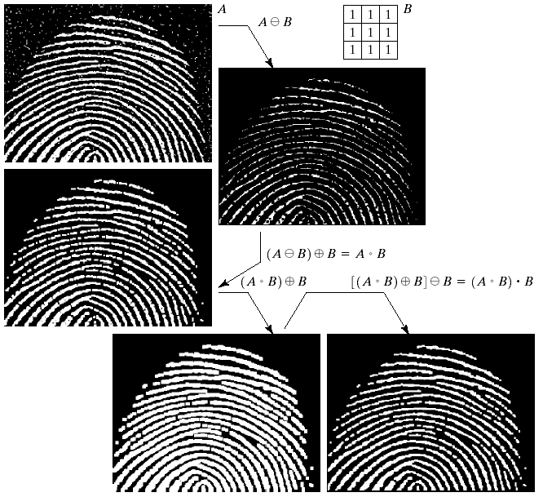
Law Enhancement and Biometrics
Automated toll systems using plate recognition
Plate detection for speed cameras
Video surveillance
Enhancement security using fingerprint

Slide 15
Remote Sensing
Images taken from Gonzalez and Woods, 2016
Hurricane Andrew taken by NOAA GEOS

Slide 16
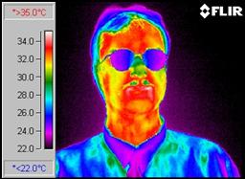
Beyond Visible of Thermal Images
Human body disperses heat (red pixels)

Slide 17
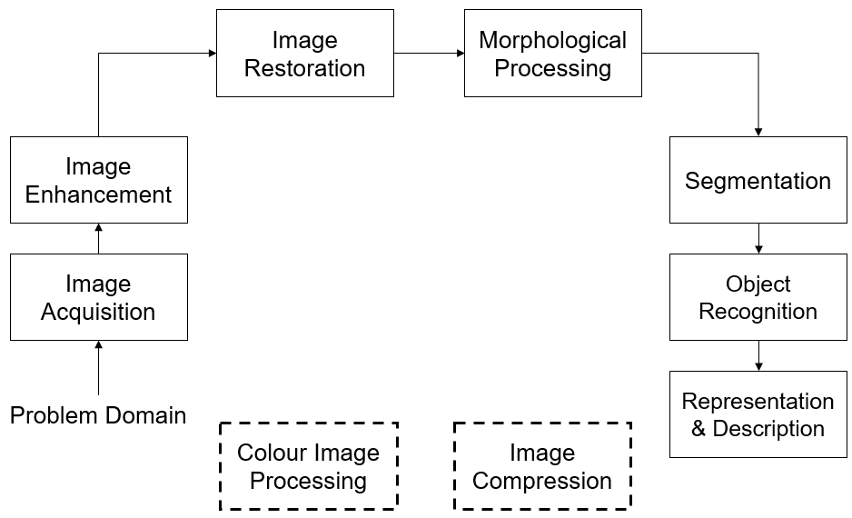
Image Processing Procedures
Images taken from Gonzalez and Woods, 2016

Slide 18
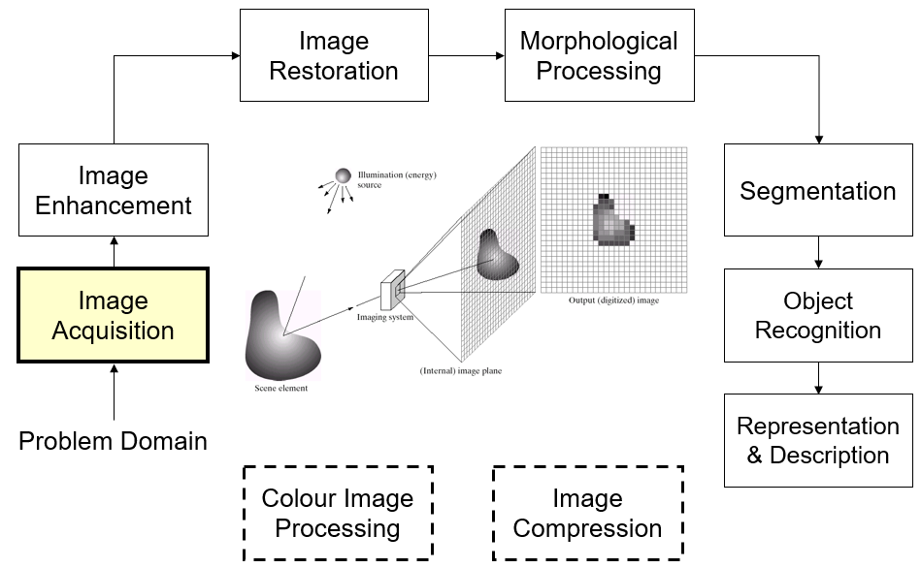
Image Aquisition
Images taken from Gonzalez and Woods, 2016

Slide 19
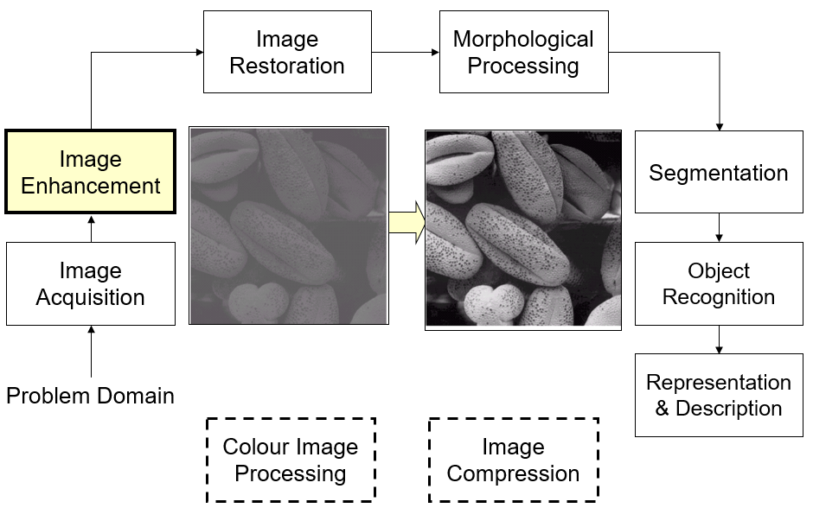
Image Enhancement
Images taken from Gonzalez and Woods, 2016

Slide 20
Image Restoration
Image Restoration
Morphological Processing
Image Enhancement
Segmentation
Images taken from Gonzalez and Woods, 2016
Image Acquisition
Object Recognition
Problem Domain
Representation & Description
Colour Image Processing
Image Compression

Slide 21
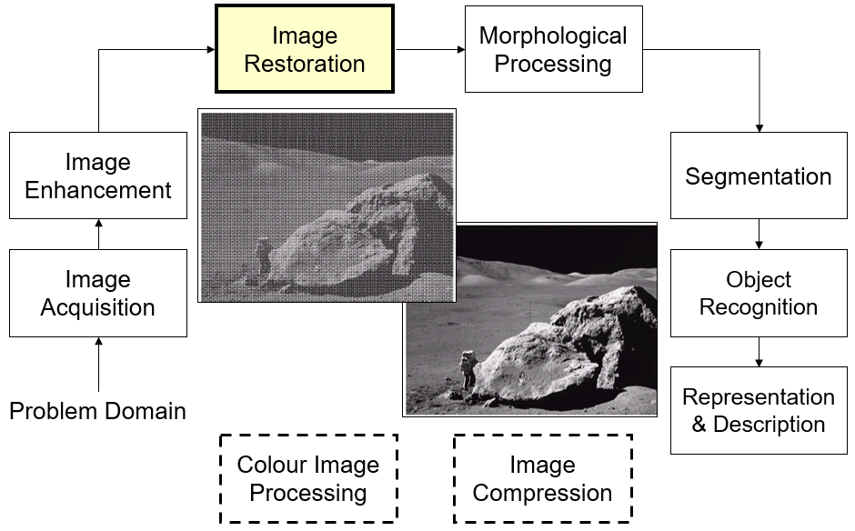
Image Restoration
Images taken from Gonzalez and Woods, 2016

Slide 22
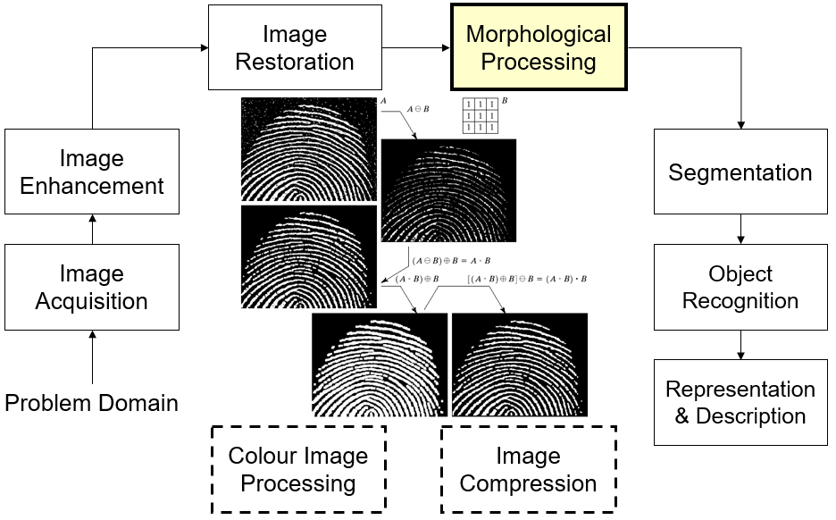
Morphological Processing
Images taken from Gonzalez and Woods, 2016

Slide 23
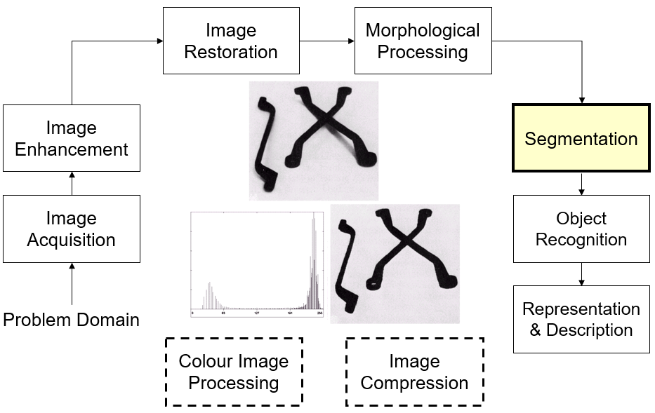
Segmentation
Images taken from Gonzalez and Woods, 2016

Slide 24
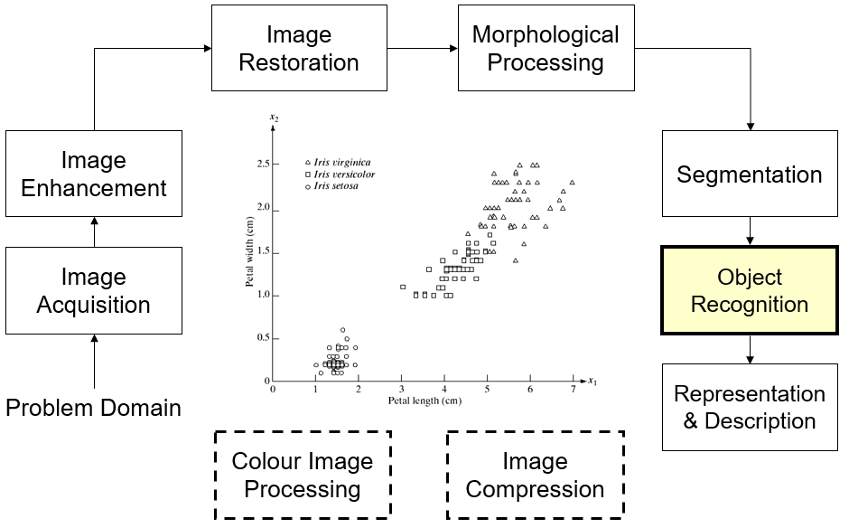
Object Recognition
Images taken from Gonzalez and Woods, 2016

Slide 25
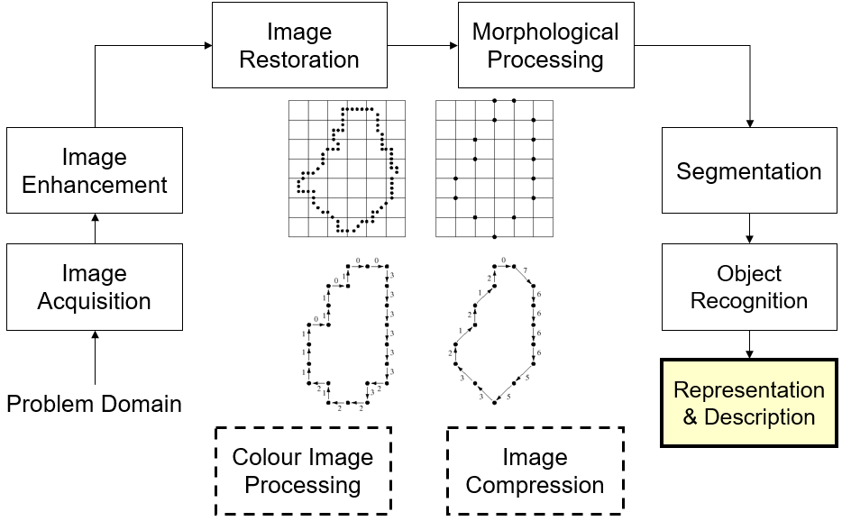
Representation & Description
Images taken from Gonzalez and Woods, 2016

Slide 26
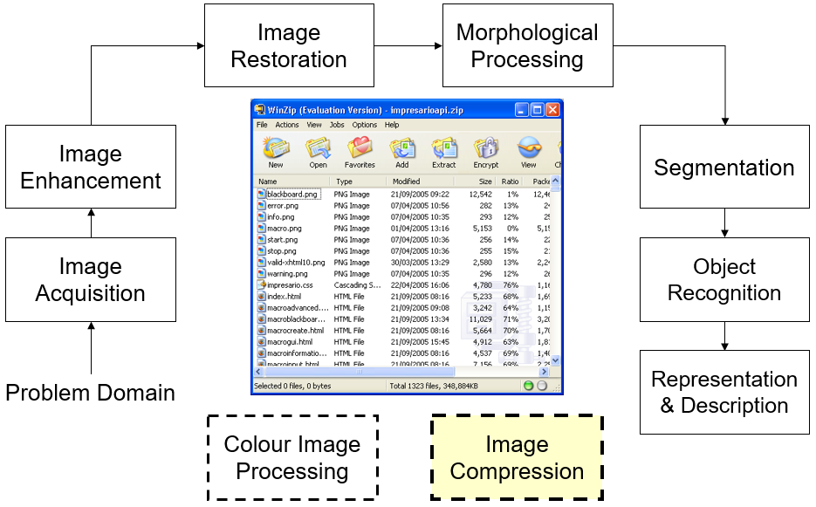
Image Compression
Images taken from Gonzalez and Woods, 2016

Slide 27
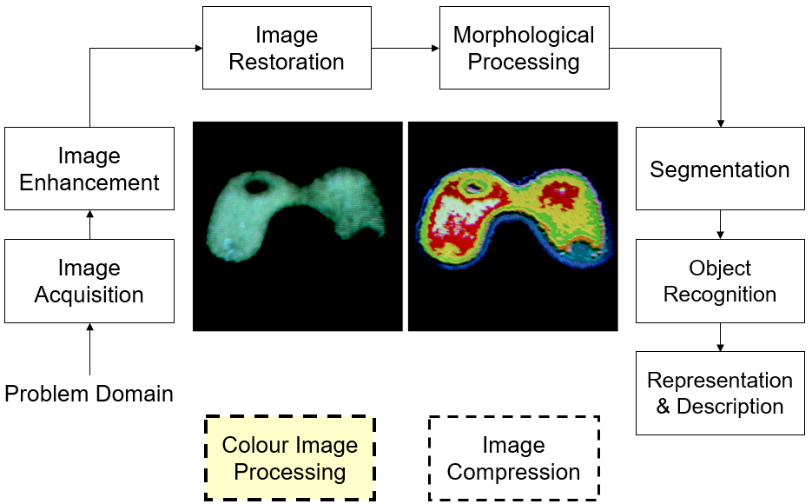
Colour Image Processing
Images taken from Gonzalez and Woods, 2016

Slide 28
References
R.C. Gonzalez and R.E. Woods, 2016. Digital Image Processing, Pearson Education India; Third edition.
A.K. Jain, 2015. Fundamentals of Digital Image Processing, Pearson Education India; First edition.
R.C. Gonzalez, R.E. Woods and S.L. Eddins, 2017. Digital Image Processing Using MATLAB. McGraw Hill Education; 2 edition.
S. Jayaraman, T. Veerakumar, S. Esakkirajan, 2017.Digital Image Processing, McGraw Hill Education; 1 edition.

