Slide 1
GEOTECHNICAL ENGINEERING Soil Compression, Consolidation and Settlement
For updated version, please click on
http://ocw.ump.edu.my
by
Dr. Amizatulhani Abdullah Faculty of Civil Engineering ad Earth Resources amizatulhani@ump.edu.my

Slide 2
Chapter description
Aims
This chapter provides further discussion and explanation related to soil consolidation and settlement.
Expected Outcomes
Understand the theory of consolidation.
References
Das, B.M., “Principles of Geotechnical Engineering, 5th edition”, Thomson Learning (2002).
Raj, P.P., “Soil Mechanics & Foundation Engineering”, Prentice Hall (2008).
Liu, C. & Evett, J.B., “Soils and Foundations, 7th edition”, Prentice Hall (2008).
Whitlow, R., “Basic Soil Mechanics”, Prentice Hall (2004).
Soil Compression, Consolidation and Settlement by Dr. Amizatulhani Abdullah

Slide 3
Content
Introduction
Types of settlement
Immediate settlement
Fundamental of consolidation (piston-spring model)
One dimensional consolidation test
Conclusion
Soil Compression, Consolidation and Settlement by Dr. Amizatulhani Abdullah

Slide 4
Introduction
Problems due to excessive settlement
1) Aesthetic view : the aesthetical value of the structure might spoiled due to presence of cracks or tilt of the structure caused by settlement.
2) Structure damage : the damages of some structure such as buildings and also utilities drains, pumps or electrical lines.
3) Structure failure : cause a structure to fail structurally and collapse.
Soil Compression, Consolidation and Settlement by Dr. Amizatulhani Abdullah

Slide 5
Types of settlement
Settlement
Immediate settlement
Primary consolidation settlement
Secondary consolidation settlement
+
+
Soil Compression, Consolidation and Settlement by Dr. Amizatulhani Abdullah

Slide 6
Immediate settlement
Caused by the elastic deformation of dry soil and of moist and saturated soils without any change in the moisture content in the soil.
Usually occurred immediately after load is imposed.
Completed quickly.
Constitutes a relatively small amount of total settlement.
Soil Compression, Consolidation and Settlement by Dr. Amizatulhani Abdullah

Slide 7
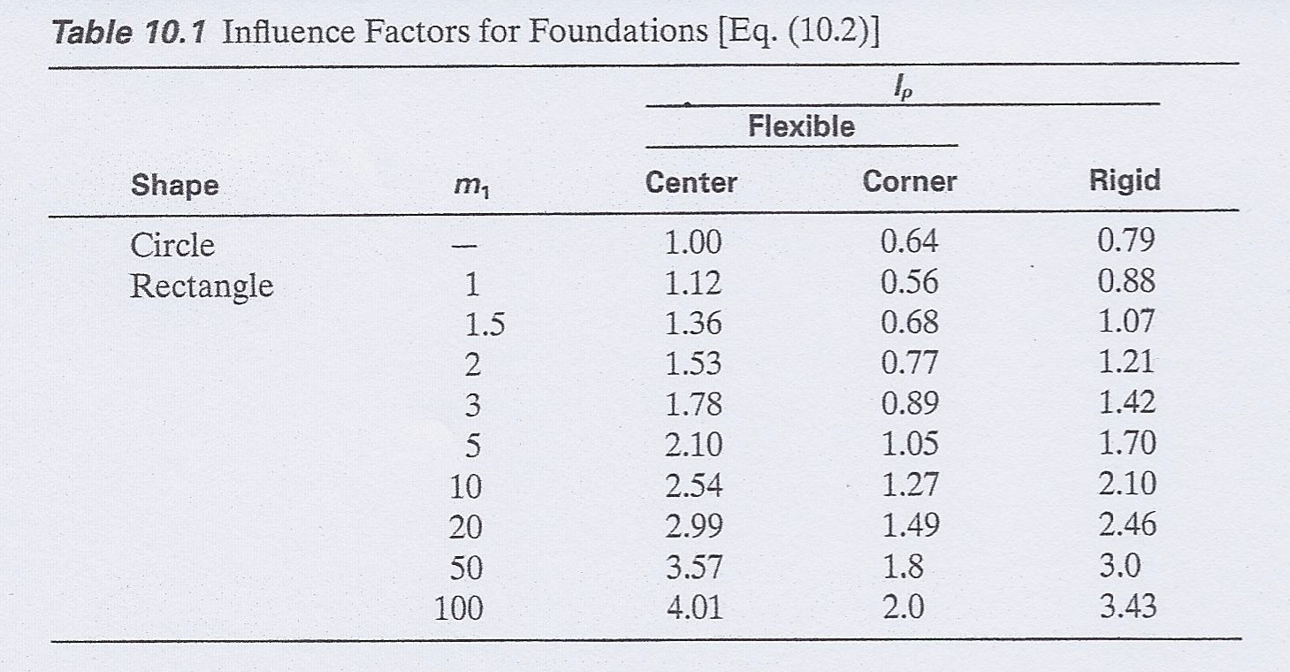
$$\frac{Length}{Width}$$
(Das, 2002)
Soil Compression, Consolidation and Settlement by Dr. Amizatulhani Abdullah

Slide 8
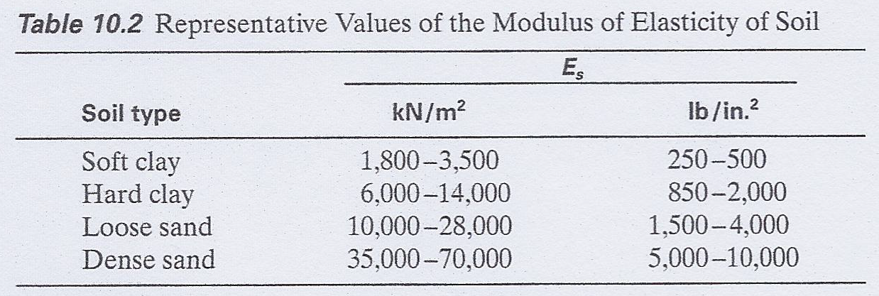
(Das, 2002)
Soil Compression, Consolidation and Settlement by Dr. Amizatulhani Abdullah

Slide 9
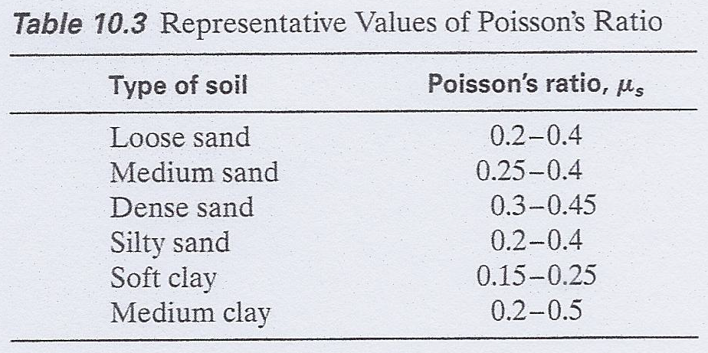
(Das, 2002)
Soil Compression, Consolidation and Settlement by Dr. Amizatulhani Abdullah

Slide 10
Example
Estimate the immediate settlement of a column footing 1.5m in diameter that is constructed on an unsaturated clay layer, given that the total carried by the column footing = 150kN, E_{s} = 7000kN/m² and μ_{s} = 0.25. Assume the footing to be rigid.
Soil Compression, Consolidation and Settlement by Dr. Amizatulhani Abdullah

Slide 11
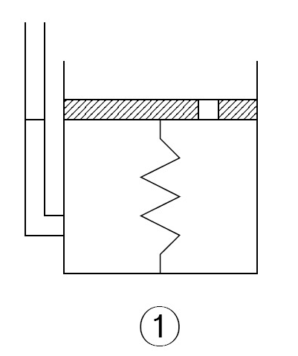
Fundamental of consolidation (piston-spring model)
in this analogy spring act as the soil skeleton.
while water act as the water in the soil.
the valve act as the void in the soil which effect the permeability of the soil.
Valve
Water
Spring
Soil Compression, Consolidation and Settlement by Dr. Amizatulhani Abdullah

Slide 12
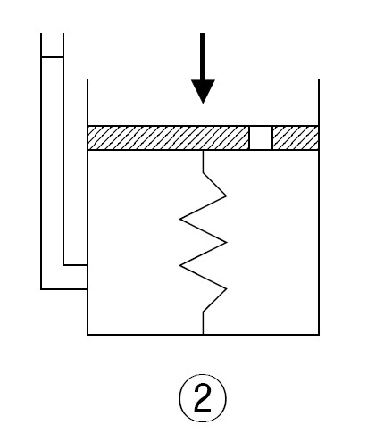
Condition 1
(if load is imposed while the valve is closed)
Spring will not move due to the incompressibility of water.
Therefore, no load transferred to spring because it was all carried by water.
This also called the undrained condition in soil.
Valve closed
Soil Compression, Consolidation and Settlement by Dr. Amizatulhani Abdullah

Slide 13
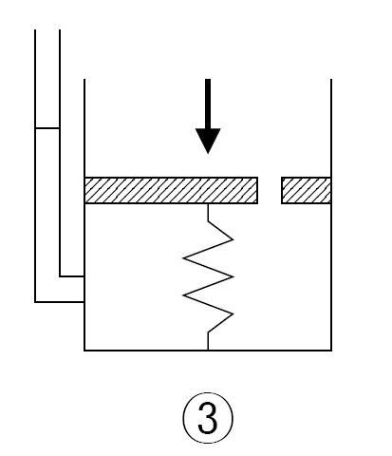
Condition 2
(if load is imposed while the valve is opened)
Water were forced to flow out through the valve.
The flow rate depend to the diameter of the hole/valve.
Some of the load carried by water while some were transferred to the spring.
The load increment to the spring depend to the decrease of pore water pressure.
Valve opened
Soil Compression, Consolidation and Settlement by Dr. Amizatulhani Abdullah

Slide 14
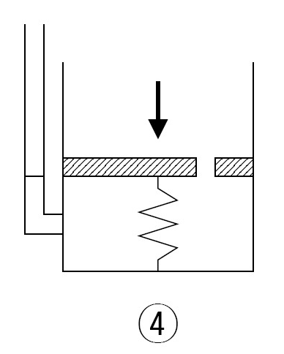
After all the water extruded, the load were totally carried by spring.
Deformation continue to occur until the spring reach the final condition.
This condition shows the drained condition in soil.
No more water inside
Soil Compression, Consolidation and Settlement by Dr. Amizatulhani Abdullah

Slide 15
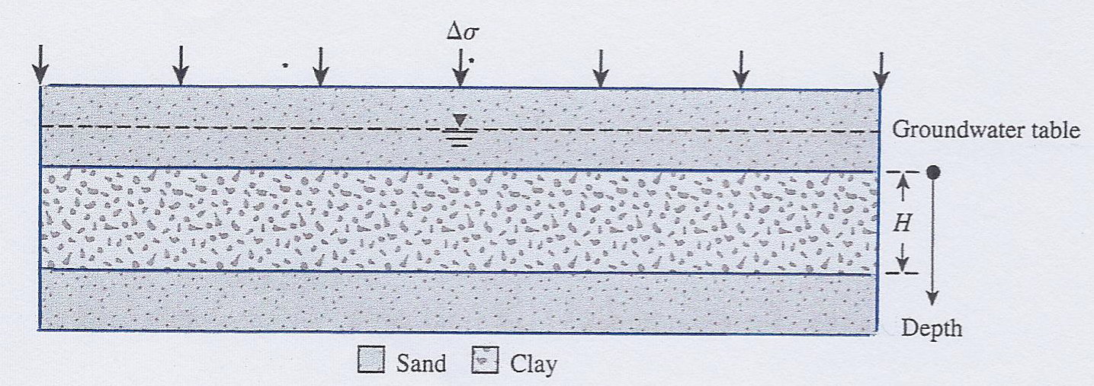
Variation of total stress, pore water pressure and effective stress in a clay layer drained at top and bottom as the result of an added stress
(Das, 2002)
Soil Compression, Consolidation and Settlement by Dr. Amizatulhani Abdullah

Slide 16
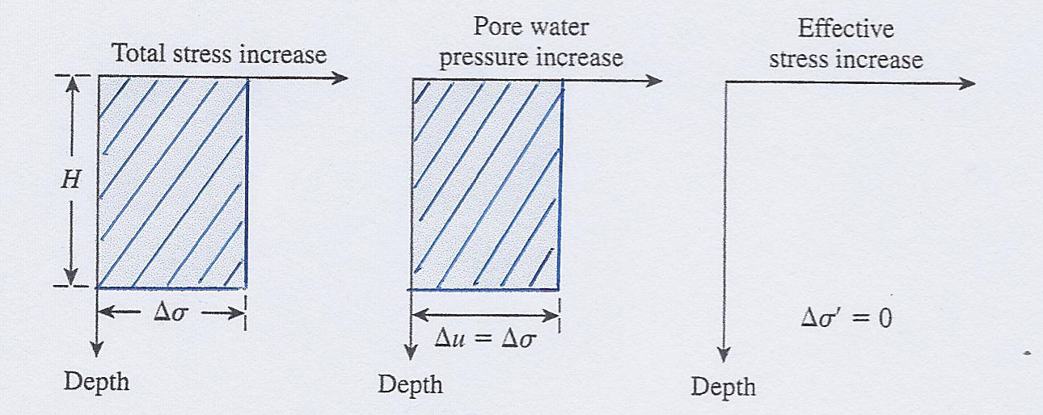
At t=0
(Das, 2002)
Soil Compression, Consolidation and Settlement by Dr. Amizatulhani Abdullah

Slide 17
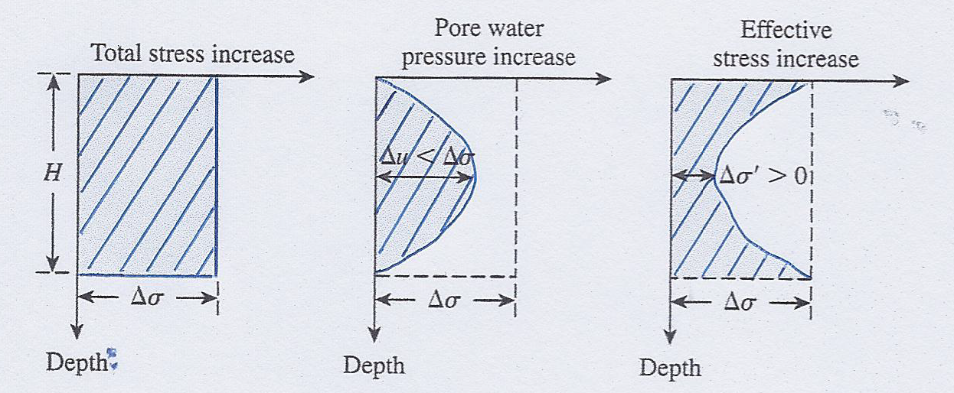
At 0 < t < ∞
(Das, 2002)
Soil Compression, Consolidation and Settlement by Dr. Amizatulhani Abdullah

Slide 18
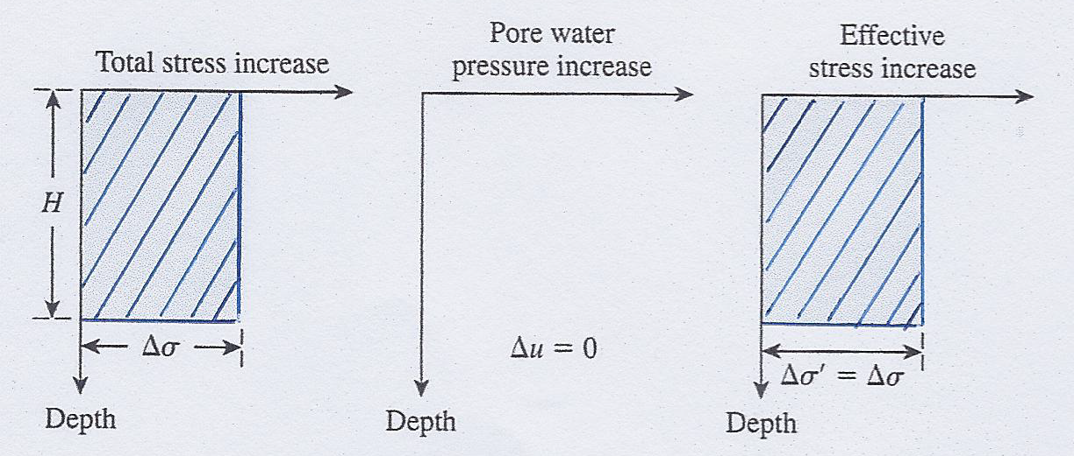
At t = ∞
(Das, 2002)
Soil Compression, Consolidation and Settlement by Dr. Amizatulhani Abdullah

Slide 19
One dimensional consolidation test
Oedometer test
Used to determine the compressibility characteristics of a saturated undisturbed or remolded soil.
Sample were collected from site.
Sample is placed in a metal ring.
Porous disk is placed above and beneath the sample (to allow water to flow vertically into and out of the soil sample).
The sample is immersed in water.
Soil Compression, Consolidation and Settlement by Dr. Amizatulhani Abdullah

Slide 20
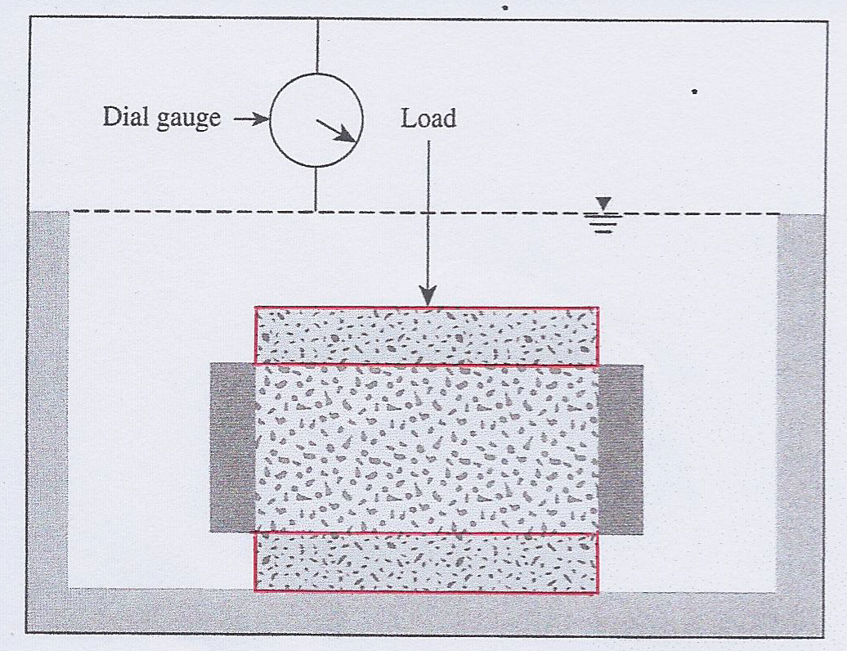
Specimen ring
Porous stone
Soil specimen
Porous stone
Schematic diagram of a consolidometer (Das, 2002)
Soil Compression, Consolidation and Settlement by Dr. Amizatulhani Abdullah

Slide 21
A specific load pressure is applied to the upper disk (the sample is compressed and deformation is measured by a dial gauge).
Dial readings and corresponding time observations are made and recorded until deformation has nearly ceased (normally 24 hour).
Graph is plotted.
The procedure will be repeated with the applied pressure doubled from the previous.
Soil Compression, Consolidation and Settlement by Dr. Amizatulhani Abdullah

Slide 22
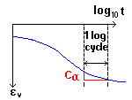
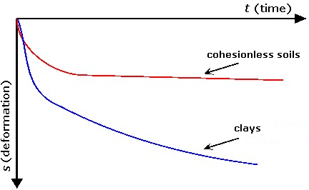
Typical result of an oedometer test
Time-deformation plot : graph with time along the abscissa (logarithmic scale) and dial readings along the ordinate (arithmetic scale).
Stage 1
Stage 2
Stage 3
Soil Compression, Consolidation and Settlement by Dr. Amizatulhani Abdullah

Slide 23
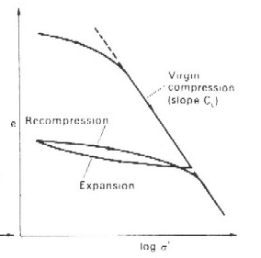
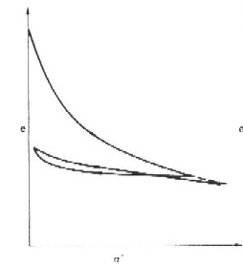
Pressure-void Ratio Curves : graph with pressure along the abscissa (logarithmic scale) and void ratio along the ordinate (arithmetic scale).
Compression curve
Rebound curve
Recompression curve
Soil Compression, Consolidation and Settlement by Dr. Amizatulhani Abdullah

Slide 24
Conclusion
Conclusion #1
Settlement of soil can be divided into three categories (immediate settlement, primary consolidation settlement, secondary consolidation settlement).
Conclusion #2
Fundamental on consolidation can be further explain using piston spring model.
Conclusion #3
One dimensional test or also known as oedometer test is a laboratory test to measure compressibility characteristics of soil.
Soil Compression, Consolidation and Settlement by Dr. Amizatulhani Abdullah

Slide 25
Author Information Dr. Amizatulhani Abdullah Dr. Mohd Yuhyi Mohd Tadza Dr. Youventharan Duraisamy Dr. Muzamir Hasan Ir. Azhani Zukri

