Slide 1
Power Plant Technology Combined Cycle and Renewable Energy Power Systems (Lecture 1)
by
Mohamad Firdaus Basrawi, Dr. (Eng) Mechanical Engineering Faculty mfirdausb@ump.edu.my

Slide 2
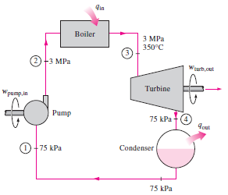
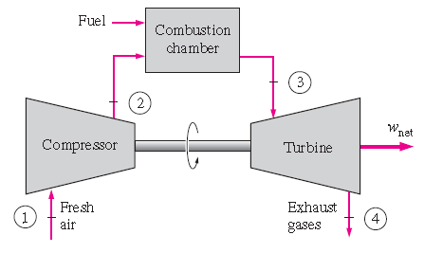
Combined cycle
Gas turbine has high temperature and mass flow rate at the exhaust stage.
Steam turbine has lower turbine inlet temperature.
A widely used combination is a gas turbine fuelled by natural gas or synthesis gas from coal, and a steam power plant.
This is called a Combined Cycle Gas Turbine (CCGT) plant.
CCGT can achieve a thermal efficiency of 60%. (a steam power plant is limited to around 35-42%).
Many new gas power plants are of this type.
T_{3,max}: 655ºC
T₃: 900-1400ºC
T₄: 450-650ºC

Slide 3
Advantages of combined cycle power plant
High overall plant efficiency
>50%
Low environmental impact
Very low NOx emissions, reduce 60% of CO2 emissions
Low investment cost
30% less than steam power plant per kW basis
Great operating flexibility
Based on Gas Cycle and Simple Steam Cycle makes it possible to start-up and shut-down the plants quickly.
Phased installation
Gas turbine can operate while steam turbine is under construction. This makes it possible to adjust the growth in demand for energy in a grid.

Slide 4
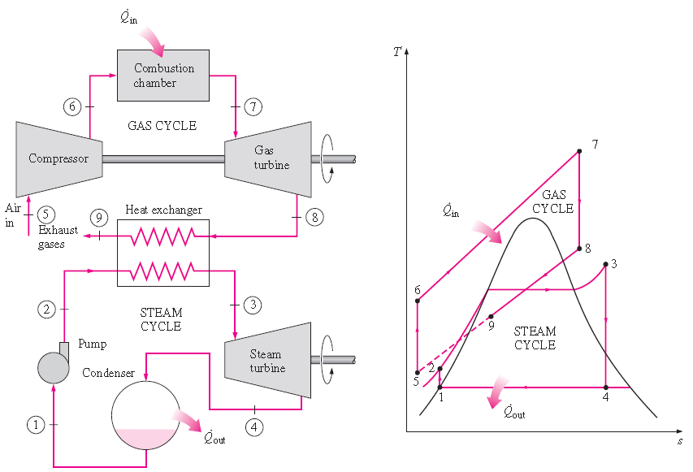
Brayton-Rankine Combined Cycle
(Combined Cycle Gas Turbine)
The topping plant operating on Bryton and the bottoming one operating on Rankine cycle.

Slide 5
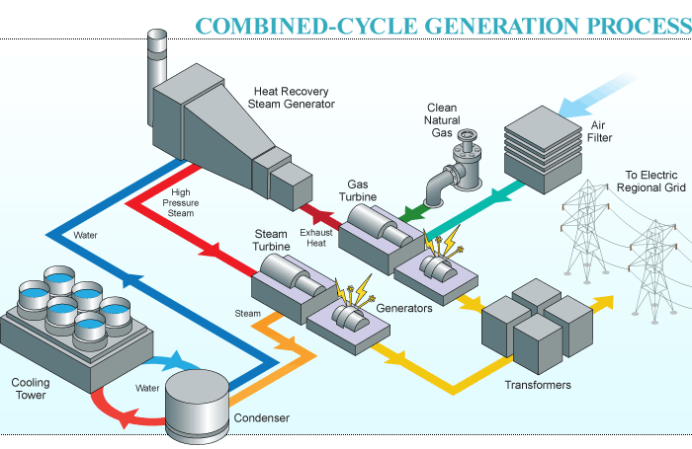
Not found
http://www.tenaskawestmorelandproject.com/howitworks.html

Slide 6
Integrated Gasification Combined Cycle (IGCC)
Coal is abundantly available in many countries.
However, coal based steam power plants emit large amount of pollutant.
Gasification technology is available to convert coal to synthetic gas (Syngas)
Since energy depletion and environmental problem became severe, many parties start to use syngas as a fuel for high efficiency CCGT.
It can increase thermal efficiency (energy), emit less emissions (environment), and save fuels and cheap coal can be used (economic).
This type of plant called IGCC. The plant called integrated because:
On-site produced syngas is used as a fuel for CCGT.
Steam produced by the syngas cooler is also used for steam turbine.

Slide 7
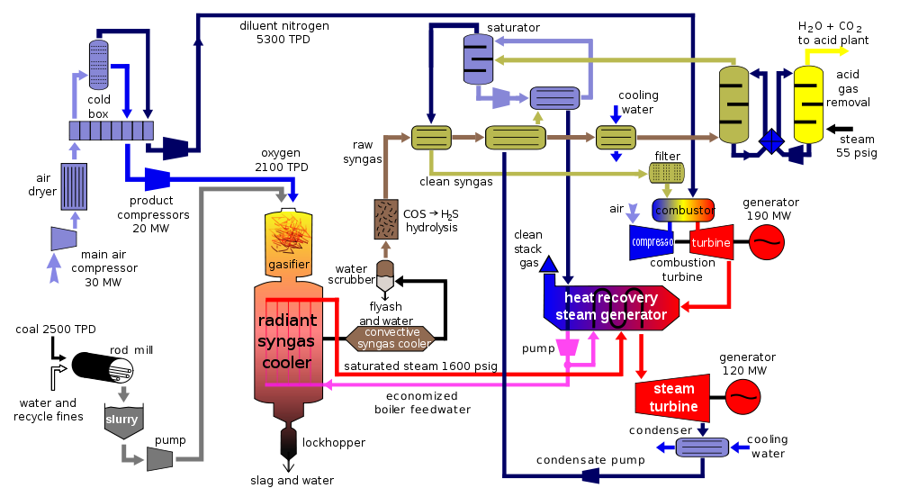
Purification
Edit arrow
Gasification
https://commons.wikimedia.org/wiki/File:IGCC_diagram.svg
Steam Turbine
Gas Turbine
Steam

Slide 8
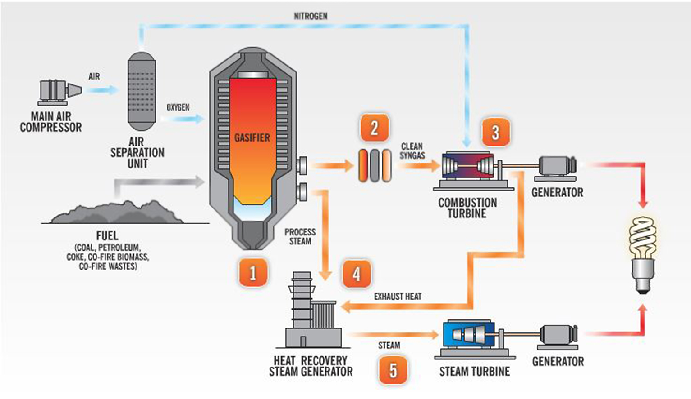
Integrated Gasification Combined Cycle (IGCC)
Power generation (Syngas+N₂)
This can reduce flame temperature and therefore thermal NOx can be reduced
Gas Purification Sulfer + Mercury is removed
Exhaust heat recovery
From Gasification and Gas Turbine
Not found
Gasification
Coal > CO+CO₂+H₂
Power Generation
http://www.ieefa.org/dukes-edwardsport-igcc-still-dealing-with-technical-problems/
http://www.duke-energy.com/about-us/how-igcc-works.asp

Slide 9
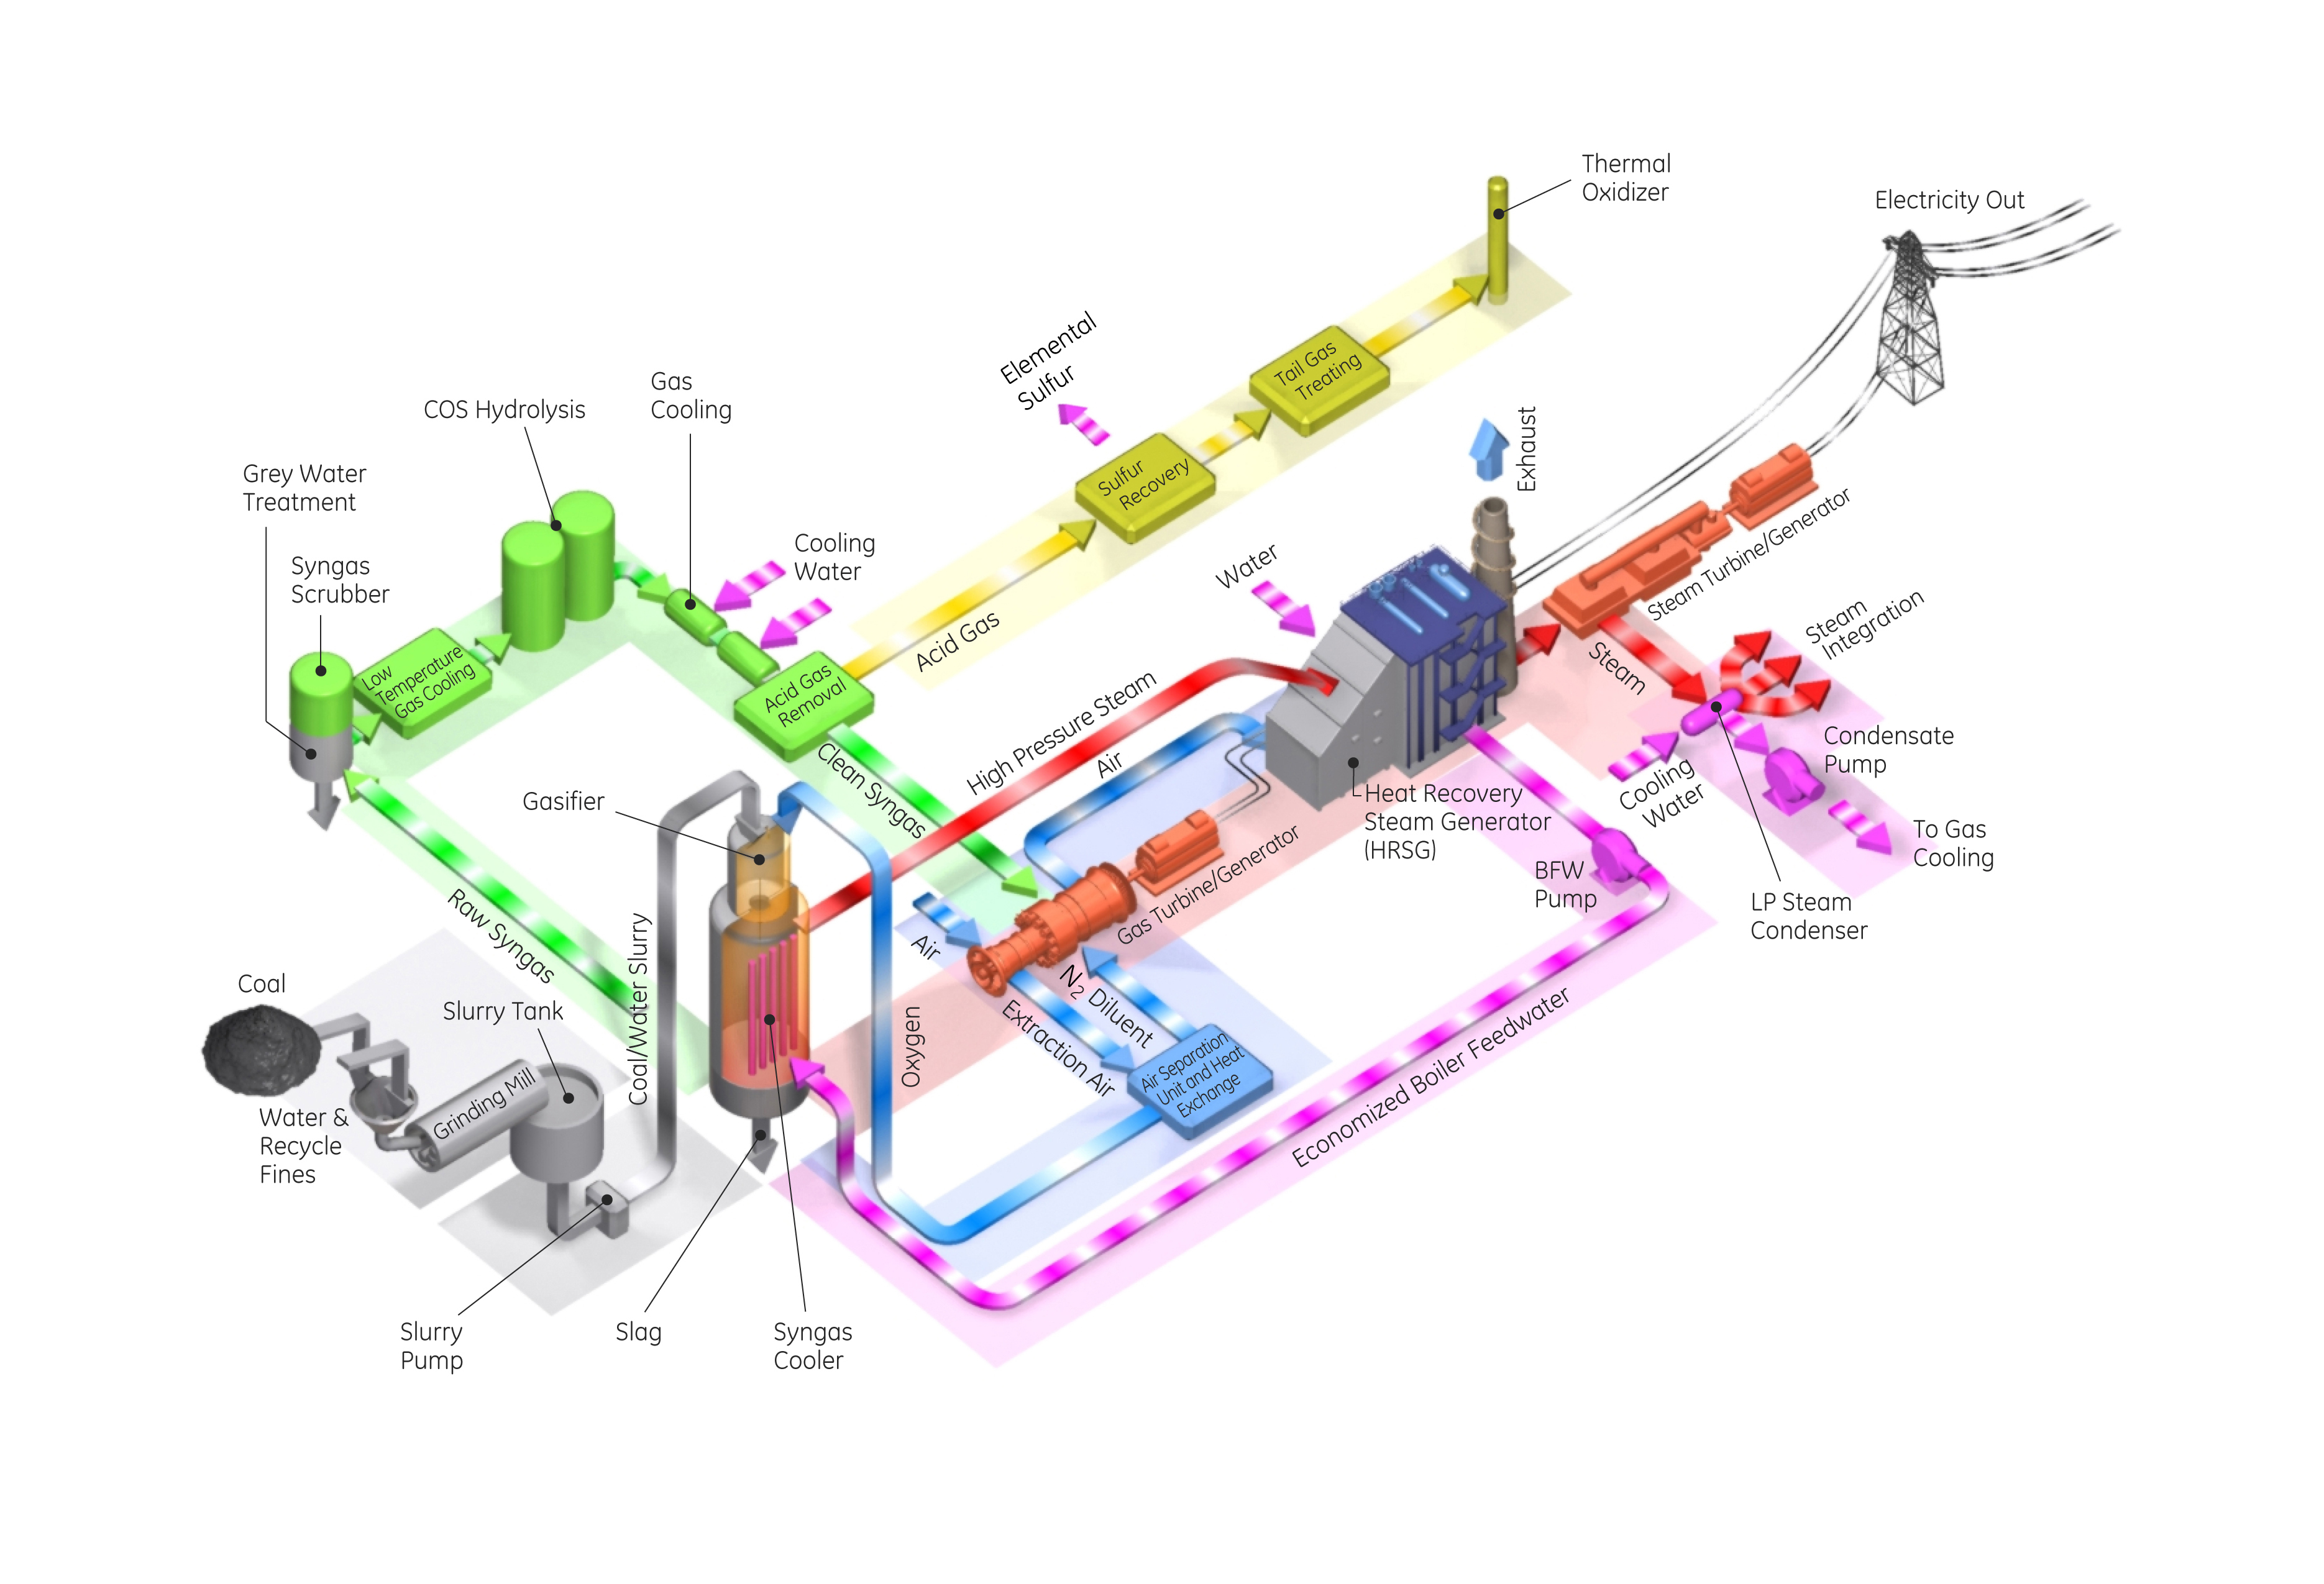
Not found

Slide 10
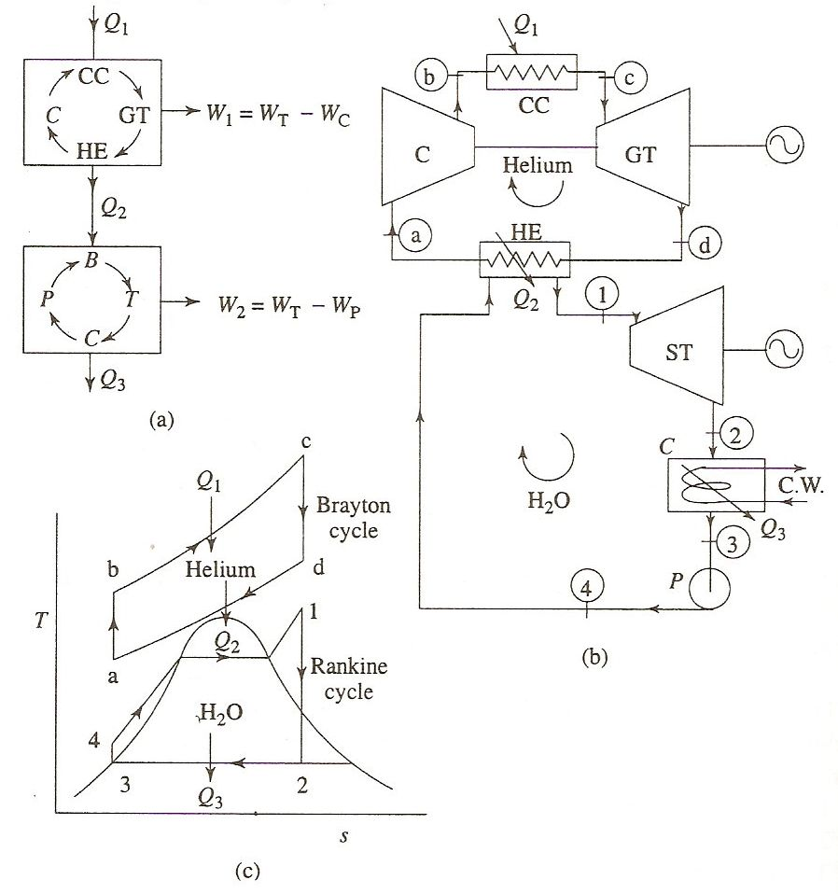
Efficiency of Combined Cycle power plant

Slide 11
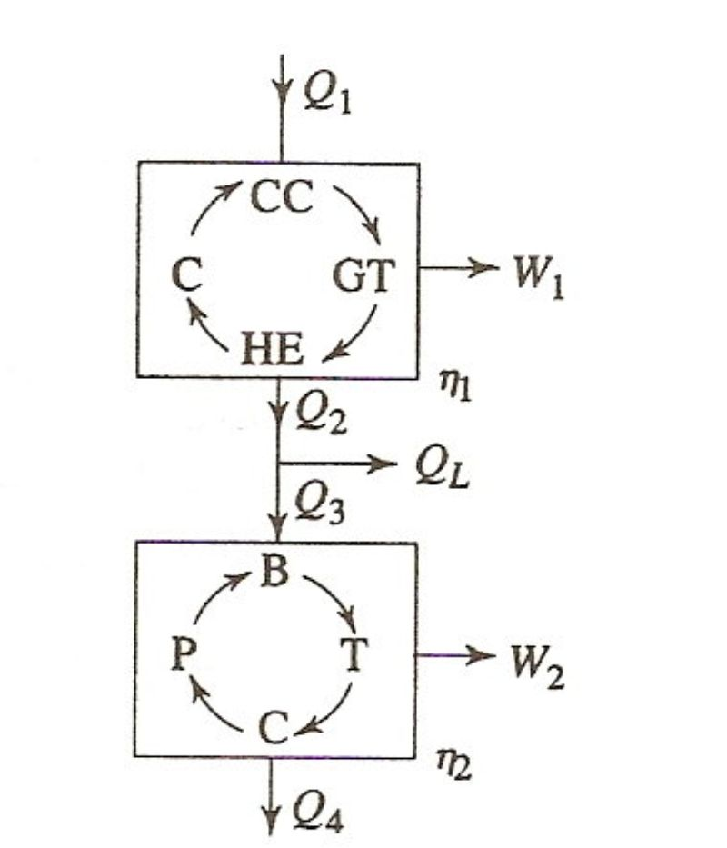
CC efficiency when heat loss at HRGS is considered
In actual cycle, there is always some heat loss and the heat absorbed is always less than the heat rejected.
The overall plant efficiency is
Heat loss
Therefore,
Heat loss in between two plants in series
x_{L} is fraction of the heat supplied which is lost (Q_{L}/Q₁)

Slide 12
The ratio of Q₃/Q₂ is the efficiency of the boiler in the bottoming plant, so that
Now,
Where x Is the overall efficiency of the bottoming plant

Slide 13
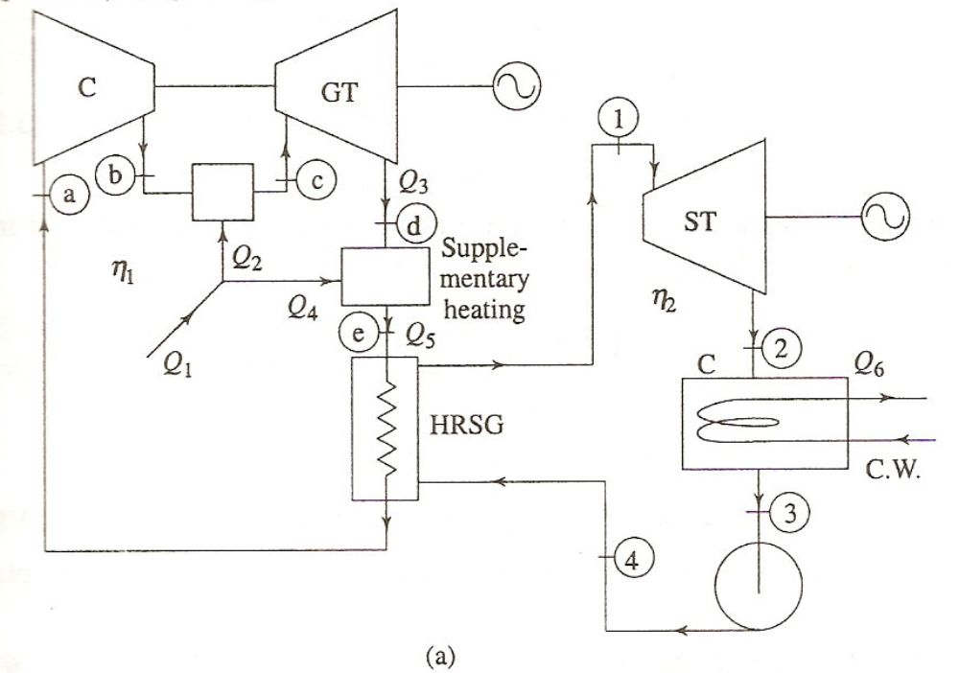
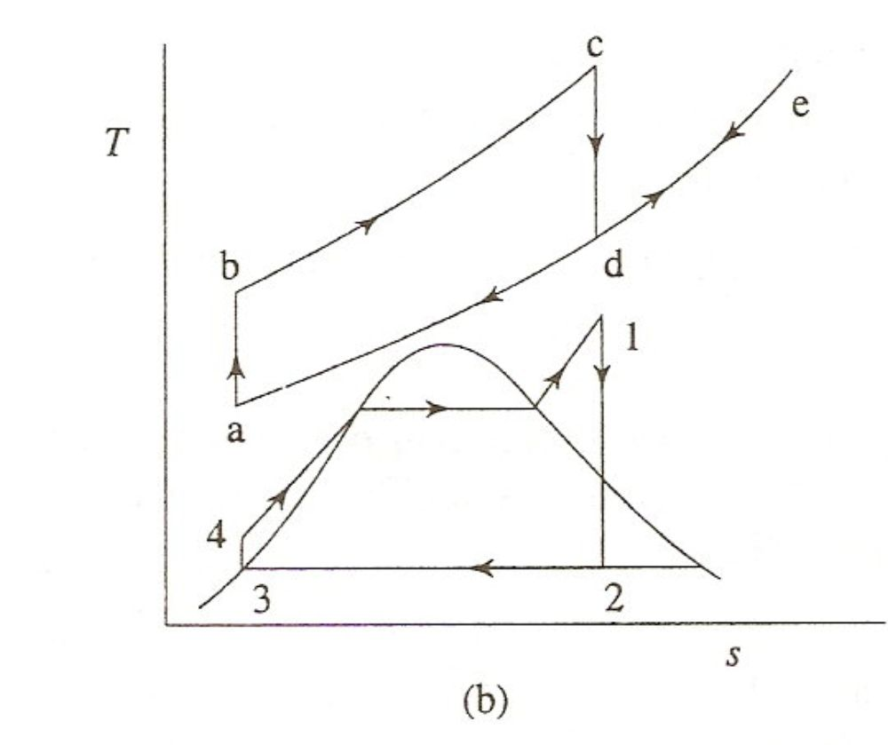
Series-parallel plants with two cyclic plants in series having supplementary firing
Brayton/Rankine cyclic plants with supplementary heating

Slide 14
Let the fraction of the total heat supplied that is used for supplementary heating be
(6)

Slide 15
Series-parallel plans with two cyclic plants in series having supplementary firing and heat loss between the two plants
Q_{L}
Brayton/Rankine cyclic plants with supplementary heating

Slide 16
Let X₂ and x_{L} be the fractions of heat supply (Q₁) which represent supplementary heat supply (Q₄) and heat loss to the surroundings (Q_{L}), respectively

Slide 17
which is the same as Eq. (3.8) derived earlier. It can also be expressed in a different way by defining the boiler efficiency
Therefore, from Eq. (3.13) the overall plant efficiency of the combined plant becomes

Slide 18
Example
A combined cycle gas turbine uses a simple gas turbine for topping cycle and simple rankine cycle for bottoming cycle. Atmospheric air enters the gas turbine at 101kPa and 20ºC, and the maximum gas cycle temperature is 1100ºC. The compressor ratio is 8 with isentropic efficiency of 85%. The turbine isentropic efficiency is 90%. The gas stream leaves the heat exchanger at the saturation temperature of the steam flowing through the heat exchanger. Steam flows through the heat exchanger with a pressure of 6MPa, and leaves at 320ºC. The steam cycle condenser operates at 20kPa, and the isentropic efficiency of the steam turbine is 90%. Determine the mass flow rate of air through the air compressor required for this system to produce 100MW of power. Use specific heat as 1.005kJ/kgK and specific heat ratio as 1.4.

Slide 19
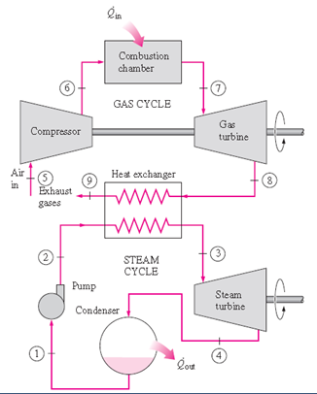
No heat losses at HE
c_{p}=1.005kJ/kg
k=1.4
T₇=1100ºC
W_{net}=100MW
From Net work relation
r_{C} =8
ƞ_{s,C} =85%
P₅=0.101MPa
From heat balance relation at heat exchanger
T₅=20ºC
P₂=P₃=6.0MPa
T₃=320ºC
ƞ_{s,T} =90%
GC: T₈, T₉, T₇, T₆, T₅
P₁=P₄=0.02MPa
SC: h₃, h₂, h₄, h₁

