Slide 1
Power Plant Technology Steam and Gas Cycle Power Plant (Assignment 2)
by
Mohamad Firdaus Basrawi, Dr. (Eng) Mechanical Engineering Faculty mfirdausb@ump.edu.my

Slide 2
CL 1B
1. Determine why Titanium cooling tower is the most suitable material for condensor that works with sea water.
2. Characterize type of cooling towers that are used for power plants.

Slide 3
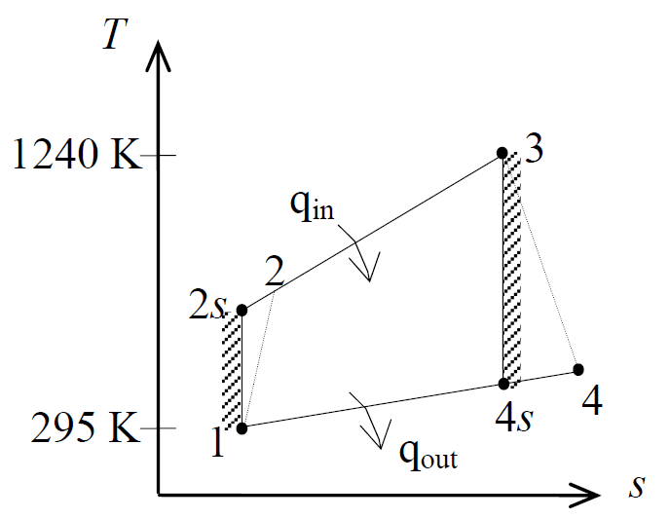
EXAMPLE
A simple Brayton cycle has a pressure ratio of 10, and air works as the working fluid. Determine air temperature at turbine exit, thermal efficiency and net work output. It should be noted that C_{p}= 1.005kJ/kg.K, k= 1.4, T_{it}= 1240K, T_{amb}=295K, n_{T}= 0.87, n_{c}=0.83.

Slide 4
EXAMPLE
A simple Brayton cycle has a pressure ratio of 10, and air works as the working fluid. Determine air temperature at turbine exit, thermal efficiency and net work output. It should be noted that C_{p}= 1.005kJ/kg.K, k= 1.4, T_{it}= 1240K, T_{amb}=295K, n_{T}= 0.87, n_{c}=0.83.

Slide 5
EXAMPLE

Slide 6
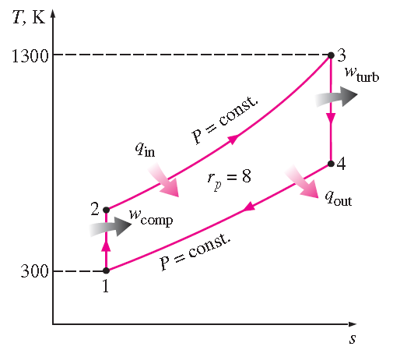
EXAMPLE
An ideal Brayton cycle has a pressure ratio of 8, compressor inlet of 300 K, and turbine inlet temperature of 1300K. Assume specific heat at constant pressure and specific heat ratio at all stages of the gas turbine as cp= 1.006kJ/kgK and k= 1.4, respectively. Determine
(a) Temperature at the compressor and turbine outlet. (b) Thermal efficiency.
Assumptions
1 Air-standard assumptions.
2 Steady state operating conditions exist.

Slide 7
CL 1C
An ideal Brayton cycle with air as working fluid has a pressure ratio of 12. Compressor inlet and turbine inlet temperature are at 300K and 1000K, respectively. If power output is 70MW, determine the mass flow rate. Calculate for 2 cases,
compressor and turbine isentropic efficiency are 100%,
compressor and turbine isentropic efficiency are 85%.
Use c_{p}=1.005kJ/kg and k= 1.4.
A gas turbine engine has compressor inlet temperature of 300K and pressure of 100kPa, and then compressed to 700kPa and 580K. Combustion supply heat of 950kJ/kg to the air before it enters a turbine. If the turbine efficiency is 86%:
the fraction of the turbine work used to run the compressor and
the thermal efficiency.
are to be determined

Slide 8
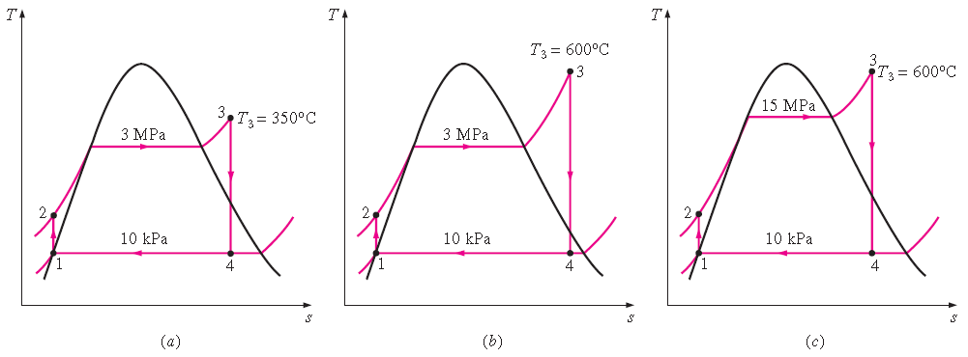
EXAMPLE
Steam in ideal rankine cycle enters a turbine at 3MPa and 350ºC and leaves a condenser at a pressure of 10kPa.
the thermal efficiency,
the thermal efficiency if turbine inlet temperature rises to 600ºC, and
the thermal efficiency if the boiler pressure rises to 15MPa with turbine inlet temperature of 600ºC
are to be determined

Slide 9
(a) The thermal efficiency is determined as below:

Slide 11
(b) States 1 and 2 remain, and the enthalpies at state 3(3Mpa and 600ºC) and state 4 (10kPa and s₄=s₃) are determined to be

Slide 12
(c) State 1 remains, but the other states change. The enthalpies at state 2 (15Mpa and s₂ = s₁), state 3 (15Mpa and 600ºC), and state 4(10kPa and s₄ = s₃) are determined in similar manner to be

