Slide 1
Engineering Surveying Introduction to Survey Engineering
By
Mohd Arif Sulaiman
Faculty of Civil Engineering & Earth Resources
mdarif@ump.edu
Introduction To Survey Engineering, by Mohd Arif

Slide 2
Exercise #3
QUESTION 1
Figure (Q1) shows, Lot 868 beside UMP, had been surveyed by the land surveyor. As the Project Technical Assistant, evaluate the closing error of the traverse, the linear accuracy of survey and area of the lot in unit hectares.
Figure (Q1)

Slide 3
QUESTION 4
Figure Q2 below shows a close theodolite traverse. It starts from known point 2 (N 26000.327, E 109.107) and ends at known point 7 (N 26178.524, E 153.790). The coordinates of each corner of a proposed building is given in table.
Calculate the length and bearing required to set out points a, b, c and d from point 6.

Slide 4
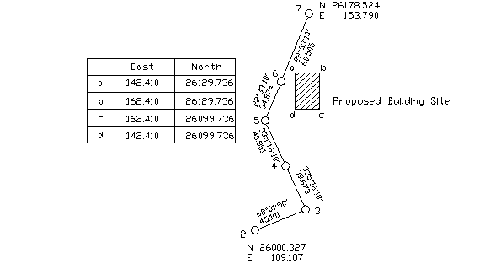

Slide 5
Author Information Dr Idris bin Ali
Dr Cheng Hock Tian

