Slide 1
GEOTECHNICAL ENGINEERING Soil Compression, Consolidation and Settlement (Learning activities)
For updated version, please click on
http://ocw.ump.edu.my
by
Dr. Amizatulhani Abdullah Faculty of Civil Engineering ad Earth Resources amizatulhani@ump.edu.my

Slide 2
Reference
1) Das, B.M., “Principles of Geotechnical Engineering, 5th edition”, Thomson Learning (2002).
Soil Compression, Consolidation and Settlement by Dr. Amizatulhani Abdullah

Slide 3
Following are the results of a consolidation test.
Plot the e log σ curve
Using Casagrande’s method, determine the preconsolidation pressure
Calculate the compression index Cc from the laboratory e log σ curve
e | Pressure, σ (kN/m²)
1.21 | 25
1.195 | 50
1.15 | 100
1.06 | 200
0.98 | 400
0.925 | 500
Soil Compression, Consolidation and Settlement by Dr. Amizatulhani Abdullah

Slide 4
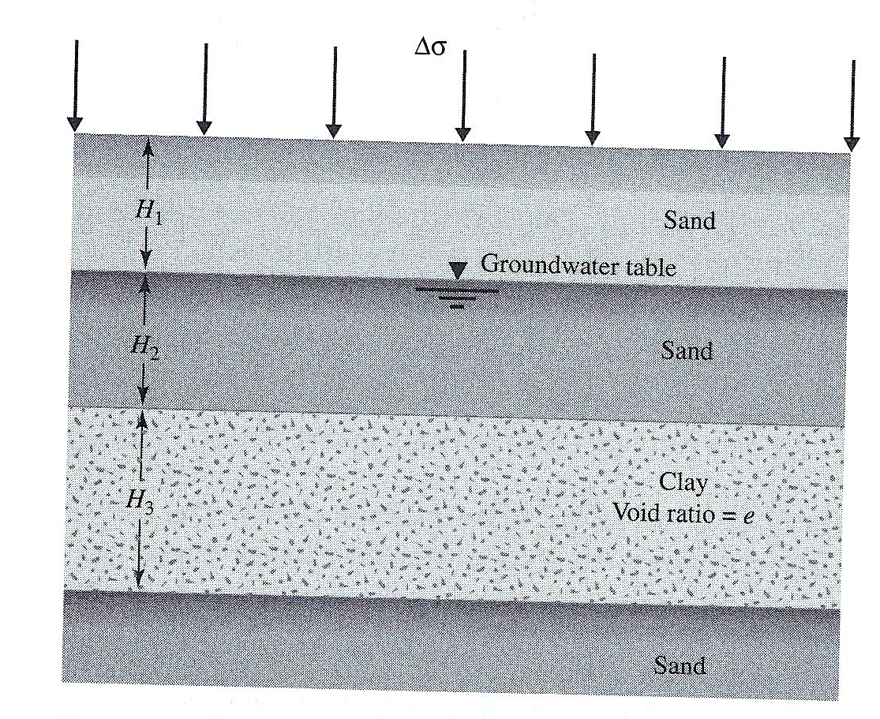
A soil profile is shown in Figure 1. The uniformly distributed load on the ground surface is Δσ. Estimate the primary settlement of the normally consolidated clay layer, given that:
H₁=2.5m, H₂=2.5m, H₃=3m
For sand, e=0.64, G_{s}=2.65
For clay, e=0.9, G_{s}=2.75, LL=55
Δσ=100kN/m²
Soil Compression, Consolidation and Settlement by Dr. Amizatulhani Abdullah

Slide 5
Author Information Dr. Amizatulhani Abdullah Dr. Mohd Yuhyi Mohd Tadza Dr. Youventharan Duraisamy Dr. Muzamir Hasan Ir. Azhani Zukri

