Slide 1
Engineering Surveying Introduction to Survey Engineering
By
Mohd Arif Sulaiman
Faculty of Civil Engineering & Earth Resources
mdarif@ump.edu
Introduction To Survey Engineering, by Mohd Arif

Slide 2
Exercise #1
QUESTION 1
From proposed dam development map, watershed area measured using a planimeter was 2500cm2. Given that the map scale is 1:100000, calculate the actual watershed area on earth surface in m2.
QUESTION 2
A rectangular parcel of land has sides measuring 75 chain and 25 chain. What is the area of the property in square meters, square kilometers and acres?
(Notes: 1 chain = 20.1168m ; 1 acres = 10 square chain)
QUESTION 3
From proposed dam development map, watershed area measured using a planimeter was 1500cm2. Given that the map scale is 1:100000, calculate the actual watershed area on earth surface in m2,

Slide 3
Question 4
Refer to the plan given, answer all the following question.
AB – Boundary line of lot
CD – Sewerage line
LP – Lamp post
Given that the scale of drawing is 1:1000,
a. determined dimensions of building in unit m and building area in unit m2,
b. determined coordinates of lamp post,
c. determined length of fence to be install along boundary AB,
d. calculate gradient of sewerage line CD.

Slide 4
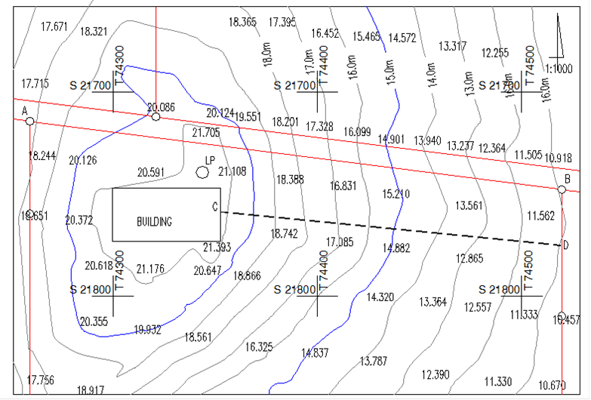

Slide 5
Author Information Dr Idris bin Ali
Dr Cheng Hock Tian

