Slide 1
Chapter 3 Absorption of drug
by
Dr. Arshad Ali Khan Faculty of Engineering Technology arshad@ump.edu.my

Slide 2
Absorption of drug
Content:
1.
Absorption process
2.
Membrane properties that inhibit drug passage
3.
Physicochemical factors that influence drug passage

Slide 3
Drug absorption
Definition;
The transportation of unchanged medicinal agent from route of administration to the blood circulation.
Drug needs to cross of the cell membrane for absorption to occur
Drug absorption mechanism;
Simple diffusion also known as Passive diffusion),
Filtration,
Facilitated diffusion,
Active transport, and
Pinocytosis (Endocytosis)
Effectiveness – determine by concentration of drug at site of action

Slide 4
Absorption process

Slide 5
Drug transport process
PASSIVE DIFFUSION
Transportation of solute from high concentration to low concentration
No carrier protein
No energy required
Occurs; passive aqueous diffusion, passive lipid diffusion

Slide 6
Passive aqueous diffusion
It is a process of absorption of ionized or polar water soluble drug through cellular channels or pores.
Moves from high to low concentration area
Faster absorption from organ with large surface area
Follows Fick’s Law
Notes:
C1: higher concentration
C2: lower concentration
A: diffusion surface area
T: thickness of the membrane

Slide 7
Passive lipid diffusion
The lipid soluble drug (non-ionized or non polar) is diffused via cell membrane.
Non-ionized / ionized fraction is determined by pH and pKa accordingly to Henderson-Hasselbach law’s
pKa of drug is the dissociation or ionization constant
pH of medium, on the other will affects the ionization of the drugs.
*weak acids: best absorbed in stomach. (e.g: Aspirin, Phenobarbitone..)
*weak bases: excellent absrobance in intestine. (E.g: Astropine, ephedrine)

Slide 8
Drug transport process
Drug transport process
ACTIVE TRANSPORT
Requires carrier and energy
The drug transportation can occurs against the concentration gradient
Competitive inhibition is feasible
Limited to drugs which has structural similarity to endogenous compound such as vitamins and sugars.

Slide 9
Comparison
PASSIVE DIFFUSION
ACTIVE TRANSPORT
From high to low concentration
(Along concentration gradient)
No carriers
Not selectively, not saturatable
No energy required
Commonly used
Lipid solubility dependency
Drug pKa – medium pH dependency
From low to high concentration
(Against concentration gradient)
Need carriers
Selective, saturatable
Energy is required
Realtively unusual
Iron absorption
Uptake of levodopa by brain

Slide 10
Membrane properties that inhibit drug passage

Slide 11
Structure and Properties of Cell Membrane
Membrane is made up of :
Lipid
Protein
Carbohydrate

Slide 12
Lipid :
Amphipathic: consist hydrophilic and hydrophobic region.
Membrane lipids:
Phospholipid bilayer
2. cholesterol.

Slide 13
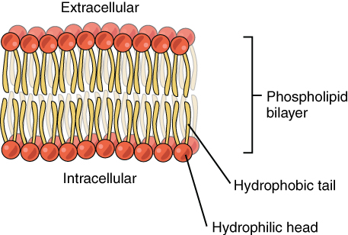
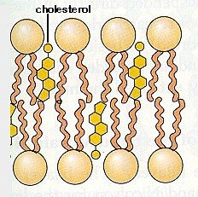
Lipid :
Phospholipid bilayer - made up of phosphates and lipids. It is semi permeable which is allow certain molecule to pass through the membrane.
Cholesterol - selectively dispersed between membrane phospholipids in order to maintains the fluidity of cell surface membrane.

Slide 14
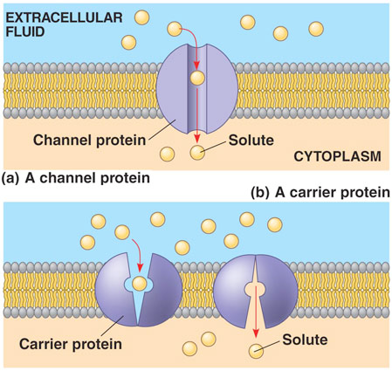
Protein :
Channel protein- it allows free passage for some specific moiety and ions.
Carrier protein – it allows to cross the plasma membrane by interact selectively with some specific moiety and ions (Na⁺ or K⁺).

Slide 15
Integral protein:
Penetrate the lipid bilayer
Amphipathic: hydrophilic and hydrophobic portions
Preserved the permeability barrier of the membrane.

Slide 16
Carbohydrate :
Carbohydrate in the plasma membrane exists at the outer extracellular space.
Carbohydrate link to both protein and lipid to form glycoprotein and glycolipid respectively.

Slide 17
Properties of Membrane
Permeability
only lipid soluble drug can cross the membrane
molecular size
solubility in water
ionized and non-ionized
concentration

Slide 18
Drug Passage

Slide 19
Drug Passage
Simple diffusion - a drug with a high partition coefficient like a lipophilic drug is readily enters the lipid phase of the membrane.

Slide 20
Factor Inhibit Drug Passage
Lipid solubility
Large molecular size of drug
Water solubility

Slide 21
Physicochemical factors that influence drug passage

Slide 22
Physicochemical factors that influence drug passage
1. Drug solubility and dissolution rate
In to the biological system, a drug get absorbed when it solubilized in to the physiological fluids.
3 theory
Diffusion layer model/film theory
Danckwert’s model /penetration or surface renewal theory
Interfacial barrier model/Double-barrier or Limited solvation theory

Slide 23
Solid dosage form
Solid drug particle
Drug in solution at absorption site
Drug in body
Disintegration
Dissolution
Permeation
across membrane

Slide 24
Rate determining step (RDS) in absorption of oral administration;
Rate of dissolution
Dissolution is the RDS for water insoluble drugs (hydrophobic & poorly aqueous soluble drugs) such as Griesiofulvin & Spironolactone.
Rate of drug permeation via biological membrane
Permeation is the RDS for hydrophilic & high aqueous soluble drugs.
E.g. Cromolyn sodium OR Neomycin.

Slide 25
Physicochemical factors that influence drug passage
2. Particle size & effective surface area
Types of surface area
Absolute surface area
- total area of solid surface of particle
Effective surface area
- Exposed area of the solid surface to the dissolution medium

Slide 26
Dissolution rate $α$ surface area
Smaller particle size – higher surface area – increased dissolution rate – better absorption
Particle size reduction – increased absorption of the poorly soluble drugs
E.g. Bis-hydroxycoumarin, digoxin and griseofulvin
The reduction of particle size in to micron size known as the “micronisation process”

Slide 27
HYDROPHILIC DRUGS: small particles have higher energy than the bulk of the solid resulting - increased interaction with the solvent. Micronisation results – highly increased absorption efficiency.
Eg. 1.Griesiofulvin – Dose reduced half after micronisation.
2. Spironolactone – dose decreased to 20 times.
3. Digoxin – BA found to be 100% in micronized tablets
HYDROPHOBIC DRUGS: micronisation results - decreased effective surface area & thus fall in dissolution rate.
Due to;
Air entrapment – wettability
Surface free energy – float or sink
Prevented by:
Use of surfactant as a wetting agent which - decreases the interfacial tension. - displaces the absorbed air with the solvent. (Ex: Phenacetin)
Add hydrophilic diluents like PEG, PVP, dextrose etc
(convert absolute s.a to effective s.a)

Slide 28
Physicochemical factors that influence drug passage
3. Polymorphism and Amorphism
POLYMORPHISM
Polymorphism influence formulation development - exhibit different solubility, dissolution rate, melting point, compactibility, hygroscopicity, etc.
Depending at relative stability, one of the various polymorph formed will be physically stable in comparison to others.
STABLE POLYMORPH – lowest energy state, higher melting point, least aqueous solubility
METASTABLE POLYMORPH - higher energy state, lower melting point, higher aqueous solubility – better BA

Slide 29
AMORPHISM
Internal crystal structure absent
Highest energy state – increased aqueous solubility than the crystalline states
Thus, the order for dissolution of different solid dosage forms drugs
Amorphous > Meta-stable > stable

Slide 30
Physicochemical factors that influence drug passage
4. Hydrates/solvates (Pseudopolymorphism)
Pseudopolymorphism - phenomenon where the solvent molecules are entrapped in the crystalline structure of the polymorph
Solvates - the stoichiometric type of adducts where the solvent molecules are incorporated in the crystal lattice of the solid are called as the solvates, and the trapped solvent as solvent of crystallization
Hydrates – common solvate forms of drug

Slide 31
Anhydrous form of drug – greater aqueous solubility than hydrate, due to higher energy state
Dissolve at faster rate, show better BA
e.g. anhydrous form of ampicillin
Organic solvate – greater aqueous solubility than non-solvate
e.g. chloroform solvates of griseofulvin – more water- soluble than their non-solvate form.

Slide 32
Physiochemical factors that influence drug passage
5. Salt form of drug
Converting weak acidic or basic drug into its salt form -- improves the solubility and dissolution rate of the drug.
Increased in solubility and dissolution rate – increase absorption
pH of diffusion layer of salt important to be considered.

Slide 33
Eg: Salt of weak acid drug – increases pH of diffusion layer – increase solubility and dissolution
In-situ salt formation principle – also enhance absorption - increase pH of microenvironment of drug by incorporation buffer agents – promote dissolution rate

Slide 34
Physicochemical factors that influence drug passage
6. pH Partition Hypothesis
States - absorption of drug compounds of molecular weight greater than 100 Daltons transported across the biological membrane by passive diffusion depend ;
Dissociation constant of the drug, pKa
Lipid solubility of the unionized drug
pH at the absorption site
pH‐partition theory: The interrelationship of dissociation constant, lipid solubility ,pH at the absorption site and absorption characteristics of various drugs throughout the GIT.

Slide 35
Physicochemical factors that influence drug passage
6a) pKa of drug & GI pH
The amount of drug that exist in unionized form is a function of dissociation constant(pKa) of the drug and pH of the fluid at the absorption site.
Weakly acidic drugs (eg :aspirin) dissolve faster in gastric fluids.
Weakly basic drugs (eg :quinine) dissolve faster in intestinal fluids.
Acidification or basification of both stomach and intestine will produce converse effects.
• Deviations from this theory include
Presence of virtual membrane pH
Absorption of ionized drug
GI surface area and residence time of drug
Presence of aqueous unstirred diffusion layer

Slide 36
PREDICTION BASED ON THEORY
FOR WEAK ACIDS
Very weak acids (pKa>8)– unionized at all pH—absorption is rapid— independent of GI pH. E.g.-phenytoin , ethosuximide
Acids in the pKa range 2.5 - 7.5 - absorption pH dependant—better absorbed from acidic conditions of stomach (ph<pKa)where they largely exist in unionized form E.g. aspirin , ibuprofen
Strong acids (pKa<2.5) ionized at entire pH range of GIT ---remain poorly absorbed. E.g. cromolyn sodium
FOR BASIC DRUGS
Very weak bases(pKa<5) unionized at all pH values ---absorption is rapid and pH independent. E.g. diazepam , nitrazepam
Bases in pKa range 5 - 11 is pH dependant –better absorbed from the relatively alkaline conditions of the intestine. E.g.chloroquine , imipramine
Strong bases (pKa>11) ionized at entire pH range –poorly absorbed. E.g. mecamylamine guanethidine

Slide 37
SUMMARY
pH-partition Hypothesis Simplest principle:
Unionised Drug: Higher Absorption
Ionised Drug: Low Absorption
*Degree of ionization of drug – determined by surrounding pH & their pKa
High Absorption
Weak Acid pKa > 8
Weak Base pKa < 5
Low Absorption
Strong Base pKa > 11
Strong Acid pKa < 2.5

Slide 38
Physicochemical factors that influence drug passage
6b) Lipophilicity & drug absorption
Lipophilic drug – easily across membrane
Only unionized (non-polar) drug having sufficient lipid solubility is absorbed
Lipid soluble drug = unionised drug - better absorption
More lipid soluble of drug – more absorption
More water soluble of drug – less absorption
Lipid solubility – determined from drug’s oil/water partition coefficient (PCo/w) value.
Increase in PCo/w – increase in % of drug absorbed

Slide 39
Physicochemical factors that influence drug passage
7. Drug stability
Stability problem
Degradation into inactive form
Interaction with different components of the dosage form or those in GIT – form poorly soluble / unabsorbable complex
– result poor BA of orally administered drug
Stability profile of drug in GI condition – must be studied – to improve dissolution

Slide 40
Physiochemical factors that influence drug passage
8. Drug permeability and absorption
3 major drug characteristics that determine passive transport/permeability of drug across intestinal epithelium;
Lipophilicity
Polarity
Molecular size

Slide 41
Thank you

