Slide 1
GEOTECHNICAL ENGINEERING Slope Stability
For updated version, please click on
http://ocw.ump.edu.my
by
Dr. Amizatulhani Abdullah Faculty of Civil Engineering ad Earth Resources amizatulhani@ump.edu.my

Slide 2
Chapter description
Aims
This chapter provides further discussion and explanation related to stability of slope.
Expected Outcomes
Check and analyze the stability of slopes using various method of analysis and propose the best solution to the problem given.
References
Das, B.M., “Principles of Geotechnical Engineering, 5th edition”, Thomson Learning (2002).
Raj, P.P., “Soil Mechanics & Foundation Engineering”, Prentice Hall (2008).
Liu, C. & Evett, J.B., “Soils and Foundations, 7th edition”, Prentice Hall (2008).
Whitlow, R., “Basic Soil Mechanics”, Prentice Hall (2004).
Slope Stability by Dr. Amizatulhani Abdullah

Slide 3
Content
Stability of finite slopes : plane failure surfaces
Stability of finite slopes : circular failure surfaces
Stability of finite slopes : circular failure surfaces (mass procedure method φ = 0)
Stability of finite slopes : circular failure surfaces (mass procedure method φ > 0)
Stability of finite slopes : circular failure surfaces (ordinary method of slices)
Stability of finite slopes : circular failure surfaces (Bishop method of slices)
Conclusion
Slope Stability by Dr. Amizatulhani Abdullah

Slide 4
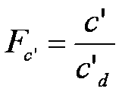
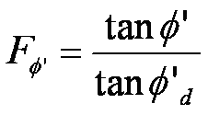
Stability of finite slopes (plane failure surfaces)
CULMANN’S METHOD
From previous :
The maximum height of the slope can be calculate using the following equation :
Slope Stability by Dr. Amizatulhani Abdullah

Slide 5
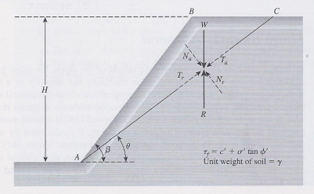
Finite slope analysis by using Culmann’s method (Das, 2002)
Slope Stability by Dr. Amizatulhani Abdullah

Slide 6
WORK EXAMPLE
A cut is to be made in a soil having γ=16.5kN/m³, c’=28.8kN/m² and φ’=15°. The side of the cut slope will make an angle of 45° with the horizontal. What should be the depth of the cut slope that will have a factor of safety of 3?
Slope Stability by Dr. Amizatulhani Abdullah

Slide 7
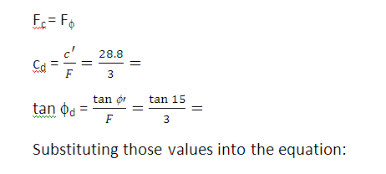
Solution
Ans : 7.04m
Slope Stability by Dr. Amizatulhani Abdullah

Slide 8
Stability of finite slope (circular failure surfaces)
MASS PROCEDURE
ORDINARY METHOD OF SLICES
In this case, the mass of soil above the surface of sliding is taken as a unit. This procedure is useful when the soil that forms the slope is assumed to be homogenous (although this is not the case in most natural slope).
The soil above the surface of sliding is divided into a number of vertical parallel slices. The stability of each slice is calculated separately. This is a versatile technique (no homogeneity, pwp).
Slope Stability by Dr. Amizatulhani Abdullah

Slide 9
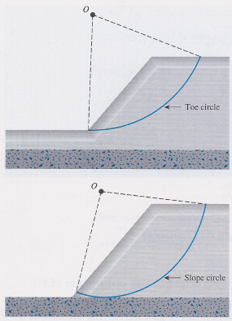
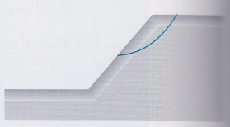
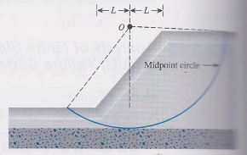
Shallow slope failure
Toe circle / slope circle
Base failure
Modes of failure of finite slope (Das, 2002)
Slope Stability by Dr. Amizatulhani Abdullah

Slide 10
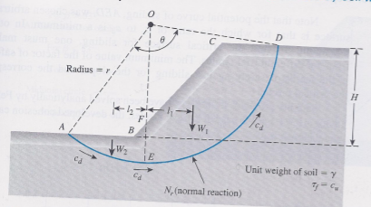
Mass procedure (slopes in homogenous clay soil with φ = 0)
(Das, 2002)
$F_{s}=\frac{Resisting moment, Mr}{Sliding moment, Md}$
Soil’s weight, W = cross sectional area x γ
Sliding / disturbing moment, M_{d} = Wl
Resisting moment, M_{r}= cLr where L = rθ
For equilibrium : M_{r} = M_{d}
cr²θ = Wl₁ – Wl₂
Slope Stability by Dr. Amizatulhani Abdullah

Slide 11
The critical failure curve when the ratio of c_{u} to c_{d} is a minimum.
$F_{s}=\frac{τ_{f}}{c_{d}}=\frac{c_{u}}{c_{d}}$
For the case of critical circle, the developed cohesion, cd.
$c_{d}=Hm$
The critical height, Hcr
$H_{cr}=\frac{c}{γm}$
Slope Stability by Dr. Amizatulhani Abdullah

Slide 12
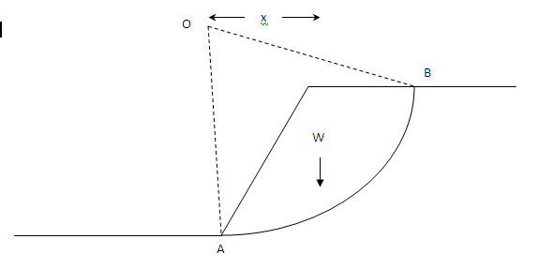
Disturbing moment = Wx
Resisting moment = cLr where L = rθ
Slope Stability by Dr. Amizatulhani Abdullah

Slide 13
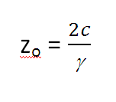
If tension crack occurs;
The slip circle is terminated at the tension crack depth,
If the crack is filled with water, the water pressure should be consider;
Slope Stability by Dr. Amizatulhani Abdullah

Slide 14
WORK EXAMPLE
A cutting in a saturated clay is inclined at a slope of 1V:1.5H and has a vertical height of 10m. The bulk unit weight of the soil is 18.5kN/m³ and its undrained cohesion is 40kPa. Determine the FOS against immediate shear failure along the slip circle given.
Ignoring the tension crack.
Allowing for tension crack (empty of water).
Allowing for tension crack when full of water.
Ans : 1.44, 1.84, 1.65
Slope Stability by Dr. Amizatulhani Abdullah

Slide 15
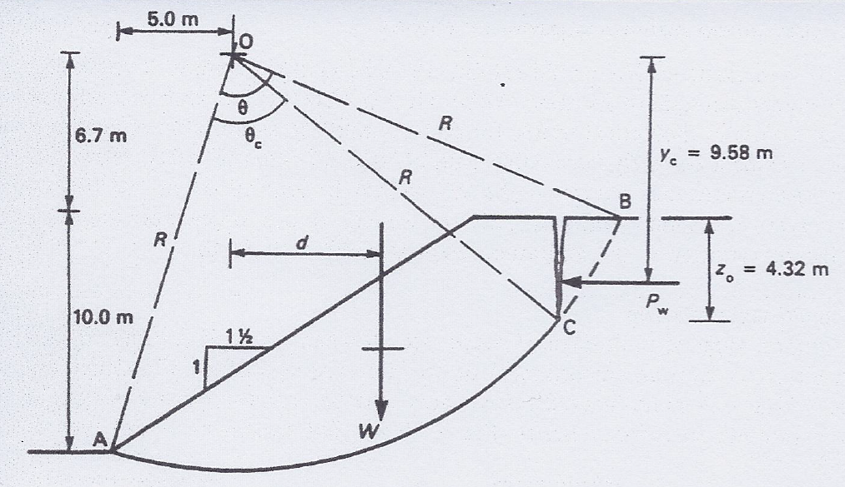
(Whitlow, 2004)
Slope Stability by Dr. Amizatulhani Abdullah

Slide 16
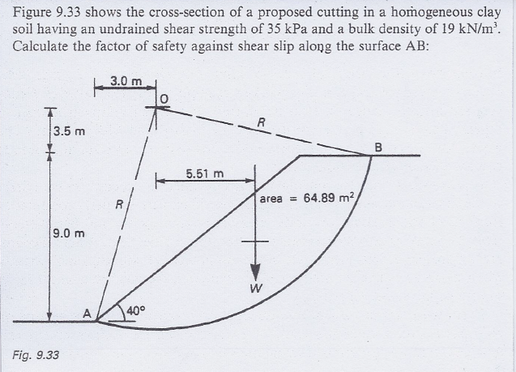
(Whitlow, 2004)
Slope Stability by Dr. Amizatulhani Abdullah

Slide 17
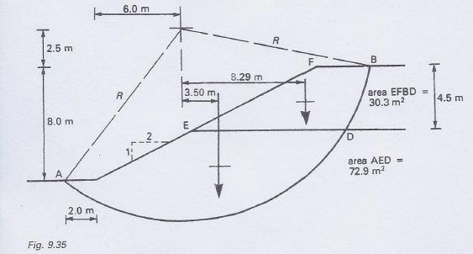
(Whitlow, 2004)
Slope Stability by Dr. Amizatulhani Abdullah

Slide 18
The corresponding circle that gives the lowest FOS value is called critical circle.
Fellenius (1927( and Taylor (1937) suggested that (for critical circle case) :
where m = Stability number
Slope Stability by Dr. Amizatulhani Abdullah

Slide 19
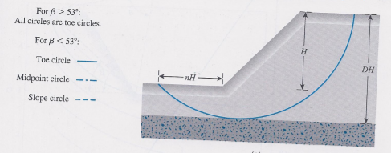
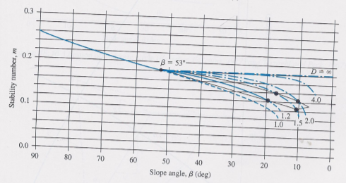
Definition of parameters for midpoint circle type of falure (Das, 2002)
Slope Stability by Dr. Amizatulhani Abdullah

Slide 20
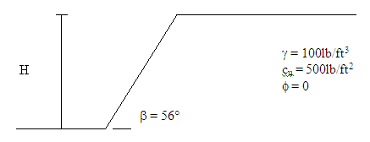
WORK EXAMPLE
A cut slope in saturated clay makes an angle of 56° with the horizontal. Determine the maximum depth up to which the cut could be made. Assume that the critical surface for sliding is circularly cylindrical. What will be the nature of the critical circle?
Slope Stability by Dr. Amizatulhani Abdullah

Slide 21
Mass procedure (slopes in homogenous clay soil with φ > 0)
TAYLOR’S STABILITY CHART
Taylor proposed stability coefficients for the analysis of homogeneous slopes.
stability number, m can be obtain from stability charts – Taylor’s stability number.
Slope Stability Dr. Amizatulhani Abdullah

Slide 22
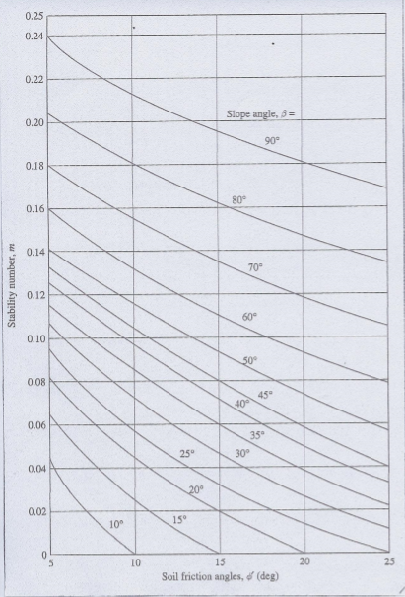
Taylor’s stability number (Das, 2002)
Slope Stability by Dr. Amizatulhani Abdullah

Slide 23
WORK EXAMPLE
Find the critical height of a slope with β = 45° to be constructed with a soil having φ’ = 20° and c’ = 15kN/m². The unit weight of the compacted soil will be 17kN/m³.
Ans : 14.706m
Slope Stability by Dr. Amizatulhani Abdullah

Slide 24
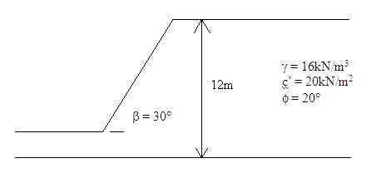
WORK EXAMPLE
A slope is shown in figure below. Determine the factor of safety with respect to strength.
You might need to use graph papers
Ans : 1.73
Slope Stability by Dr. Amizatulhani Abdullah

Slide 25
Assume φ_{d}.
Find m by using Taylor’s stability number chart.
Calculate c_{d}.
Determine F_{c} and F_{φ}. Both value must be the same. If not, make another trial by assume new value of φ_{d}.
Slope Stability by Dr. Amizatulhani Abdullah

Slide 26
Stability of finite slope (ordinary method of slices)
ORDINARY METHOD OF SLICES
The soil above the surface of sliding is divided into a number of vertical parallel slices. The stability of each slice is calculated separately. This is a versatile technique (no homogeneity, pwp).
Slope Stability by Dr. Amizatulhani Abdullah

Slide 27
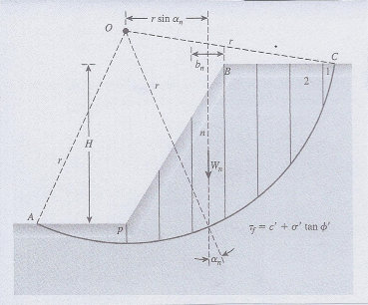
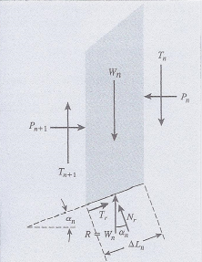
Stability analysis by ordinary method of slices (Das, 2002)
Slope Stability by Dr. Amizatulhani Abdullah

Slide 28
Procedure
Draw to scale a cross section of the slope.
A trial curved surface along which sliding is assumed to take place is drawn.
The trial surface is normally approximately circular.
Soil between the trial surface and the slope is then divided into a number of vertical slices of equal width.
Slope Stability by Dr. Amizatulhani Abdullah

Slide 29
Weight of soil within each slice = Slice volume x Soil unit weight
Noted as W.
Can be resolved into two component ;
i) component of W normal to the base, W_{n} and
ii) component of W parallel to the base, W_{p}
It is the parallel component that tends to cause sliding.
Resisting to sliding is afforded by the soil’s cohesion and internal friction.
Cohesion force = Soil cohesion x Length of the slice
Friction force = W_{n} x Friction coefficient, tan φ
Slope Stability by Dr. Amizatulhani Abdullah

Slide 30
Apply value into formula
Slope Stability by Dr. Amizatulhani Abdullah

Slide 31
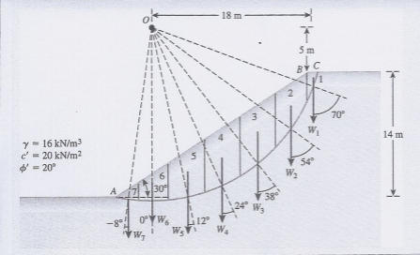
WORK EXAMPLE
Find the factor of safety against sliding for the trial slip surface given. Use ordinary method of slices.
(Das, 2002)
Ans : 1.55
Slope Stability by Dr. Amizatulhani Abdullah

Slide 32
Slope Stability by Dr. Amizatulhani Abdullah

Slide 33
Stability of finite slope (Bishop method of slices)
BISHOP METHOD OF SLICES
Bishop proposes a more refined solution to previous method where the effect of forces on the sides of each slice are accounted.
Procedure
Trial and error to find the value of F_{s}
where :
Slope Stability by Dr. Amizatulhani Abdullah

Slide 34
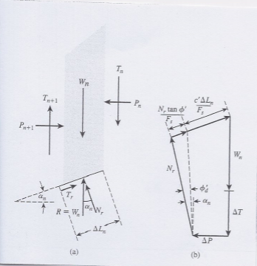
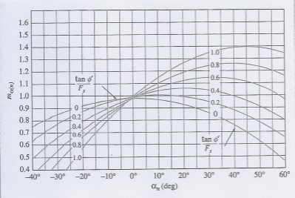
where :
Bishop’s simplified method of slices (Das, 2002)
Slope Stability by Dr. Amizatulhani Abdullah

Slide 35
Several number of failure surface must be investigated so that the critical surface(yields the lowest FOS value) can be found.
This method gives satisfactory results in most cases when incorporated into computer programs.
Widely used.
Slope Stability by Dr. Amizatulhani Abdullah

Slide 36
Conclusion
Conclusion #1
There are various method that can be use to analyze finite slope stability and it depends to the types of failure surface (either plane or circular).
Conclusion #2
For finite slope with circular failure surface, the analysis can be further divided into following: 1) Mass procedure (φ = 0 or φ > 0) 3) Method of slices (ordinary or Bishop)
Slope Stability by Dr. Amizatulhani Abdullah

Slide 37
Author Information Dr. Amizatulhani Abdullah Dr. Mohd Yuhyi Mohd Tadza Dr. Youventharan Duraisamy Dr. Muzamir Hasan Ir. Azhani Zukri

