Slide 1
Electric and Electronic Technology Chapter 5A – Op-Amp
by
Akhtar Razali FKM akhtar@ump.edu.my

Slide 2
Chapter Description
Aims
To understand the principle of Op-Amp
To understand the application and analysis of various type of op-amps
Expected Outcomes
Students able to understand how Op-Amp works, its application and other related analysis
Students able to distinguish various type of op-amp and its application
Other related Information
One question for final exam is from this topic
No other relevant information be disclosed
References
Rizzoni G., 2004, Principles and Applications of Electrical Engineering, Revised Fourth Edition, Fourth Edition, McGraw Hill
Hambley A.R., 2005, Electrical Engineering Principles and Applications, Third Edition, Pearson Prentice Hall

Slide 3
Contents
Describe the operation of the operational amplifier principles and characteristics.
Analyze the inverting and non-inverting operational amplifier circuits.

Slide 4
Op-Amp Introduction
An operational amplifier is an integrated circuit, that is, a large collection of individual electrical and electronic circuits integrated on a single silicon wafer.
An operational amplifier — op-amp — can perform a great number of operations, such as addition, filtering, or integration, which are all based on the properties of ideal amplifiers and of ideal circuit elements. The introduction of the operational amplifier in integrated circuit form marked the beginning of a new era in modern electronics.

Slide 5
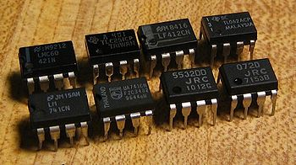
Op-Amp in Real
Source: https://commons.wikimedia.org/wiki/File:Op-amps.jpg

Slide 6
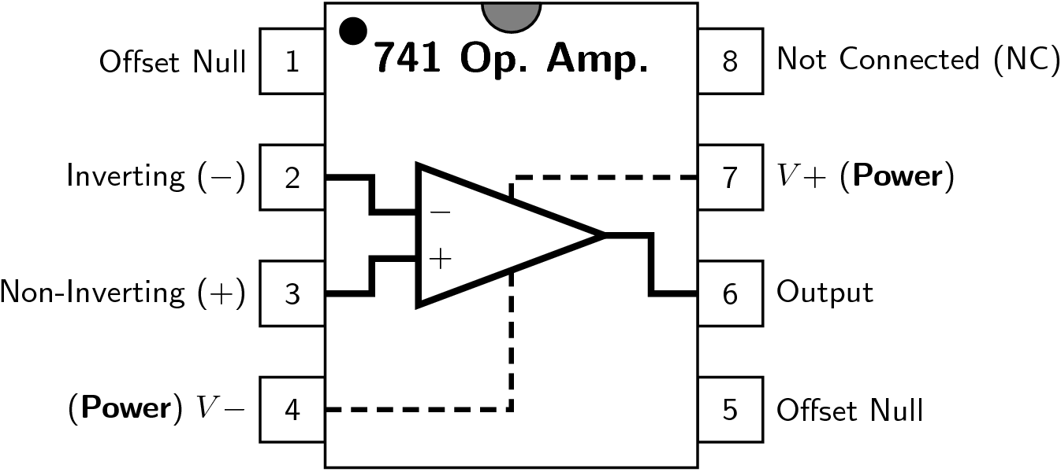
Op-Amp Pinout
Source: https://commons.wikimedia.org/wiki/File:Generic_741_pinout_top.png

Slide 7
Ideal Op-Amp
Infinite voltage gain, A_{v} = ∞
Infinite input impedance, Z_{in} = ∞
Zero output impedance, Z_{out} = 0.
However, the ideal op-amp can never be made.
Because any device has limitations: current, voltage are limited.

Slide 8
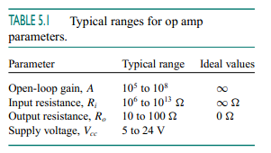
Typical Ranges of Op-Amp
Source: Rizzoni

Slide 9
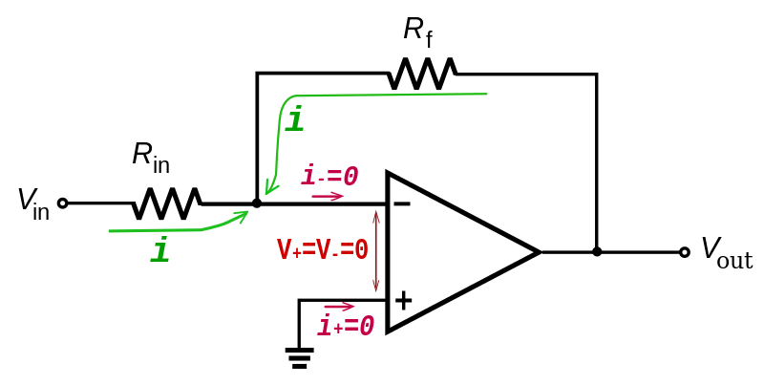
Inverting Op-Amp
Source: https://commons.wikimedia.org/wiki/File:Op-Amp_Inverting_Amplifier_KCL.svg

Slide 10
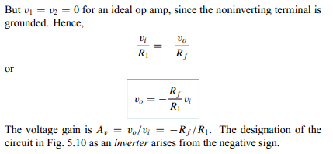
Inverting Op-Amp
Source: Rizzoni

Slide 11
Example
If R1 = 100 ohm, Rf = 200 ohm and Vi = 10 V
Such that:
Vo = -(Rf/R1).Vi
= - (200/100)10 = - 20 V
And current through R1 is:
i = (Vi – 0)/ R1 = 10/100 = 0.1 amp

Slide 12
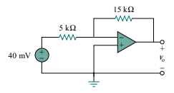
Exercise 1
Source: Rizzoni

Slide 13
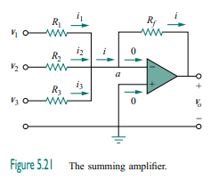
Summing Op-Amp
Source: Rizzoni

Slide 14
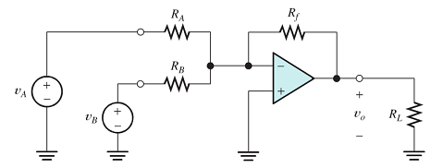
Example
Source: Rizzoni

Slide 15
Example
If Rf = 100 ohm, Ra = 200 ohm, Rb = 100 ohm and VA = VB = 10 V
Such that:
Vo = -(Rf/RA).VA - (Rf/RB).VB
= - (100/200)10 - (100/100)10 = - 15 V

Slide 16
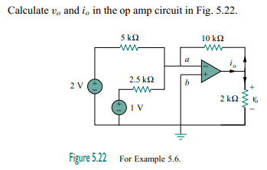
Exercise 1
Source: Rizzoni

Slide 17
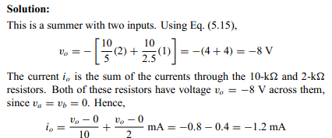
Example 1 - Solution
Source: Rizzoni

Slide 18
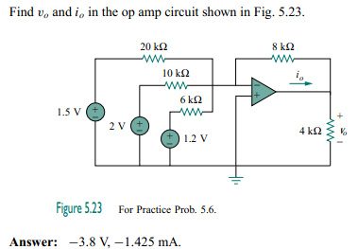
Exercise 1
Source: Rizzoni

Slide 19
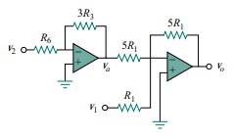
Exercise 2
Source: Rizzoni

Slide 20
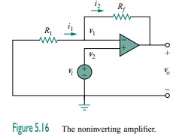
Non-inverting Amplifier
Source: Rizzoni

Slide 21
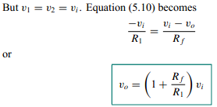
Non-Inverting Op-Amp Formula
Source: Rizzoni

Slide 22
Example 1
If R1 = 100 ohm, Rf = 200 ohm and Vi = 10 V
Such that:
Vo = (1 + Rf/R1).Vi
= (1 + 200/100)10 = 30 V

Slide 23
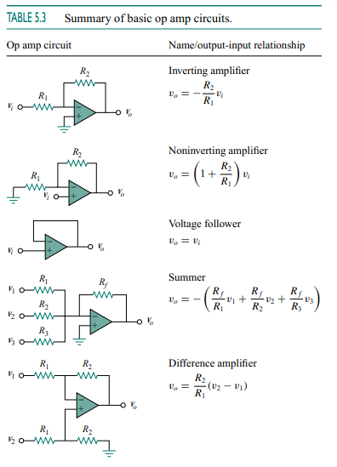
Various Type of Op-Amp
Source: Rizzoni

Slide 24
Conclusion of The Chapter
Conclusion #1
Inverting Op-Amp produces inverting output while at the same time amplifies the output voltage.
Non-inverting Op-Amp does not inverts output but amplifies the output voltage
Summing Op-Amp added up the Op-Amp and amplifies output voltage.
KCL is used to derive the equation for each Op-Amp.

Slide 25
Akhtar Razali FKM, UMP.

