Slide 1
Digital Electronics Number Systems and Codes
Prepared by: Norazian Subari
Fakulti Kejuruteraan Elektrik & Elektronik aziansubari@ump.edu.my
Credited to: Faradila Naim, Nurul Wahidah Arshad

Slide 2
Chapter Description
Expected Outcomes
At the end of this topic, students should be able to:
Convert a number from one system (decimal, binary, octal, hexadecimal) to its equivalent in one of the other number systems.
Discuss the difference between BCD and binary numbers.
Explain the purpose of alphanumeric codes such as the ASCII code.

Slide 3
Topics
Decimal, Binary, Octal and Hexadecimal Number Systems.
Conversion between Number System
Numbering Code
Alphanumeric Code
Signed Number
Signed and Magnitude
1st and 2nd Compliment
Addition and Subtraction

Slide 4
DIGITAL number systems
Number Systems
Decimal
Binary
Octal
Hexadecimal

Slide 5
DIGITAL number systems (Decimal)
Source: https://drstienecker.com

Slide 6
DIGITAL number systems (binary)
Source: https://drstienecker.com

Slide 7
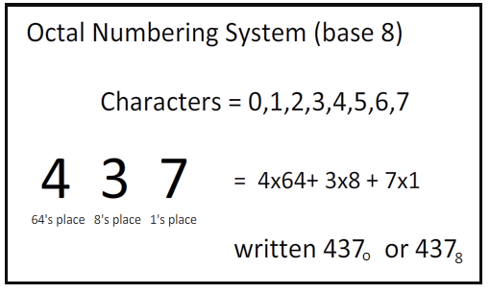
DIGITAL number systems (octal)
Source: https://drstienecker.com

Slide 8
DIGITAL number systems (hexadecimal)
Source: https://drstienecker.com

Slide 9
Conversion between number systems
Decimal Conversion
Binary
Octal
Binary Conversion
Decimal
Octal
Octal Conversion
Decimal
Binary
Hexadecimal
Hexadecimal
Hexadecimal Conversion
Decimal
Binary

Slide 10
Decimal conversion: decimal to binary
Divide the decimal number by 2 until the quotient is 0.
LSB
MSB – Most Significant Digit
LSB – Least Significant Digit
MSB

Slide 11
Decimal conversion: decimal to octal
Divide the decimal number by 8 until the quotient is 0.
LSB
MSB – Most Significant Digit
LSB – Least Significant Digit
MSB

Slide 12
Decimal conversion: decimal to hexadecimal
Divide the decimal number by 16 until the quotient is 0.
LSB
MSB – Most Significant Digit
LSB – Least Significant Digit
MSB

Slide 13
binary conversion: binary to decimal
Multiply each binary number by its weight and summing the products
(11101) ₂ = (1x2³) + (1x2³) + (1x2²) + (1x0¹ ) + (1x2⁰)
= 16 + 8 + 4 + 1
= (29)₁₀

Slide 14
binary conversion: binary to octal
Grouped of three bits starting at the LSB
Then convert each group to its octal equivalent

Slide 15
binary conversion: binary to hexadecimal
Grouped of four bits starting at the LSB
Then convert each group to its octal equivalent
Zeros are added to make each group complete with 4 bits

Slide 16
octal conversion: octal to decimal
Multiply each octal number by its weight and summing the products
(362) ₈ = (3x8²) + (3x8¹) + (3x8⁰)
= 192 + 48 + 2
= (242)₁₀

Slide 17
octal conversion: octal to binary
Convert each octal digit to its three-bit binary equivalent.

Slide 18
hexadecimal conversion: hexadecimal to decimal
Multiply each hexadecimal number by its weight and summing the products
(19B) ₁₆ = (1x16²) + (9x16¹) + (11x16⁰)
= 256 + 144 + 11
= (411)₁₀

Slide 19
hexadecimal conversion: hexadecimal to binary
Convert each hexadecimal digit to its four-bit binary equivalent.

Slide 20
Arithmetic operations of the number systems
Binary Addition & Subtraction
Octal Addition & Subtraction
Hexadecimal Addition & Subtraction

Slide 21
Arithmetic operations of the number systems
Binary
Additional
0 + 0 = 0 Sum of 0 with a carry of 0
Subtraction
Additional
0 - 0 = 0
0 + 1 = 1 Sum of 1 with a carry of 0
1 + 0 = 1 Sum of 1 with a carry of 0
1 + 1 = 10 Sum of 0 with a carry of 1
1 - 1 = 0
1 - 0 = 1
10 - 1 = 1 0 - 1 with a borrow of 1

Slide 22
Arithmetic operations of the number systems
Octal
Additional
0 + 0 = 0 Sum of 0 with a carry of 0
Octal
Additional
0 - 0 = 0
0 + 1 = 1 Sum of 1 with a carry of 0
1 + 0 = 1 Sum of 1 with a carry of 0
1 + 1 = 10 Sum of 0 with a carry of 1
1 - 1 = 0
1 - 0 = 1
10 - 1 = 1 0 - 1 with a borrow of 1

Slide 23
Arithmetic operations of the number systems
Hexadecimal
Additional
0 + 0 = 0 Sum of 0 with a carry of 0
Hexadeciaml
Additional
0 - 0 = 0
0 + 1 = 1 Sum of 1 with a carry of 0
1 + 0 = 1 Sum of 1 with a carry of 0
1 + 1 = 10 Sum of 0 with a carry of 1
1 - 1 = 0
1 - 0 = 1
10 - 1 = 1 0 - 1 with a borrow of 1

Slide 24
Numbering code
* Codes : A special group of symbols
* Encode : Representing number letter or words into a code
Numbering Code
Gray Code
BCD Code

Slide 25
Numbering code (BCD CODE)
BCD CODE
Coding decimal to its binary equivalent
Code available
0000 - 1001
Four bits = one decimal digit

Slide 26
Numbering code (gray CODE)
Binary to Gray Code
Gray to Binary Code

Slide 27
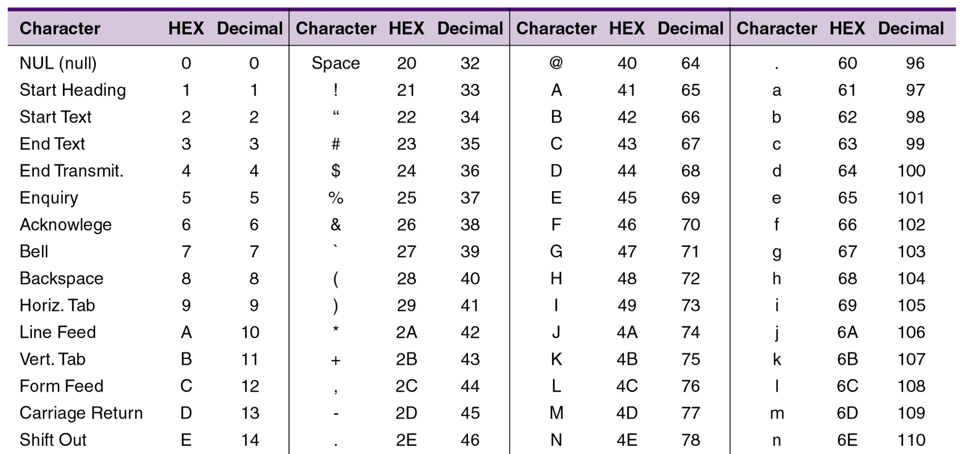
Alphanumeric code
See the entire table in textbook.

Slide 28
Signed number
Changing each of the bit value.
0→1
1→0
The remaining bits are the magnitude bits.
Eg: Express -25 in an 8-bit sign-magnitude binary number.
25₁₀ = 00011001
-25₁₀ = 10011001

Slide 29
1’s Complement
Changing each of the bit value.
0→1
1→0
+ve no.: same as +ve sign-magnitude.
-ve no.: the 1’s complement of the corresponding +ve number.

Slide 30
2’s Complement
+ve no.: same as +ve sign-magnitude.
-ve no.: 2’s complement of the corresponding +ve number.
Obtained by adding 1 to the 1’s complement of the corresponding number.

Slide 31
References
T. Floyd, “Digital Fundamental”, 10th Ed., USA : Prentice-Hall, 2008.
R.J. Tocci, “Digital Systems: Principles and Applications”, 10th Ed., USA : Prentice-Hall, 2006.

Slide 32
Norazian Subari Fakulti Kejuruteraan Elektrik & Elektronik Universiti Malaysia Pahang 26600 Pekan, Pahang, Malaysia http://fkee.ump.edu.my/index.php/en/staff-menu/articles-staff/1622-norazian-subari-main-profile

