Slide 1
BSB3503 - Biomanufacturing CHAPTER 2 Process Plant Design – Part II
Author: Nurul Azyyati Sabri
Co-Author / Editor: Rama Yusvana Faculty Industrial Sciences & Technology yusvana@ump.edu.my

Slide 2
COST
Manufacturing cost comprise:
Investment costs
Operating costs
Target is to minimize the costs as whole
1) Investment costs
Non-recurring procurement cost
Could be obtained from banks or project investors

Slide 3
Cost
Operator demands for low procurement costs.
Achieve “break even point” fastest possible time.
Without compromising quality of the plant.
The low quality and lifespan of a finished product usually due to low procurement costs.

Slide 4
Cost
Usually, plant operator determines the quality level of the plants.
Extensive sets of specification.
Minimize investment costs that fulfills all requirements.

Slide 5
2) Operating costs
Continuously arising
Costs for material, energy (utility), labor costs and repair and maintenance.
Utility costs
Based on quantity
Depending on types of material and energy

Slide 6
Utility cost
Should be kept to a minimum
Depends on their quality and purity
Operator has no influence on price development.

Slide 7
Utility cost
Energy costs:
Electric power
Others such as steam, natural gas, petroleum, coal

Slide 8
b) Employment cost
Operator’s cost for operating, service and maintenance personnel.
Depending of plant size, operating personnel include the following:
Plant manager
Crew/operators

Slide 9
c) Service & Maintenance Cost
Especially in the case of plants with long service life
Types of costs: upkeep, repairs, etc

Slide 10
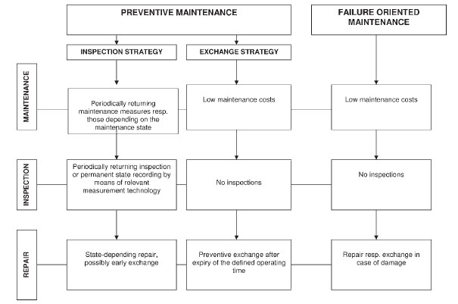
Maintenance strategies

Slide 11
PREVENTATIVE FAILURE APPROACH
Risk (Asset Damage): Low
Cost: Low maintenance
Lifespan: Long
Sustainability: High / Good
Risk (Asset Damage): N/A
Cost: Low (No monthly maintenance)
Lifespan: N/A
Sustainability: Medium / High
ADVANTAGES
Risk (Asset Damage): High
Cost: Recurring cost (high annually)
Lifespan: Fixed (Follow Expiry date)
Sustainability: None
Risk (Asset Damage): High
Cost: High repair / replacement
Lifespan: short (failure occurs due to no maintenance)
Sustainability: at risk
DISADVANTAGES

Slide 12
Maintenance Strategies
In failure-oriented maintenance, no costs for upkeep and inspection
Arise in case of failure
Preventive maintenance, more reliable but higher inspection and maintenance costs.

Slide 13
COST – Return On Investment (ROI)
To estimate the profitability of the new product
Aim :
Estimate the time to reach the break – even point ,
Maximize profit

Slide 14
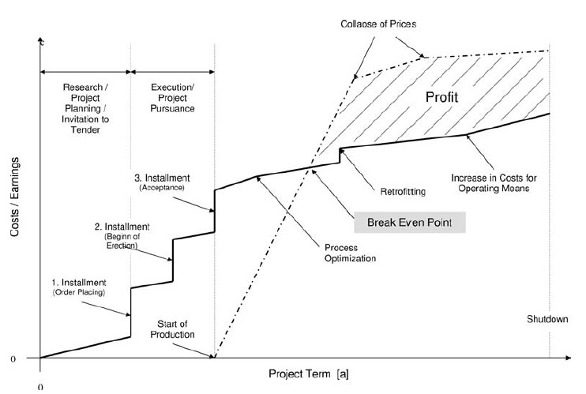
Example Cash Flow of a project.

Slide 15
INQUIRY / INVITATION TO TENDER (ITT)
Generate competing offers from different bidders
Could be preceded by a pre-qualification questionnaire (PQQ).

Slide 16
INQUIRY / INVITATION TO TENDER (ITT)
Type of ITT:
Open Tenders, open calls for tenders, or advertised tenders are open to all vendors or contractors who can guarantee performance.
Restricted tenders, restricted calls for tenders, or invited tenders are only open to selected prequalified vendors or contractors
May be divided into two-stage process: the first stage is the Expression-of-Interest (EOI) tender call that produces a shortlist of suitable vendors / contractors.

Slide 17
INQUIRY / INVITATION TO TENDER (ITT)
The reasons for initiating restricted tenders is due to differences in scope and purpose.
Restricted tenders could be chosen because:
essentially only one suitable supplier of the services or product exists

Slide 18
Request For Proposal (RFP)
A Request For Proposal (RFP) is different with Invitation to Tender (ITT)
RFP is a solicitation or a request to a potential suppliers to submit a business proposal.

Slide 19
Project planning
Operator
Plant manufacturer
Risk analysis
Product development
Plant type
Costs
Inquiry / invitation to tender
Basic engineering
Quotation

Slide 20
Risk analysis
Six aspects of risk analysis should be considered:
Customer
Paying habit and solvency – debt-ridden customers represent higher risk than customer without debt
Interfere in everything
Customer specification
Sometimes not very significant risk because customer specification comprise of details and plant operator / owners not knowing the details.

Slide 21
Risk analysis
Six aspects of risk analysis should be considered:
Location
Project in foreign countries will face higher risks than inland project. Reasons: legislation (eg: custom regulations), infrastructure (transport difficulties), working conditions (climate), language barriers, political issue (terrorism, war).
Commercial / business part
High contractual penalties, the claim for the liability for lost profit.

Slide 22
Risk Analysis
Deadline situation
Usually, deadlines are short
If a project already been realized several times under similar conditions, this risk can be assessed as low
Process engineering
The risk is high if involves with a new technology
Have to make sure the quantity and quality products
If the technology is not possible, the plant might be closed down.

Slide 23
Basic engineering
Process development
Balancing
Basic and process flow diagram
Material concept
Main apparatus
Layout
Quotation

Slide 24
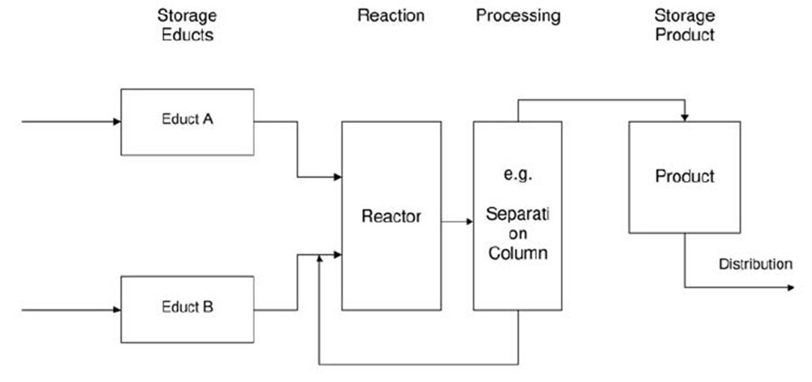
Process development
Basic Flow Diagram
Materials in stores before reach reactor
Product is stored before sales
By product have to separated and led to reactor again
Rector cannot achieve 100% selectivity
Notes:
Ratios of how much of a reactant has reacted (X — conversion, normally between zero and one), how much of a desired product was formed (Y — yield, normally also between zero and one) and how much desired product was formed in ratio to the undesired product(s) (S — selectivity).
Conversion can be defined for (semi-) batch and continuous reactors and as instantaneous and overall conversion

Slide 25
Process development
Finding the ideal process for the manufacturing of a new product is difficult
It can be determined with extensive R&D activities.
Lab pilot plant station pilot plant large scale
Procurement cost increase with the growing size of pilot plant.
Smallest scale, reactor 1 litre
Reactor 10-100 litres
Reactor 1000litres
Reactor > 1000litres

Slide 26
Balancing
Define the mass and enthalpy balances for the individual process and whole plant.
First law of thermodynamics:
Inlet Energy + Heat - Outlet Energy – Work = Accumulation
The results will be recorded in media data sheets
Notes:
The first law of thermodynamics is conservation of energy, The law of conservation of energy states that the total energy of an isolated system is constant; energy can be transformed from one form to another, but cannot be created or destroyed. The first law is often formulated by stating that the change in the internal energy of a closed system is equal to the amount of heat supplied to the system, minus the amount of work done by the system on its surroundings.

Slide 28
Recycle
Recycling some of unreacted reactant found in the product back to the reactor chamber

Slide 29
Recycle
Purpose
Recovery of catalyst
Dilution
Control of process variables
Circulation of working fluid

Slide 30
Bypass
Fraction of the feed to a process unit is diverted around the unit and combined with the output stream from the unit
Fresh
Feed
Process Unit
Product
Bypass Stream

Slide 31
One use of bypass is to obtain precise control of the output stream, as when a small wet air stream bypasses a drier so that the output humidity can be regulated.

Slide 32
Process Classification
Three type of process
Batch process
Continuous process
Semi batch process

Slide 33
Operation of Continuous Process
Steady state
All the variables remain relatively constant
Minor fluctuation can be acceptable
Unsteady state or transient
Process variable change with time, in particular mass flow rate.

Slide 34
Basic and process flow diagram
Flow diagram is important in process plant.
Drawn up in 3 stages:
Basic or Block Flow Diagram (BFD)
Process flow diagram (PFD)
Piping and instrumentation diagram (P&ID)

Slide 35
BFD
Level of Conceptual
Understanding
Increases
Level of Details / Complexity
Increases
PFD
P&ID

Slide 36
Basic / BLOCK FLOW DIAGRAM (BFD)
BFD shows overall processing picture of a chemical process and overall material balances and conditions at each stage, where appropriate.
Helpful in summarizing processing sections and its appropriate in early design stages where alternative processes are under consideration

Slide 37
Basic flow diagram

Slide 38
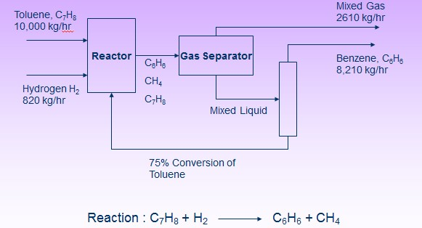
Block Flow Diagram for the Production of Benzene

