Slide 1
Power Plant Technology Steam and Gas Cycle Power Plant (Assignment 1)
by
Mohamad Firdaus Basrawi, Dr. (Eng) Mechanical Engineering Faculty mfirdausb@ump.edu.my

Slide 2
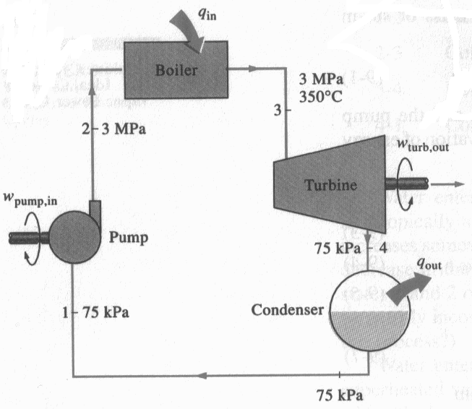
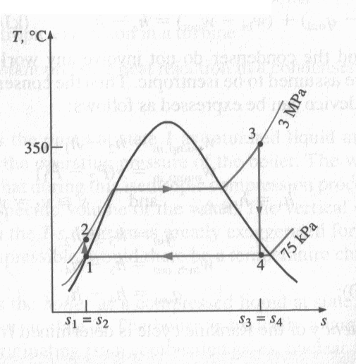
Example 1
Consider an ideal Rankine cycle shown below. The steam enters turbine at 350ºC and 3 MPa. Then, leaves the condenser at 75 kPa. Determine the cycle thermal efficiency.

Slide 3
Example 2
Consider a non-ideal Rankine cycle. Isentropic efficiency for turbine and pump is 87%. Steam enters the turbine at 500ºC and 7 MPa. Then, it enters the condenser and at pressure of 10kPa. The net output of the turbine is 45 MW.
Sketch T-s diagram considering saturation lines.
Then, mass flow rate of steam and
the thermal efficiency of the cycle.
are to be determined

Slide 4
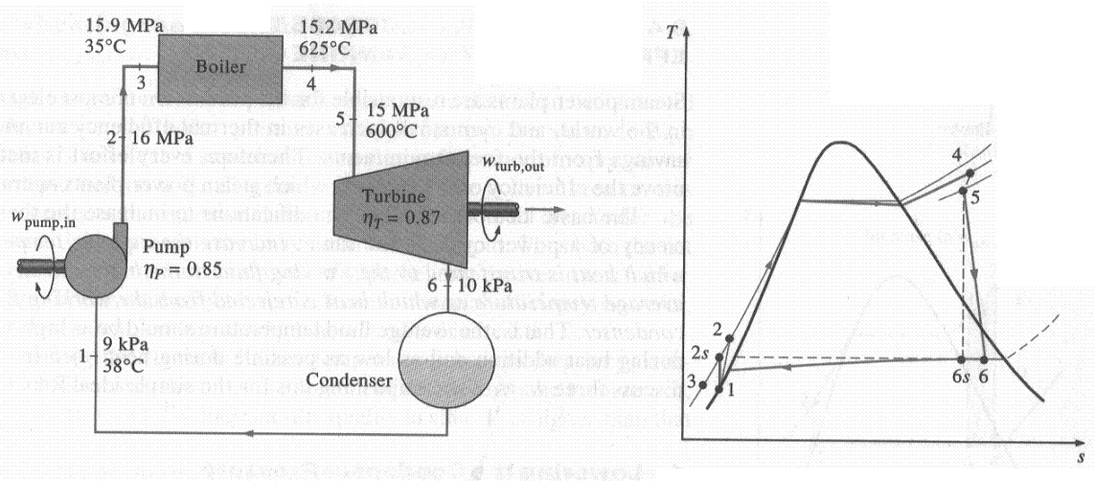
Example 3
A steam power plant shown in figure below has a turbine that that has adiabatic efficiency of 87%. If adiabatic efficiency of the pump is 85%,
Thermal efficiency of the cycle, and
Net power output when mass flow rate is 15 kg/s.
are to be determined

Slide 5
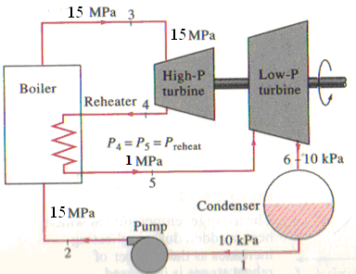
CL 1A
Consider a steam power plant that operates on a reheat Rankine cycle that has a 140 MW power output. Turbine inlet pressure and temperature for high pressure turbine is 15 MPa and 600°C, respectively. Whereas turbine inlet pressure and temperature for low-pressure turbine is 1 MPa and 600°C, respectively. Condenser operates at a pressure of 10 kPa. The isentropic efficiency of the turbines and pump are 85% and 95%, respectively. Sketch the cycle on a T-s diagram with respect to saturation lines:
If steam expanded isentropically in the LP-Turbine and leave the turbine as saturated liquid, determine the steam quality
If steam at LP-Turbine outlet is in superheated condition in actual process, determine temperature of the superheated steam.
The thermal efficiency.
The steam mass flow rate.

Slide 6
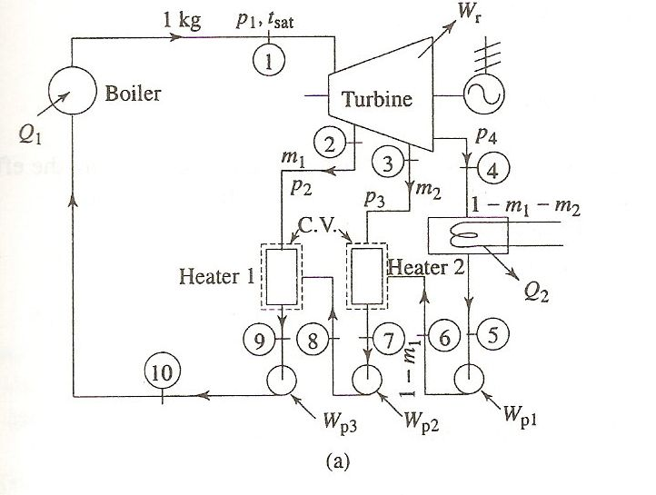
Example: Two OPEN Feedwater Heaters for Ideal Regenerative Rankine Cycle
Stage 1: Superheated vapor
(P₁=10MPa).
Stage 2: Saturated liquid-vapor mixture (P₂= 5MPa, x₂= 0.98).
Stage 3: Saturated liquid-vapor mixture (P₃= 1MPa, x₃= 0.80).
Stage 4: Saturated liquid-vapor mixture (P₄= 0.01MPa)
Stage 5: Saturated liquid
Condition of steam at outlet of FWHs and condenser is saturated liquid.
Since ideal, process at turbine and pump process are isentropic.
Sketch T-s diagram.
Calculate mass fractions of m₁ & m₂.

Slide 7
CL 1B
Stage 1: Superheated vapor
(P₁=10MPa, T₁=350ºC).
Stage 2: Saturated liquid-vapor mixture (P₂= 5MPa).
Stage 3: Saturated liquid-vapor mixture (P₃= 1MPa).
Stage 4: Saturated liquid-vapor mixture (P₄= 0.01MPa)
Stage 5: Saturated liquid
Condition of steam at outlet of FWHs and condenser is saturated liquid.
Since ideal, process at turbine and pump process are isentropic.
Sketch T-s diagram.
Calculate mass fractions of m₁ & m₂.
If the power plant capacity 100 MW, calculate mass flow rate of the steam.
Finally, Calculate its efficiency.

